Slide 1
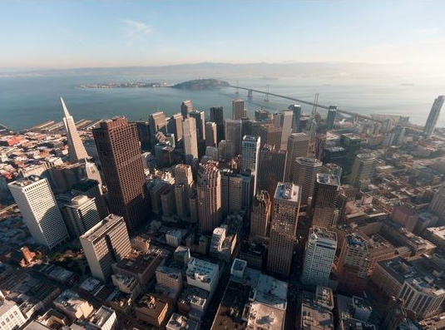
San Francisco Department of
Emergency Management
Alerts and Warnings

Slide 2
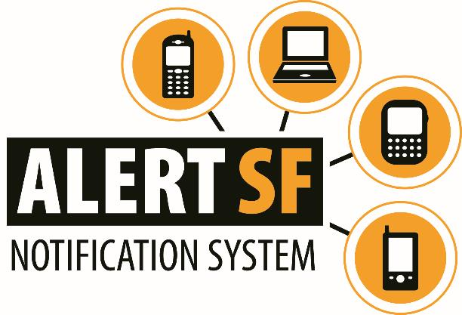
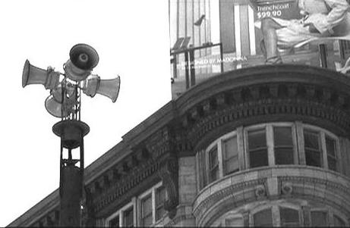
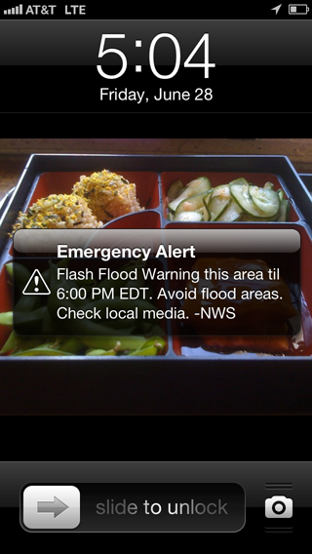
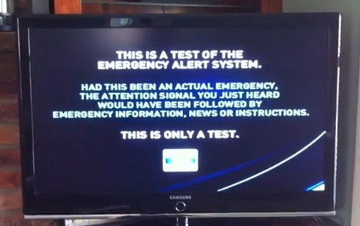
San Francisco’s Alert and Warning Systems

Slide 3
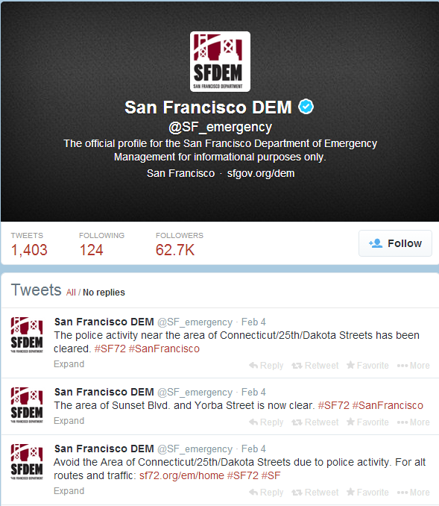


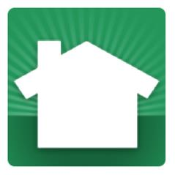
Social Media
San Francisco uses social media to inform the public about events or incidents which may affect their lives and safety.

Slide 4
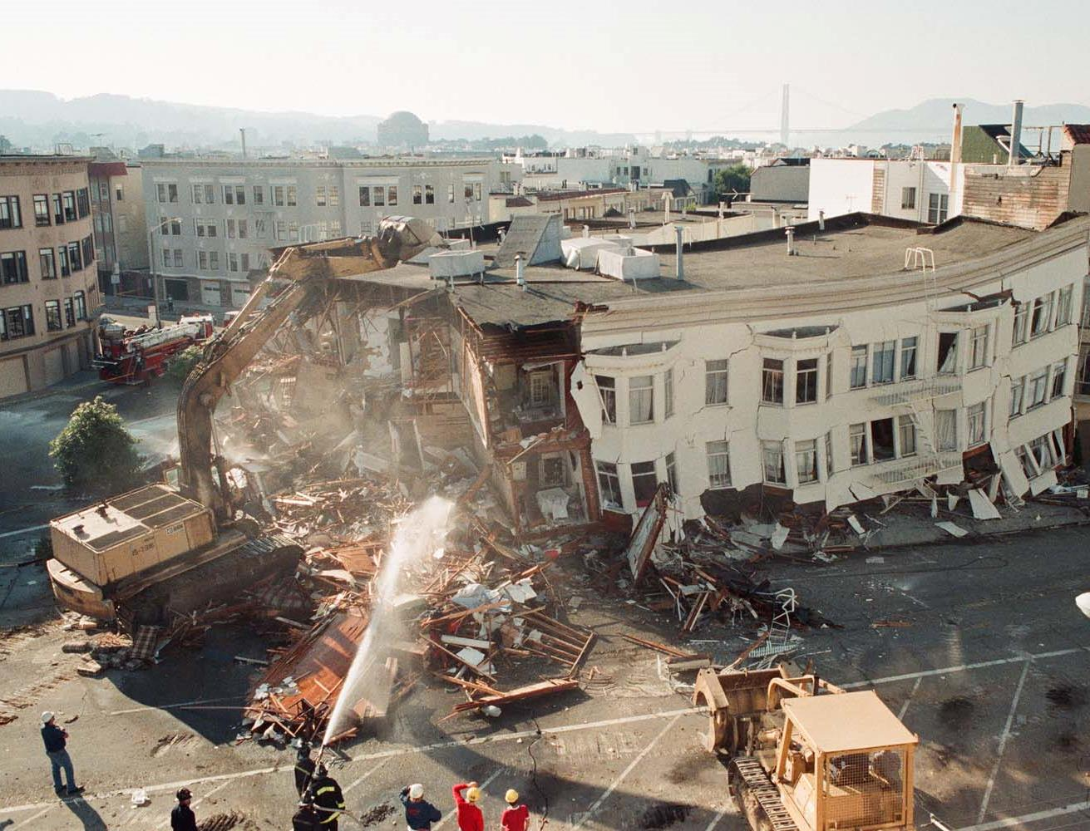
Alerts and Warnings in Recent Incidents
1
High Pressure Gas Line Break
2
8.0 Alaska Earthquake and Tsunami Watch
3
4.4 Earthquake ESE of Berkeley, CA

Slide 5
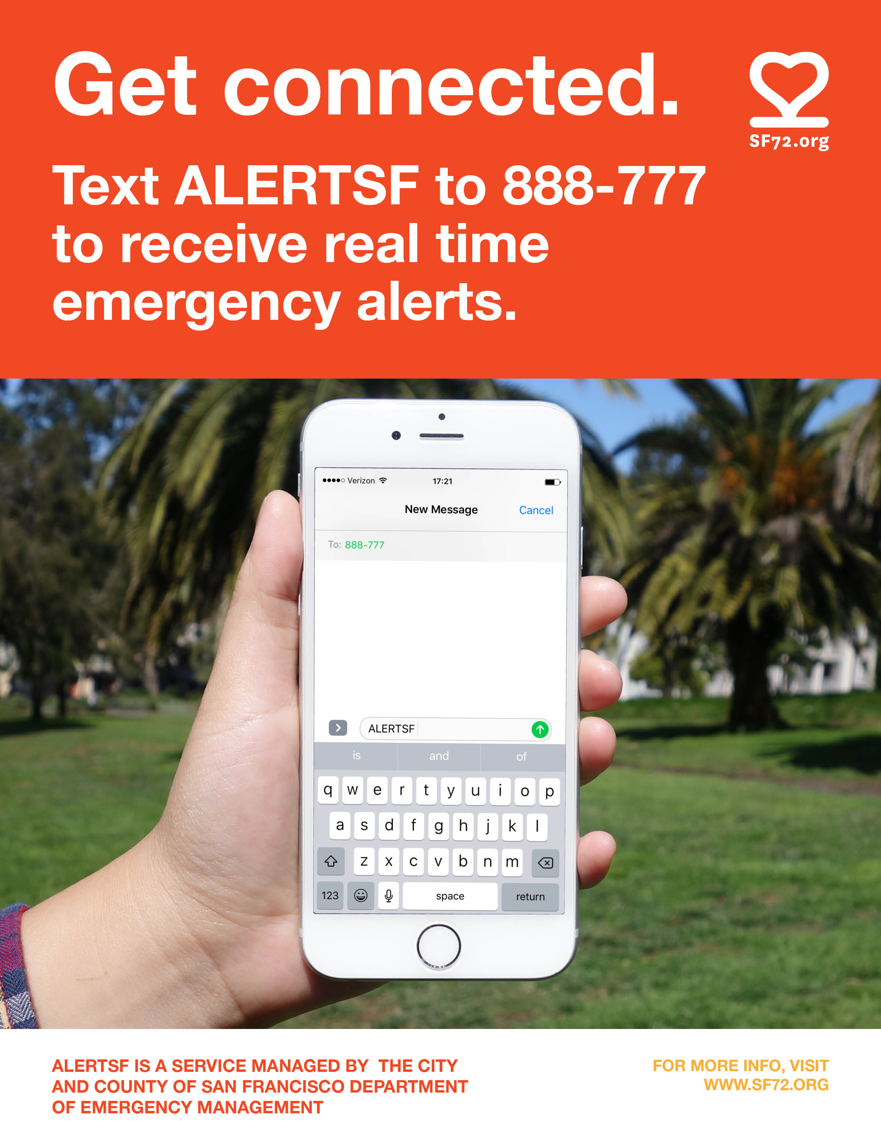

Slide 6
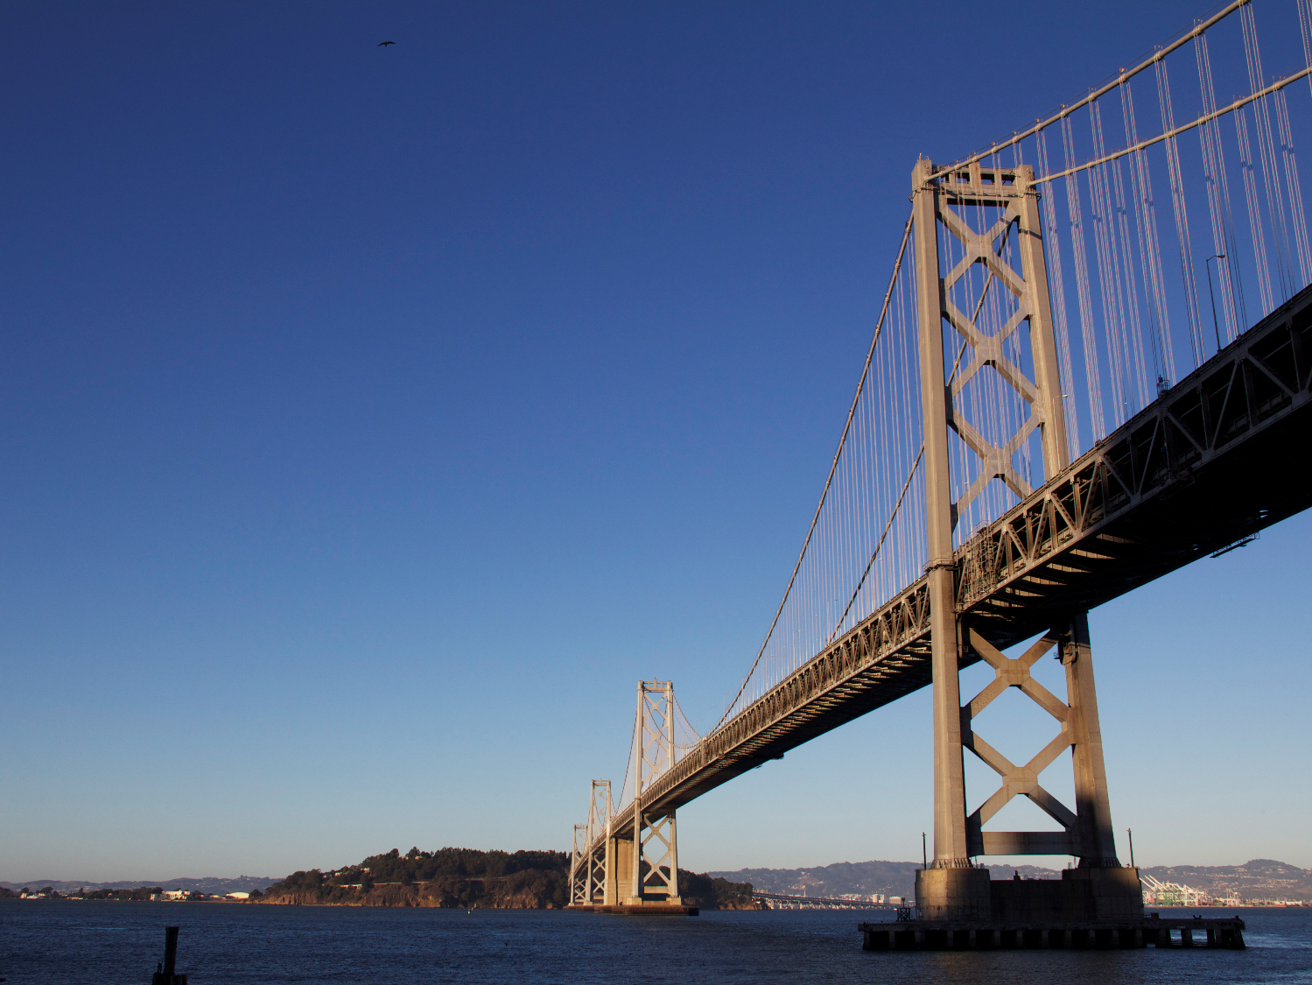
Questions?

