Slide 1
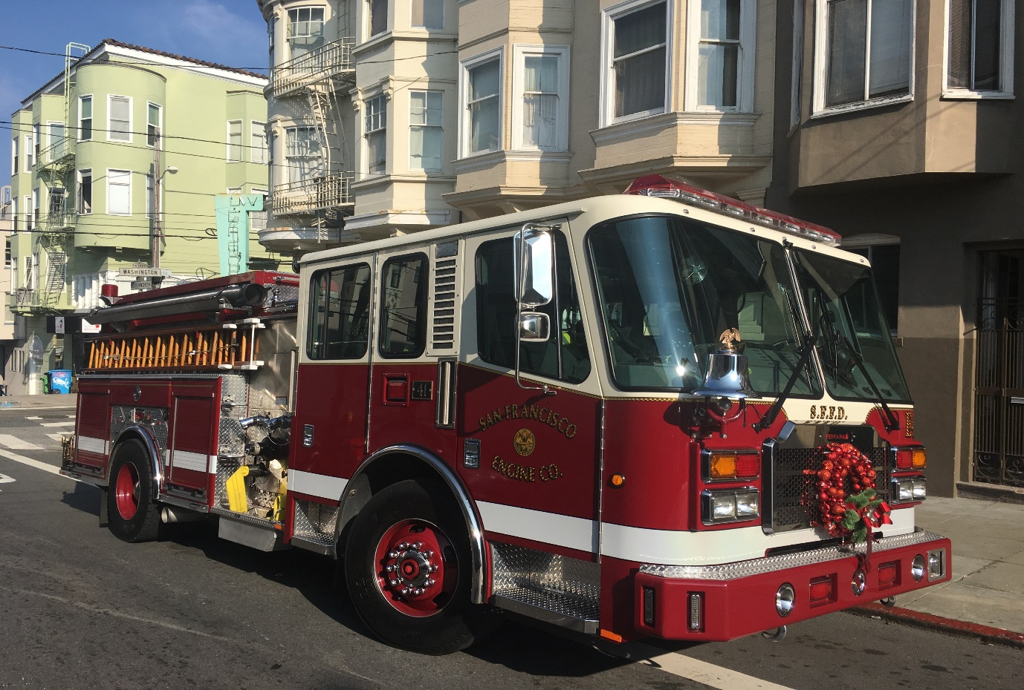
San Francisco Fire Department
Division of Support Services:
Accomplishments and Future Projects

Slide 2
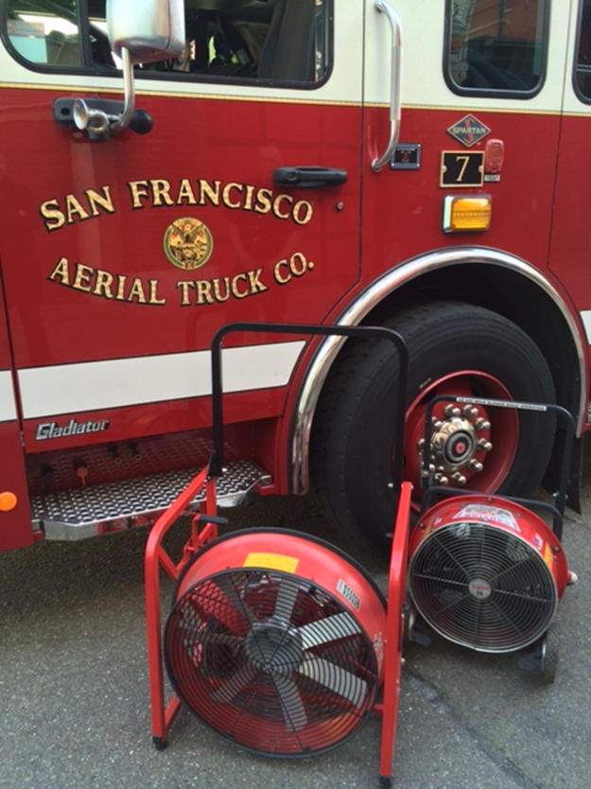
Tools and Equipment Electric Ventilation Fans Cordless LED Lights
Reduced reliance on fossil fuels
Less firefighter exposure to carcinogens
Simplifies usage
Noise reduction
No trip hazard
Lighter weight
Brighter, more
efficient LED
lighting

Slide 3
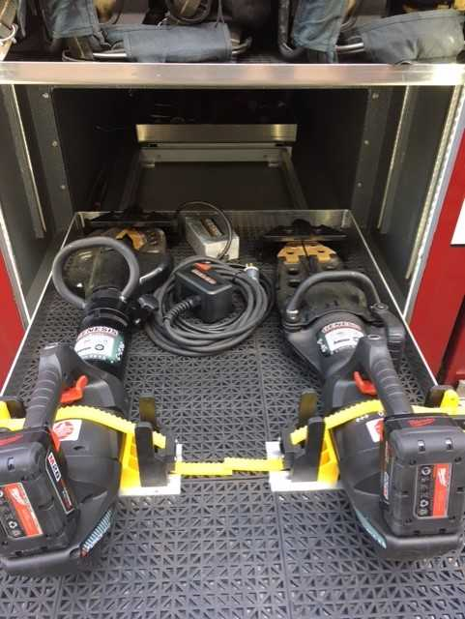
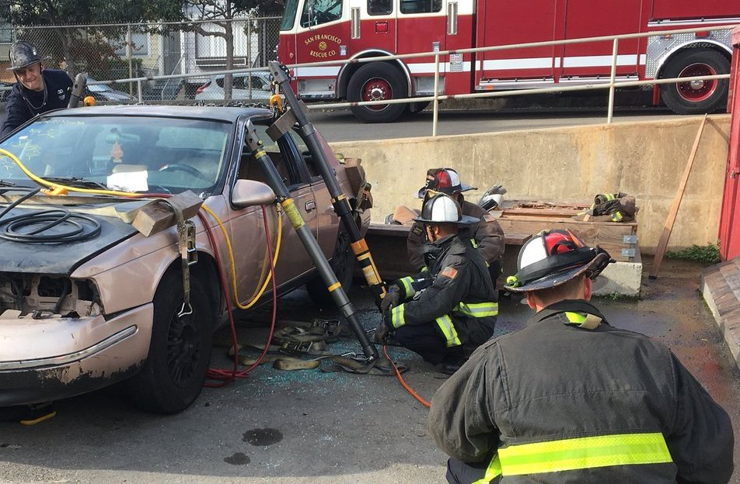
Cordless Extrication Tools
Battery powered
No cumbersome hydraulic hoses
Rapid deployment
Quiet-no gasoline generator
Reduced FF exposure to carcinogens
Grant funded

Slide 4
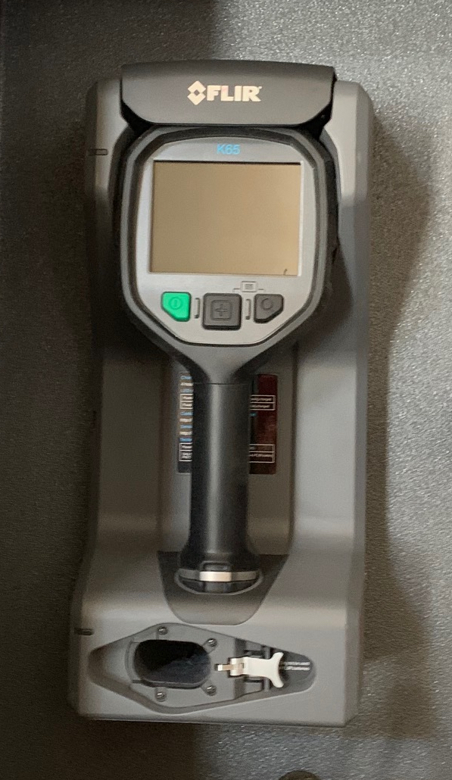
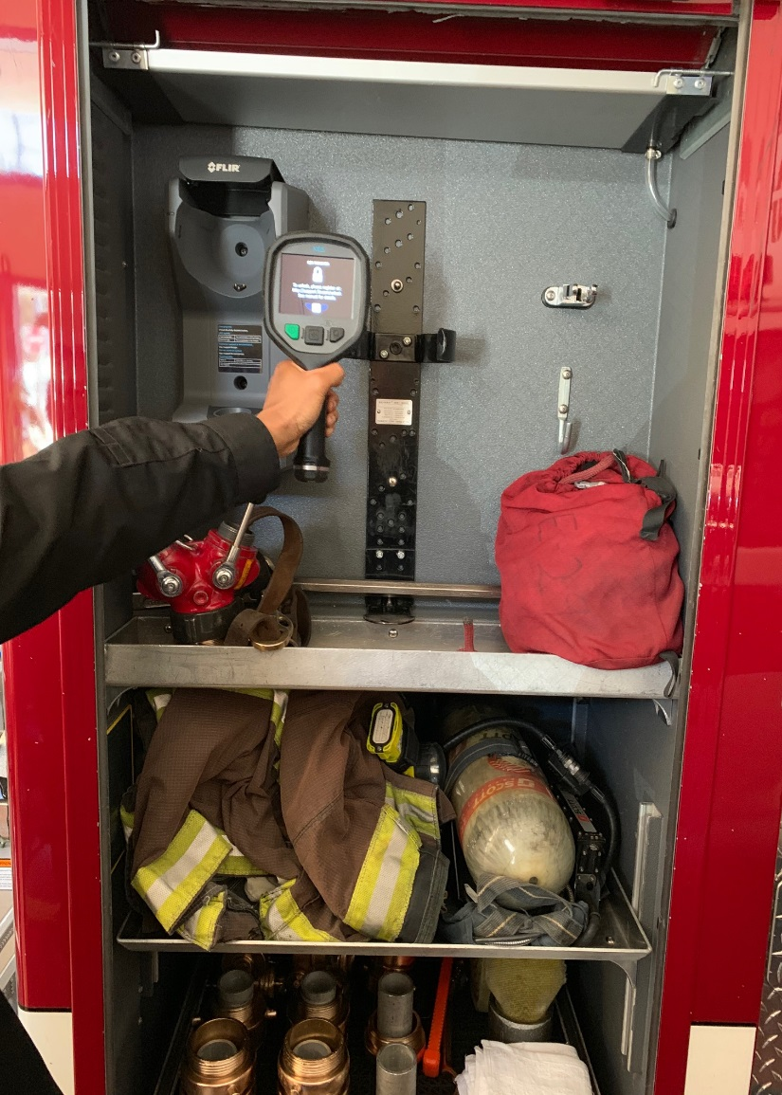
Thermal Imaging Cameras
Vehicle mounted for rapid deployment
Installing on all SFFD Suppression Vehicles
Increased amount
Grant funded

Slide 5
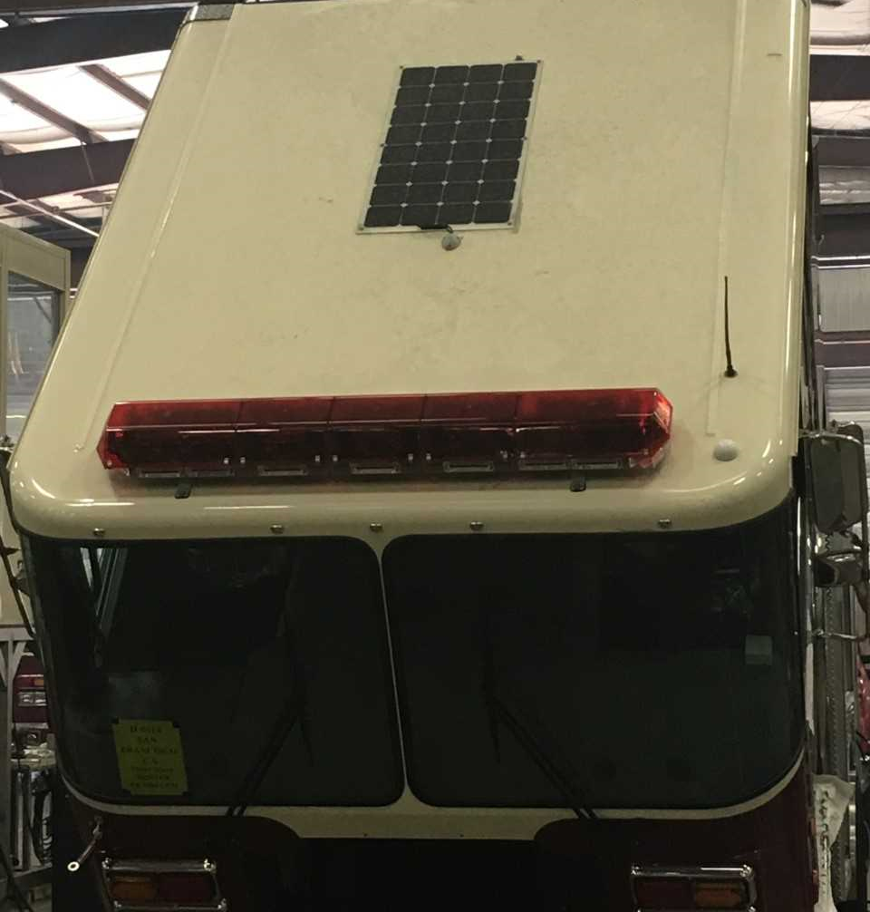
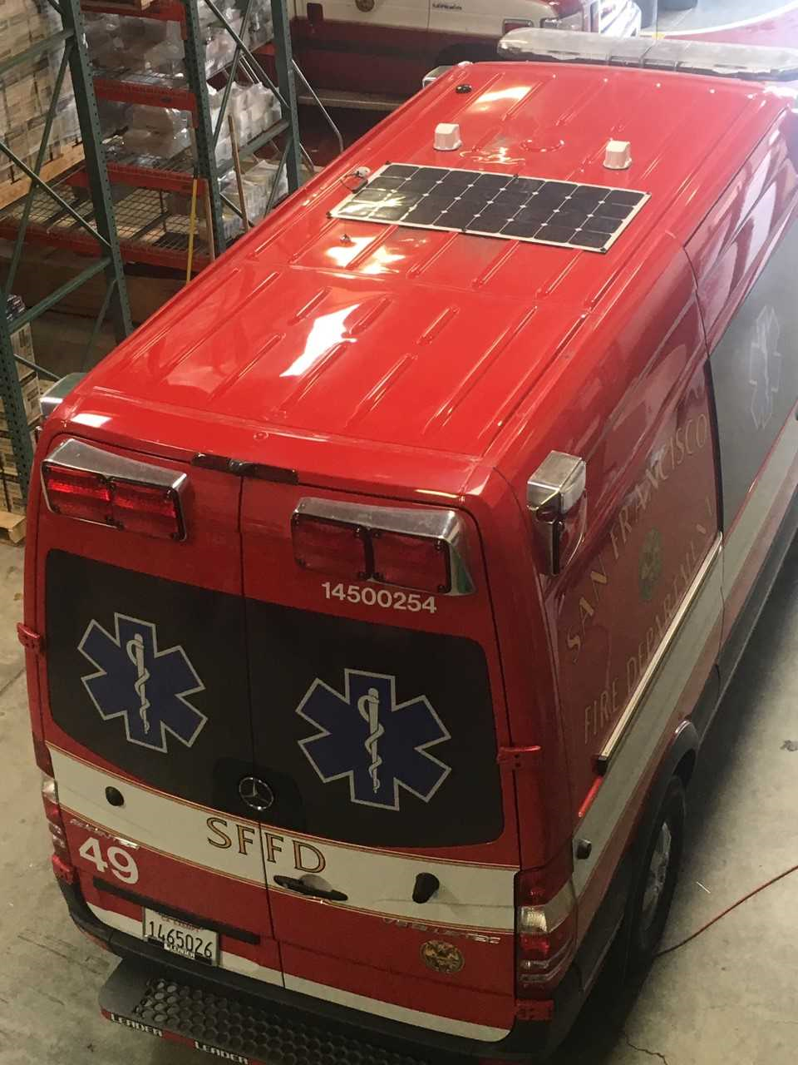
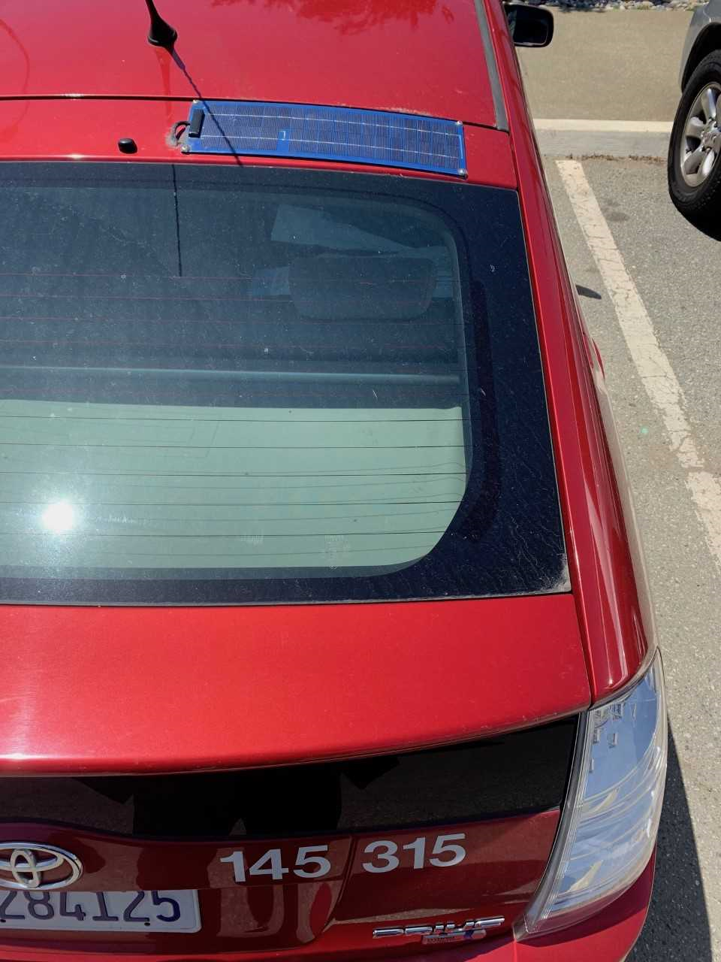
Solar Panels on SFFD Fleet Engines, Trucks, Squads, Ambulances, Buggies
Increased vehicle battery life
Less maintenance required
Decreased battery replacement costs
.

Slide 6
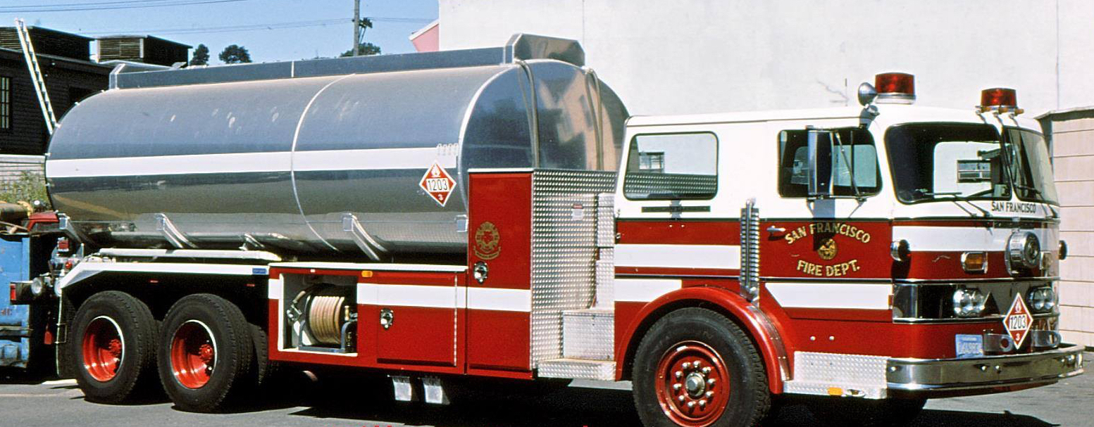
Renewable Diesel
SFFD began using RD in 2015
First City agency to use Renewable Diesel
Used in Ambulances, Engines, Trucks, Squads
No Impact to Vehicle Warranties
Approved for Fireboat in 2018

Slide 7
Vehicle Mounted Filtration System FF Exhaust Protection Solution
Automatic- “Always On”
Fulltime protection for firefighters and the public
On Scene protection
OSHA, NIOSH, NFPA compliant

Slide 8
Opacity Smog Testing
Installed device on Engine 3 in 2018
Tested by Independent 3rd Party
Supervised by Central Shops
Ordered on all future Suppression vehicles
2017 Engine Co. 3
3.96
3.53 _{3.22} 3.57
NO Detectable Levels
0.0 0.0 0.0 0.0
PRIOR TO DEVICE INSTALL INSTALLED
FINAL TEST RESULTS: 0.0 %

Slide 9
What is next
for the SFFD Fleet?

Slide 10
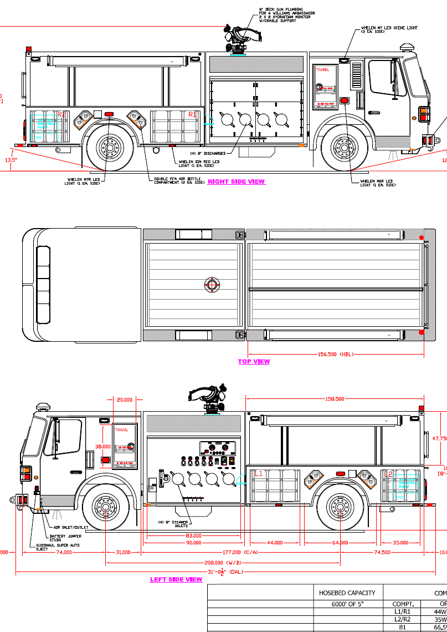
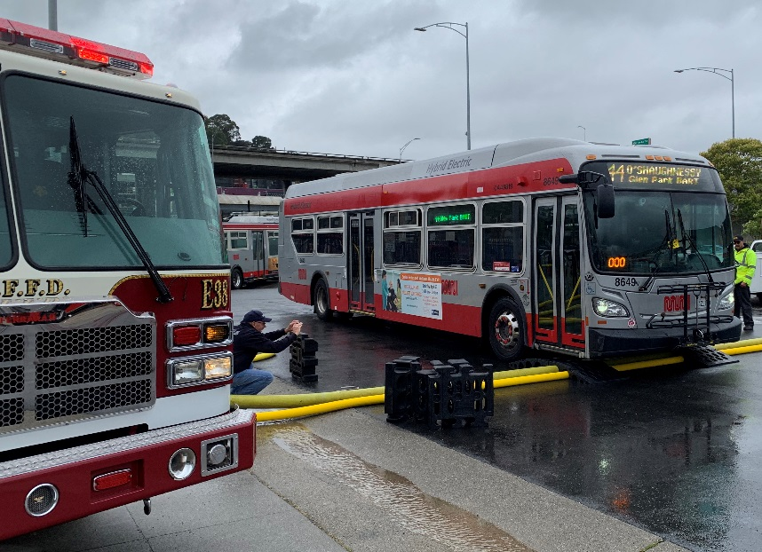
New SFFD Hose Tenders
Ability to Pump and Draft from any water source
Carries 6,000 ft of 5” fire hose
Can extend current AWSS
Four wheel drive
Portable onboard submersible water pump

Slide 11
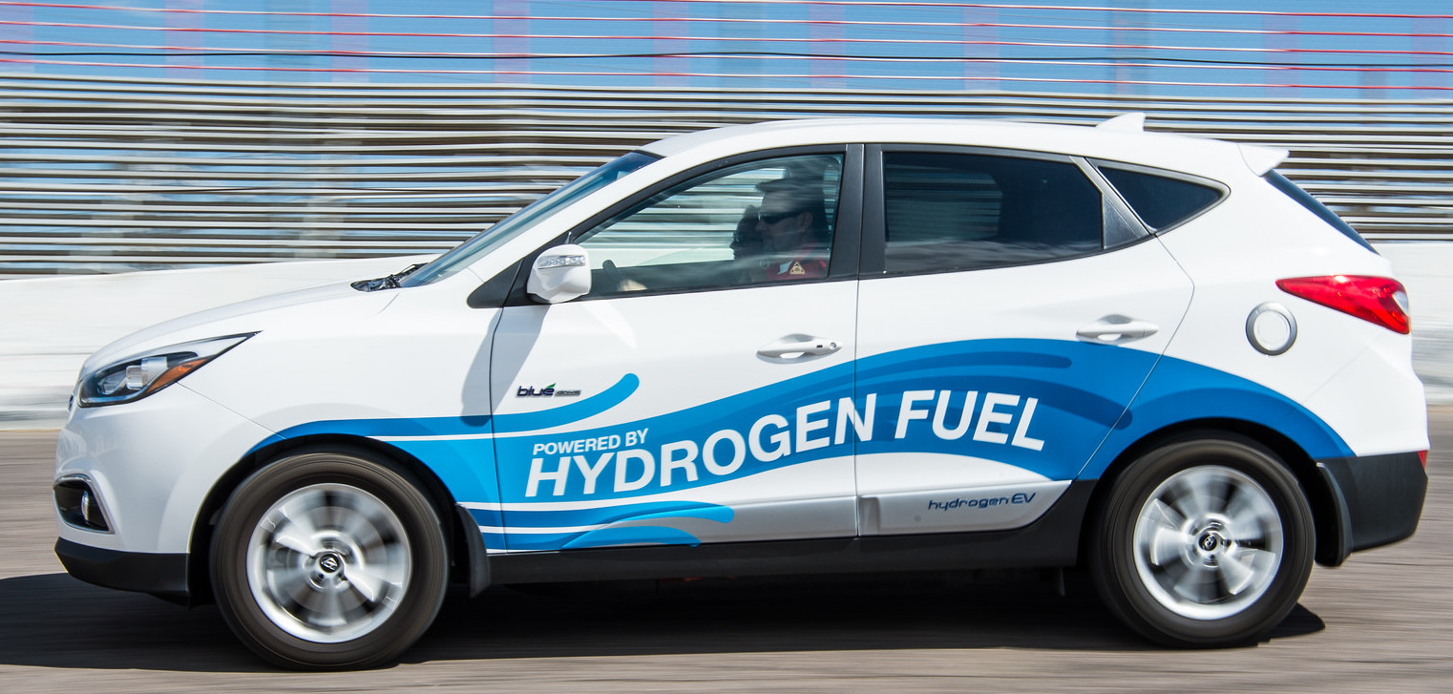
Hydrogen Powered Staff Vehicles
SFFD Pilot Program with Toyota or Hyundai
Three SF fueling stations planned for Oct. 2019
Tested by U.S. Army (Chevy truck)

Slide 12
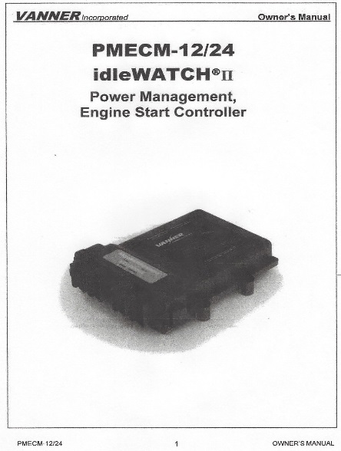
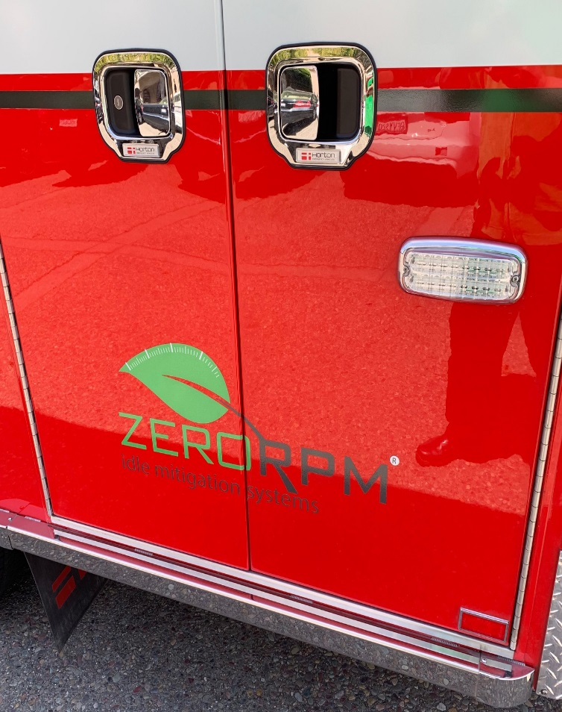
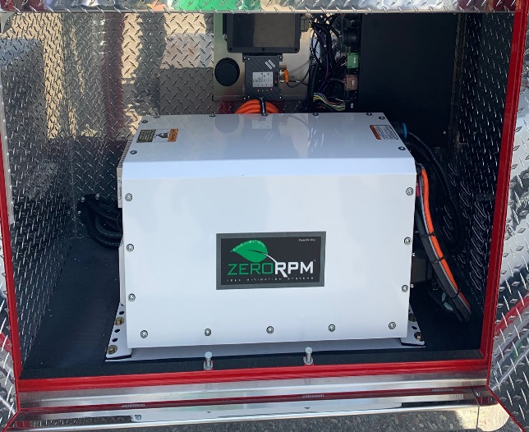
IDLE MITIGATION for the SFFD Fleet
To be installed on Engines, Trucks, Ambulances
Reduce Fuel Costs
Lower Vehicle Maintenance Costs
Protects SFFD, Public, and the Environment
from carcinogens

Slide 13
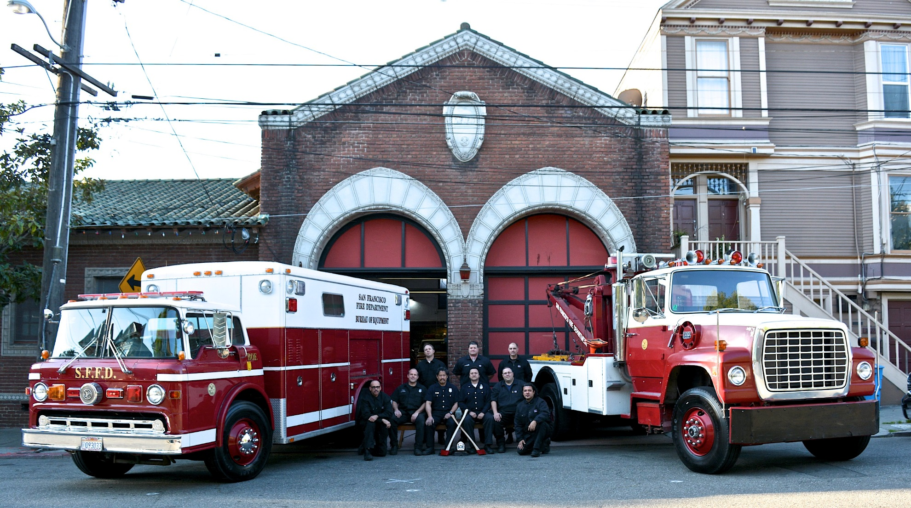
Special thanks to BOE!

