Slide 1
The San Francisco Fire Department
EMS Division Report
July 10, 2019

Slide 2
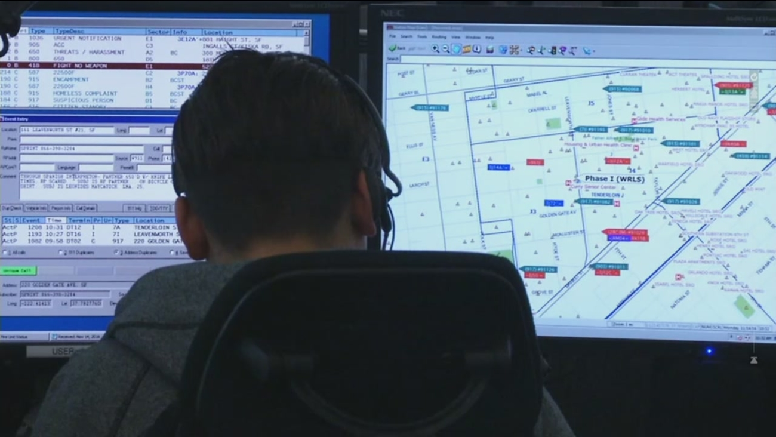
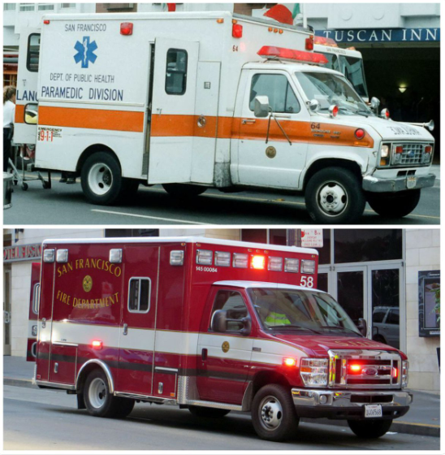
EMS 1 Introduction and Background
o DPH medic
o After the merger with the SFFD: RC in Dispatch for 4 years
o RC in the Field, Dispatch and Station 49
o Doctorate Organizational Psychology
o Retired with over 28 years

Slide 3
Management Approach
Create participatory processes
Data driven but also person centered decisions

Slide 4
Goals and Objectives
GOALS:
To provide the best EMS service possible
To create an EMS Division Strategic Plan

Slide 5
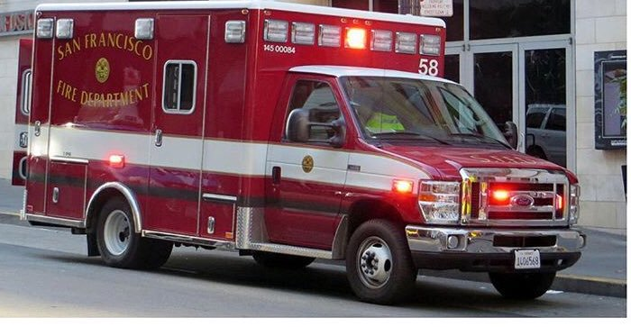
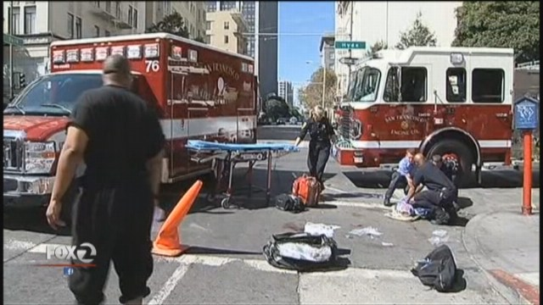
Goals and Objectives
OBJECTIVE:
Examine and improve how we provide pre-hospital care in SF
Appropriate ambulance staffing and response

Slide 6
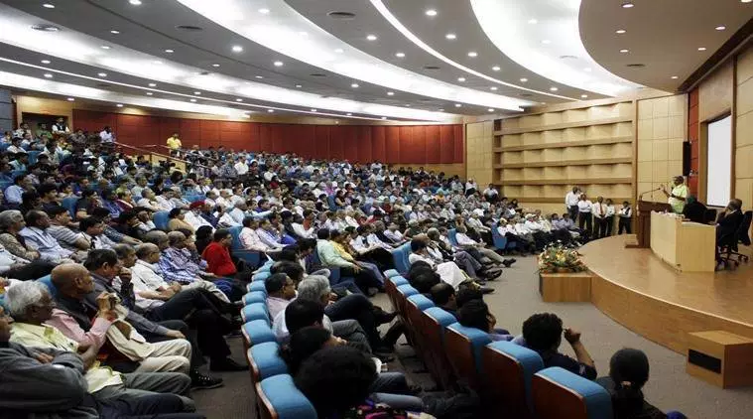
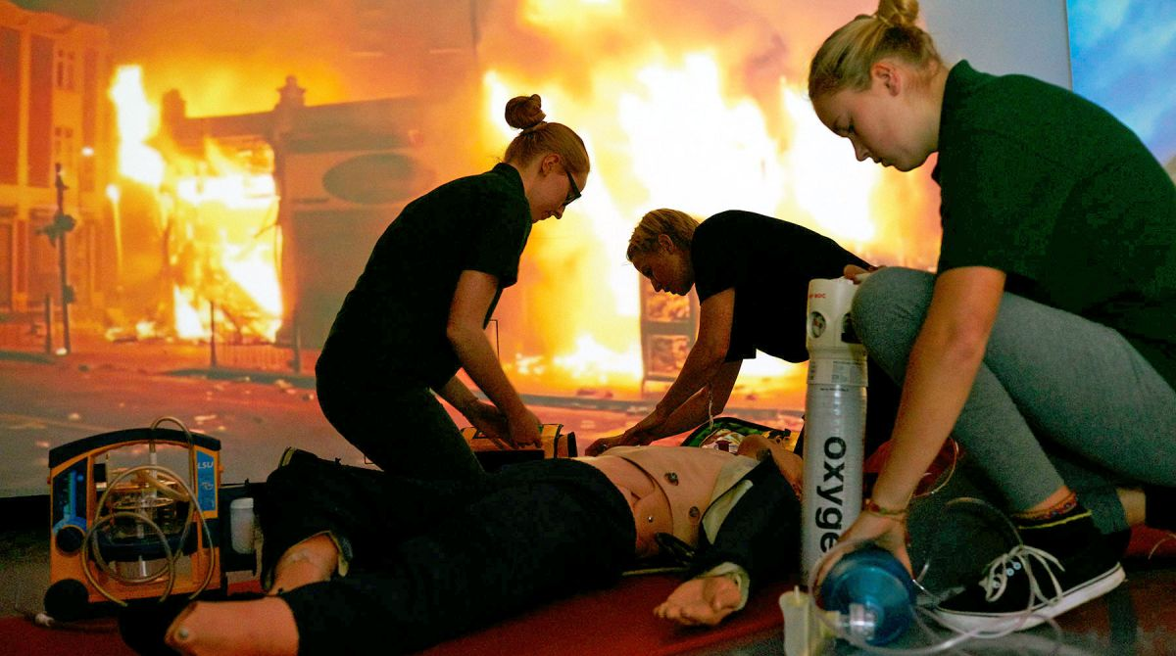
Goals and Objectives
OBJECTIVE:
Examine and improve how we provide pre-hospital care in SF
Increase opportunities to learn
Training and Research

Slide 7
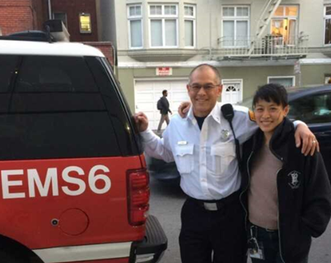
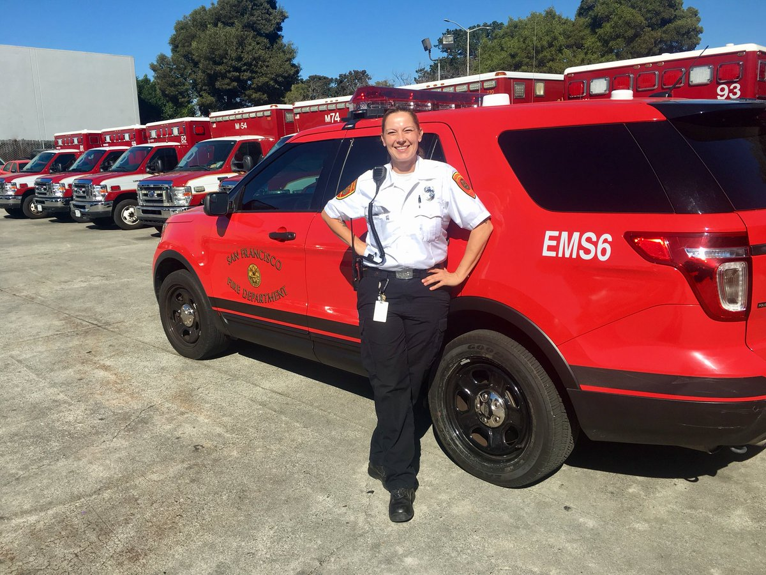
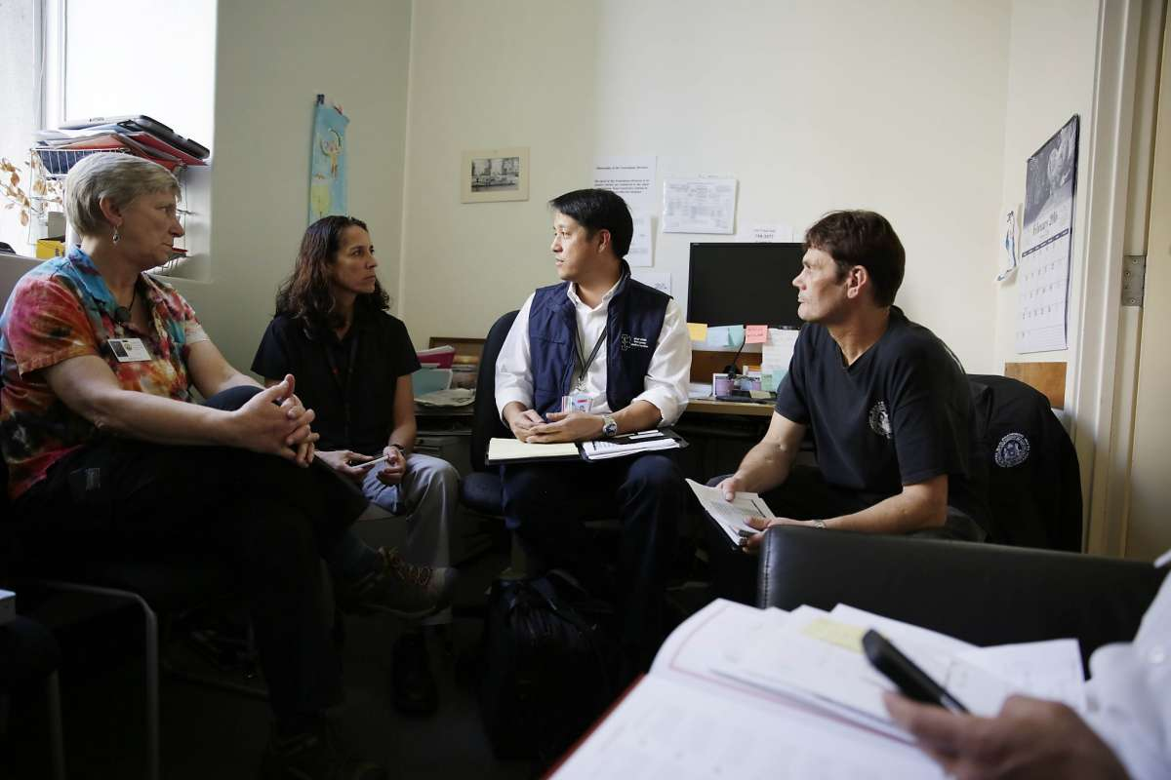
Goals and Objectives
OBJECTIVE:
Examine and improve how we provide pre-hospital care in SF
Explore the growing trend towards Mobile Integrated Healthcare and
Community Paramedicine (MIH-CP)

Slide 8
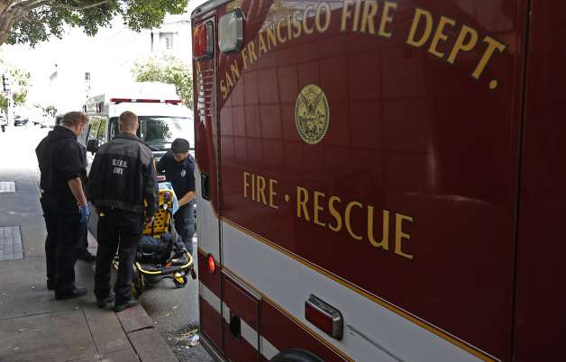
Goals and Objectives
OBJECTIVE:
Address morale at Station 49
Increase two-way communication
Increase opportunities to provide input
Keep members safe and healthy

Slide 9
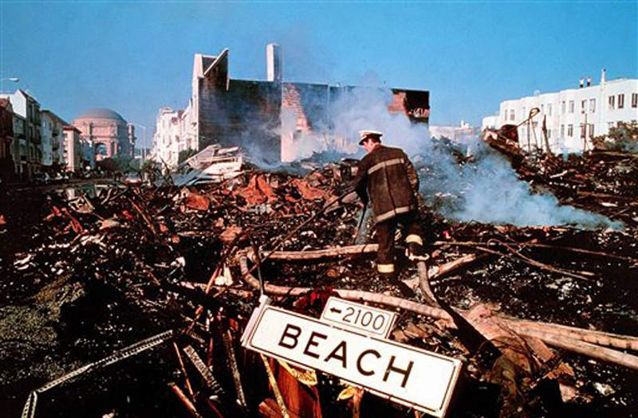
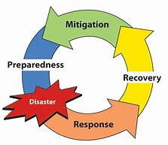
Goals and Objectives
OBJECTIVE:
Improve Disaster Preparedness

Slide 10
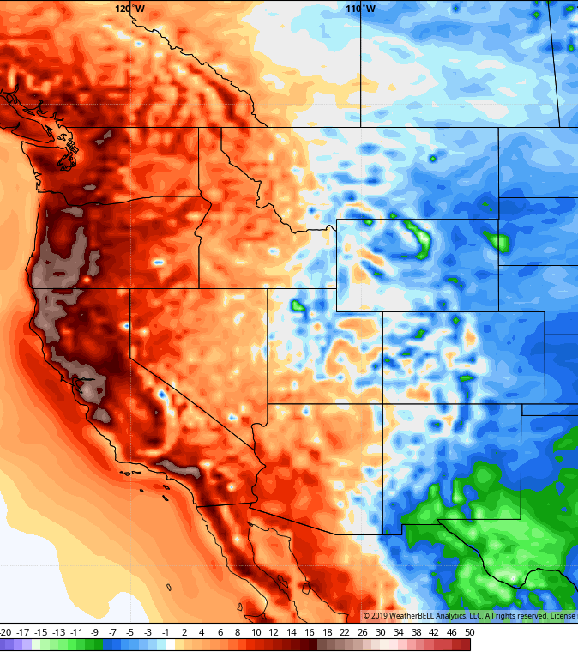
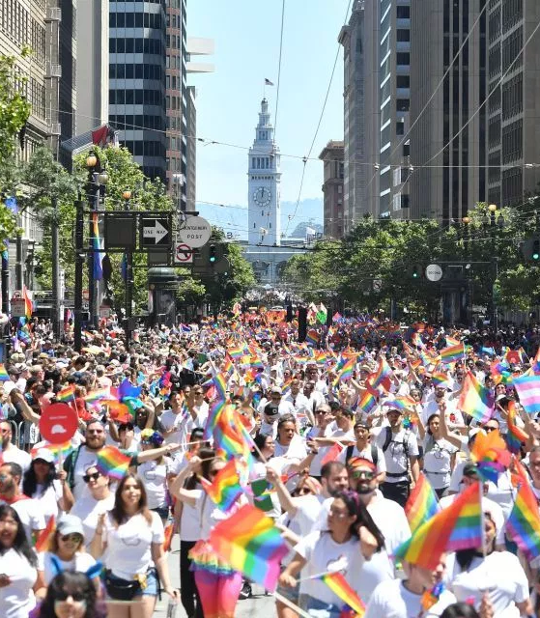
The first 60 days
Orientation
Section Chief selection process
Budget support - data gathering
Address immediate needs
Heat emergency event
Orientation to the new Station 49 / ADF
Pride Parade preparation

Slide 11
Focused activities moving forward
Continue day-to-day work
Start Assessment process

Slide 12
Areas to Investigate

Slide 13
Thank you!

