Slide 1
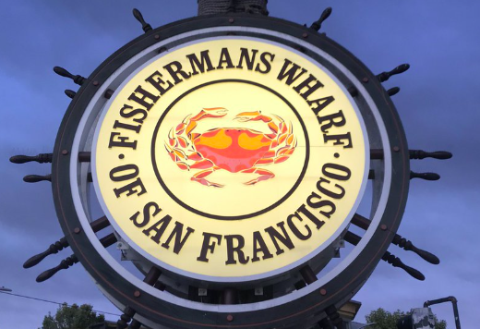
4th Alarm Fire Pier 45

Slide 2
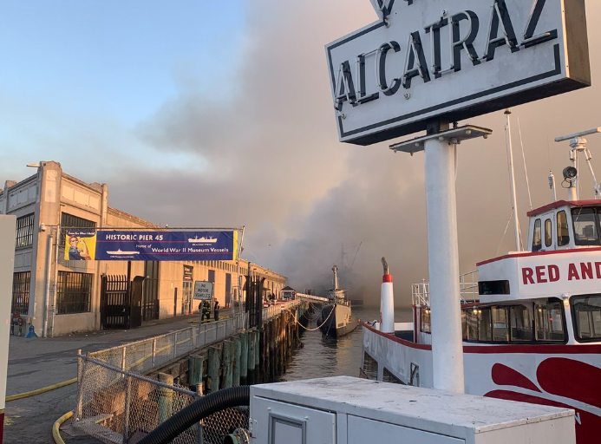
Entrance & Rear Side Shots

Slide 3
Two SFFD Fireboats Battling the Blaze

Slide 5
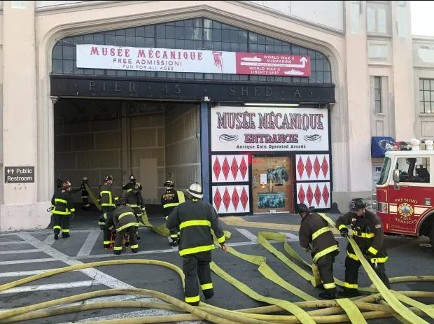
Utilizing the Auxiliary Water Supply System and 5” Hose Tender

Slide 7
Homeland Security & Support Services Chiefs in Action

Slide 8
Supporting City Agencies

