Slide 1
The San Francisco Fire Department and its role with the Transportation Advisory Staff Committee

Slide 2
Transportation Advisory Staff Committee (TASC)
Overview of TASC
Challenges
Recommendations

Slide 3
Transportation Advisory Staff Committee (TASC)
is described as:
“ An interdepartmental committee chaired by the SFMTA that
discusses proposed legislation or proposed street changes
prior to proceeding to a SFMTA public hearing ”
Provides a regular forum for key agencies to review and
comment on proposed changes to the public right-of-way
TASC: only an informal advisory board; the committee
does not approve or disapprove items presented at TASC

Slide 4
Agencies represented at TASC bi-monthly meetings:
SFMTA Sustainable Streets
SFMTA Transit Operations
SFMTA Parking Enforcement
SFMTA Taxi Services
Planning Dept.
Dept. of Public Works
Police Dept.
Fire Dept.
Agenda items heard at TASC meetings are for proposed legislative or street changes requested by a project sponsor
Sponsors include:
Individuals (property owner, resident, business owner)
Community/Business organizations
Private Developers
City agencies

Slide 5
Proposed legislative or street change presented at TASC include:
Curb-color designation
Lane striping/re-configuration
Speed limits
Bicycle parking
Bicycle path, lane, route
Street Parking
Pedestrian and traffic signals
Traffic and parking signage
Transit shelters
Traffic calming and pedestrian safety measures:
- Speed humps/cushions
- Bulb-outs/widened sidewalks
- Chicanes
- Medians/Islands
- Raised Crosswalks
- Lane Reduction/removal
- Speed Limit Changes
- Traffic circles

Slide 6
Items required to be heard at a SFMTA public hearing are typically presented at TASC through a SFMTA representative before proceeding to the public hearing
Meetings are not open to the public; however, non-
governmental parties are invited to present or participate
in committee meetings when appropriate
TASC members may review, discuss, and comment on items
Each agency states whether they “object/not object” to
the item; can also “not object with conditions or
recommendations”

Slide 7
Committee agencies can also recommend that an item be
placed “on-hold”; the item is not scheduled for public hearing
until agency issues are resolved
Proposals not scheduled for a SFMTA public hearing may also
be presented to the Committee but are for discussion or
information purposes only
The TASC disposition is provided to the SFMTA Board for
consideration in conjunction with public comments during
the SFMTA public hearing

Slide 8
SFFD review:
SFFD reviews each agenda item prior to the TASC meeting
SFFD requests item documents be provided to SFFD
for review a minimum of (5) business days before the
TASC meeting
SFFD requires drawings be provided reflecting fire service
features under both existing conditions and proposed
conditions

Slide 9
Fire service features reviewed include:
fire vehicle access
building access and fire dept. connection access
fire water supply access
fire ground operation access

Slide 10
SFFD reviewers also consult with Support Services and Field Operations during reviews

Slide 11
Field evaluations of proposals are utilized in the review

Slide 12
Reviews may include vehicle field tests under existing and proposed conditions that are performed when necessary
Existing Conditions Proposed Conditions

Slide 13
Proposals that create compromised fire service features are typically vetted with the representative/sponsor before the TASC meeting
Unresolved items are either placed “on-hold”, withdrawn from the agenda, or objected to by SFFD

Slide 14
SFFD Challenges
Meeting the increased demand to review new and existing infrastructure projects
Communicating to various City Departments the complex SFFD operational needs

Slide 15
SFFD Recommendations
Develop a plan for a separate SFFD section that includes dedicated staff to review TASC proposals over the next four years, made up of members; include SFFD operation members in that section
Request the SFFD City Attorney to provide clarity regarding interpretation of which municipal codes supersede the Fire Code and Health and Safety Code and govern when there is a conflict;
Educate sister city agencies and their staff of specific SFFD operation and access requirements and needs related to medical and fire incidents; recommend SFFD Division of Training create a fire department informational video/power point presentation with supporting documentation of fire response and fire ground operations and present to sister agencies
Continue to work with MTA to better communicate on all TASC related projects

Slide 16
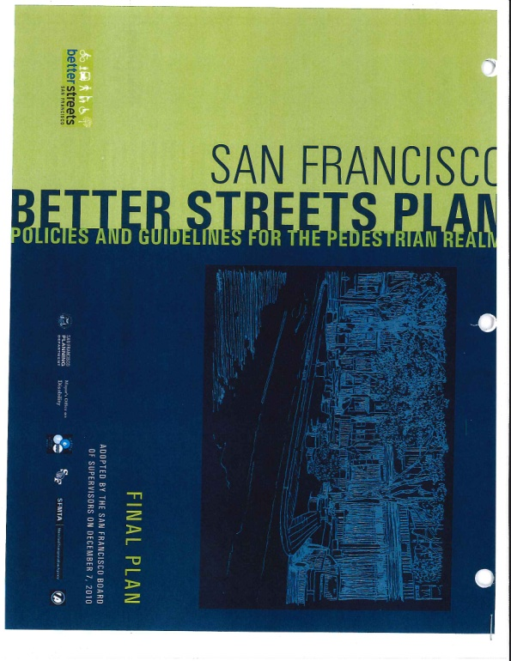
Thank you ! Questions?
Vision Zero goals to be achieved by 2024:
Eliminate all traffic deaths
Reduce severe and fatal injury inequities
across neighborhoods, transportation modes,
and populations

