Slide 1
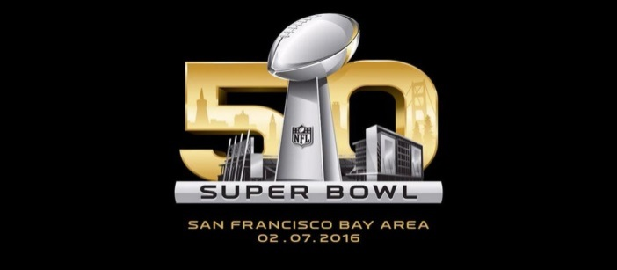


Slide 2
Events: Jan. 30 – Feb. 7 (Build out Jan. 22)
NFL Sanctioned Events
  NFL Experience
  SB City
  NFL Honors
  SB Host Committee Events
  NFL VIP Party
  NFL Owner’s Party
Non-Sanctioned Events:
  CBS
  Maxim
  Playboy
  Bud Light
  ESPN
  Direct TV
  Metallica
  Still Unknown…
SB 50 San Francisco

Slide 3
Working with the following Agencies:
Other CCSF Agencies: DEM, MTA, SFPD, SFSD, SF Port, SFO, etc…
Federal Agencies: FBI, DOE, DHS, National Guard Civil Support Team
Local/Regional: Cal OES, Santa Clara County, San Mateo County, Alameda County, Marin County
Centers to be Activated: IOC, JOC, JIC, AHC, FAA, SCC EOC, SF EOC, SFPD DOC, Command Posts at SB City & NFLX
SB 50 San Francisco

Slide 4
Developing:
Fire Response Plans
EMS Plans (NFLX & SB City)
Haz Mat Plans
Interoperable Communications Plans
Mutual Aid Plans
Fire Prevention (very involved with permitting and life safety)
Credentialing
Visiting Public Safety Officials
Traffic Planning with the SFPD!!
SB 50 San Francisco

Slide 5
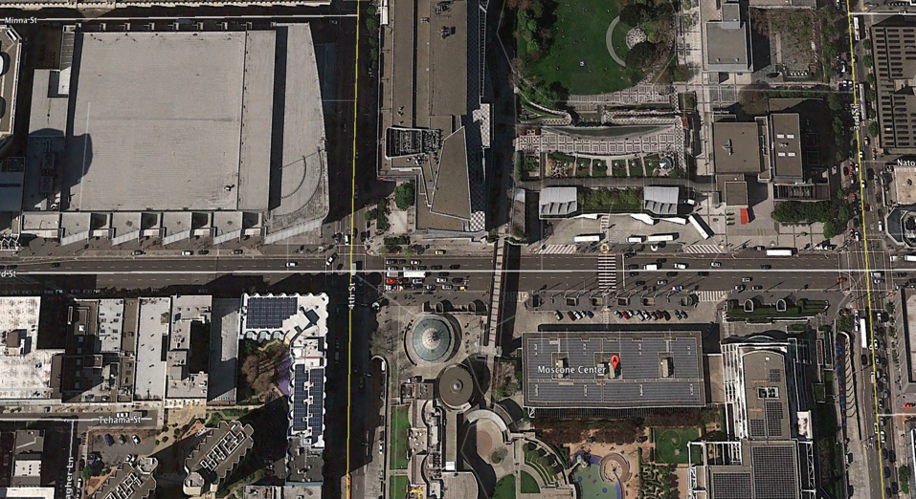
OVERALL SITE PLAN
Yerba Buena Gardens
Moscone West
NFL Shop
• Media Center
• Downtown Accred Center
• NFLX Box Office
Metreon
YBCA
Moscone North
• NFLX
Howard Street
4th Street
Howard Street
3rd Street
Moscone South
• NFLX

Slide 6
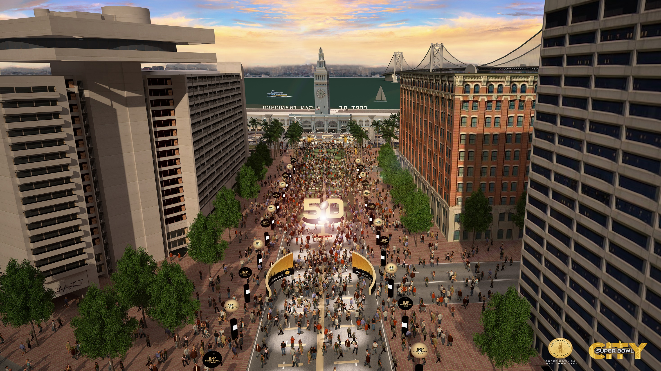

Slide 7
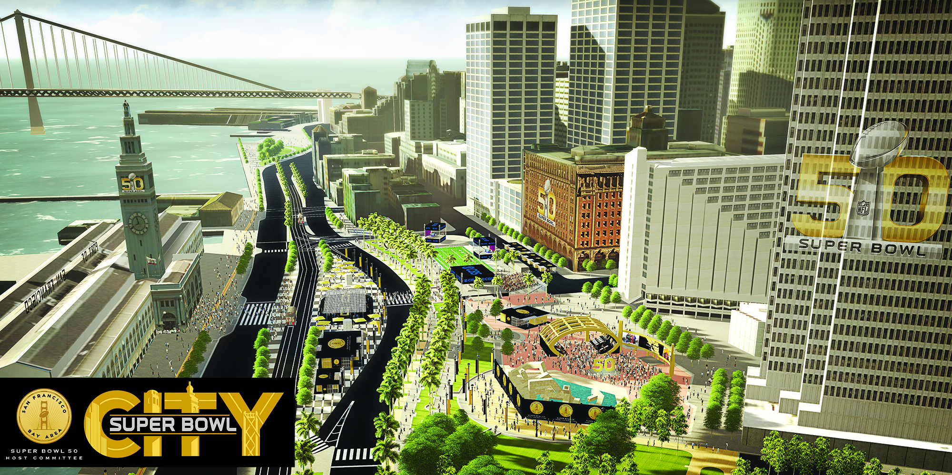

Slide 8
Questions
SB 50 San Francisco

