Slide 1
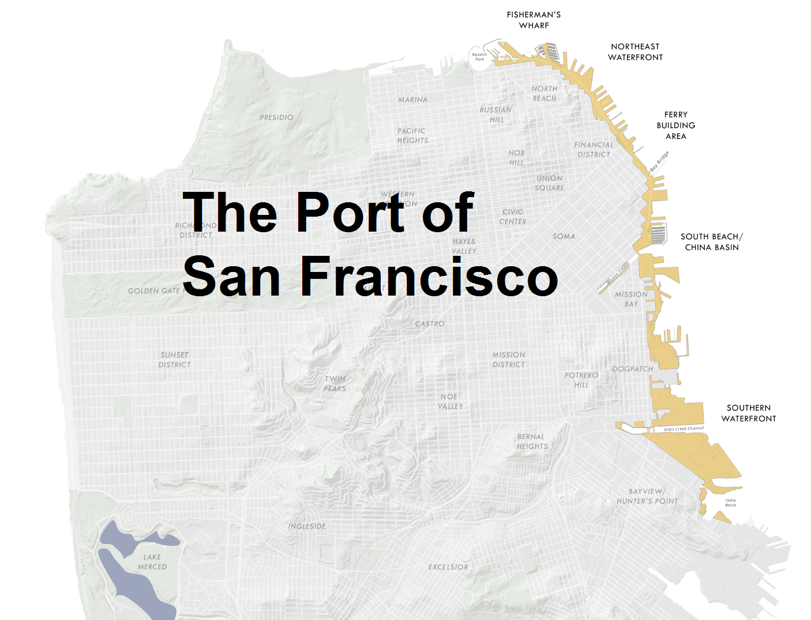

Slide 2
Transferred from the State of California to the City and County of San Francisco in 1968 via Burton Act AB2649
7.5 miles of waterfront from Hyde Street Harbor to Hunters Point Shipyard
Piers and Sea Wall Lots
Pier sheds are S-2 occupancies

Slide 3
AT&T Park

Slide 4
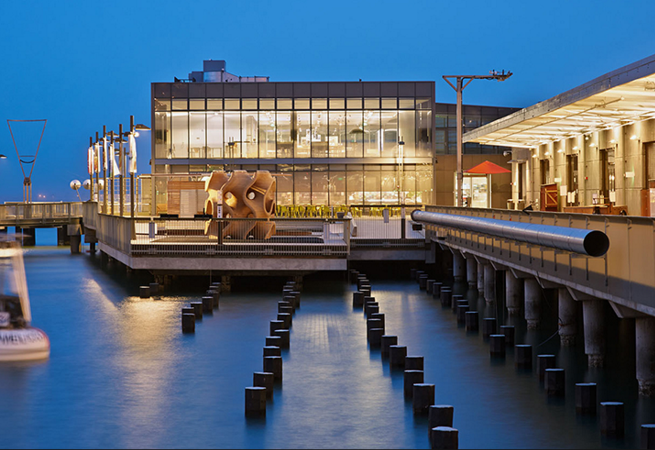
Exploratorium-Pier 15

Slide 5
JR Herman Cruise Terminal Pier 27

Slide 6
Pasha-Pier 80

Slide 7
Port Fire Marshal
Located at Pier 1- Port of San Francisco offices
Staff of two are tasked with the following:
Issuance of operational permits
Review and permitting of special events
Plan review of all building plans
Construction inspections
Annual safety inspection of all occupancies
Pre-construction planning meetings
Predevelopment infrastructure review
Special Port projects
Employee safety training
NEW!!!- Fire Protection Engineer

Slide 8
Mission Rock
SF Giants Parking Lot A
8-acre development

Slide 9
Pier 70
Shipyard and storage
Special Use/Historic District

Slide 10
Broadway Hotel

Slide 11
Portwide Events
34th America’s Cup
SF Giants World Series
Superbowl L
Cirque du Soleil
Fleet Week
Concerts at AT&T Park
Event space at Piers 27, 35, and 48

Slide 12
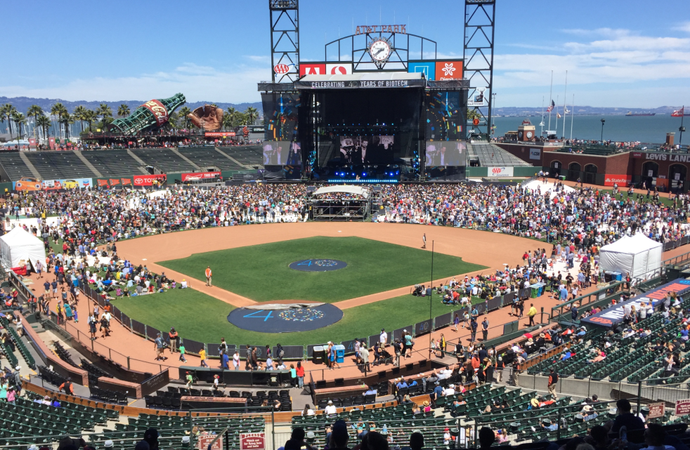
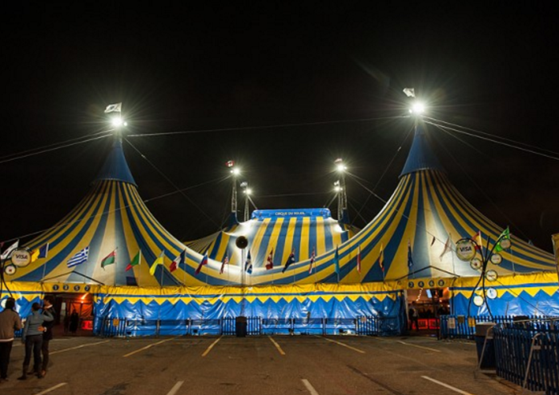
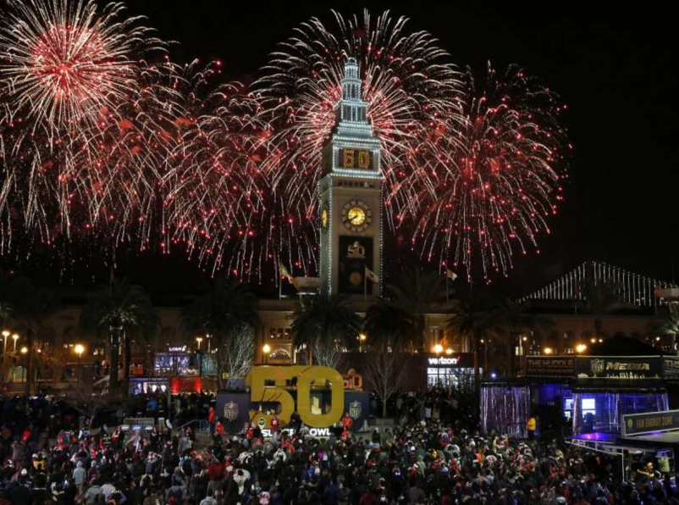
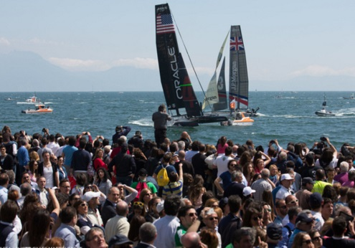
Events

Slide 13
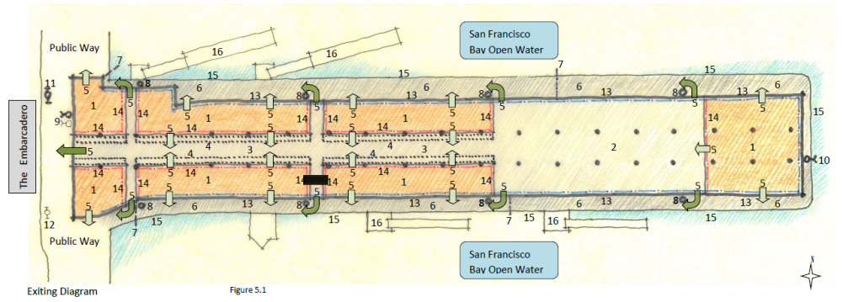
Pier Fire Safety Analysis

Slide 14
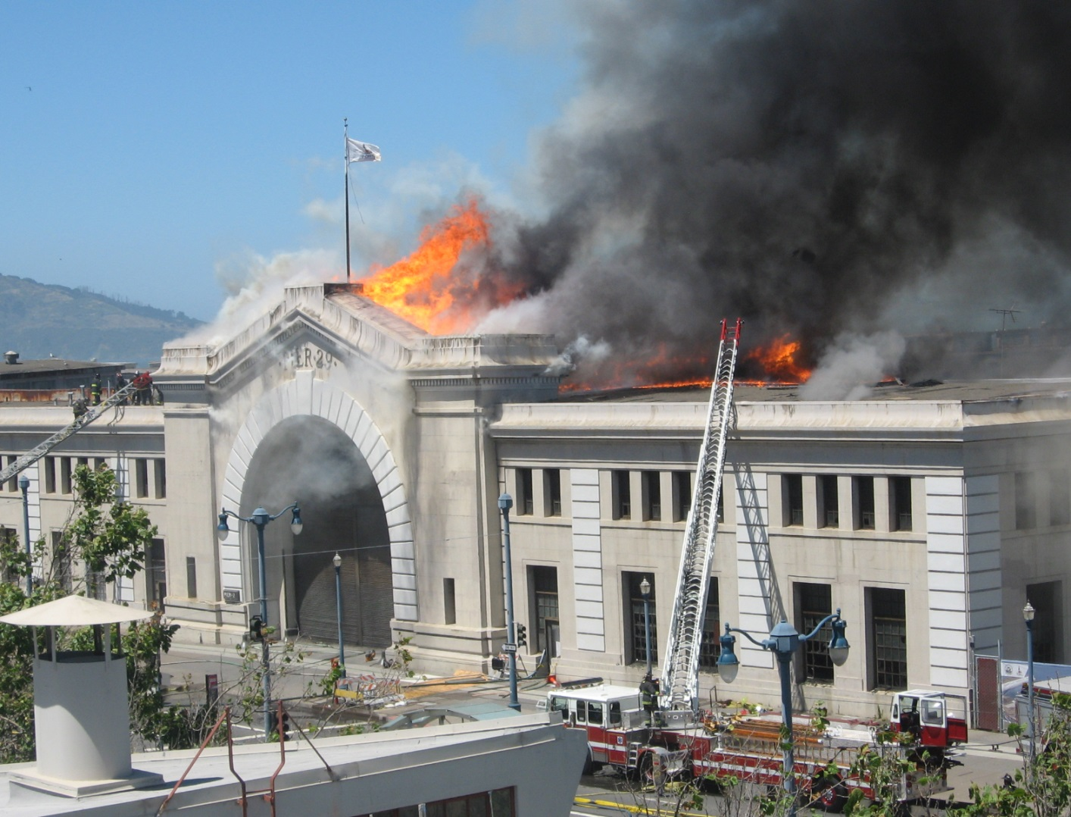
June 20, 2012- Pier 29

