Slide 1

EMS-6 Update
San Francisco Fire Commission
March 8, 2017

Slide 2
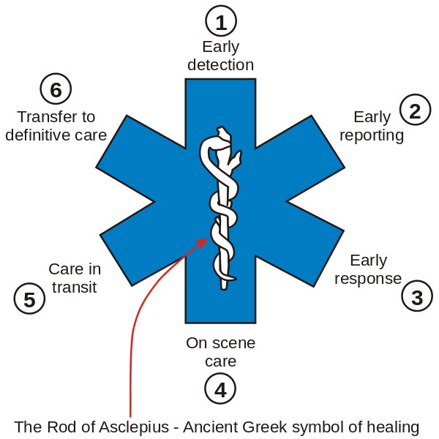
EMS-6 Team
H-33 EMS Captains
  April Bassett
  Simon Pang
SF HSH Homeless Outreach Team + DPH Street Medicine
  Jason Davi
  Joan Chen
Operations began January 2016

Slide 3
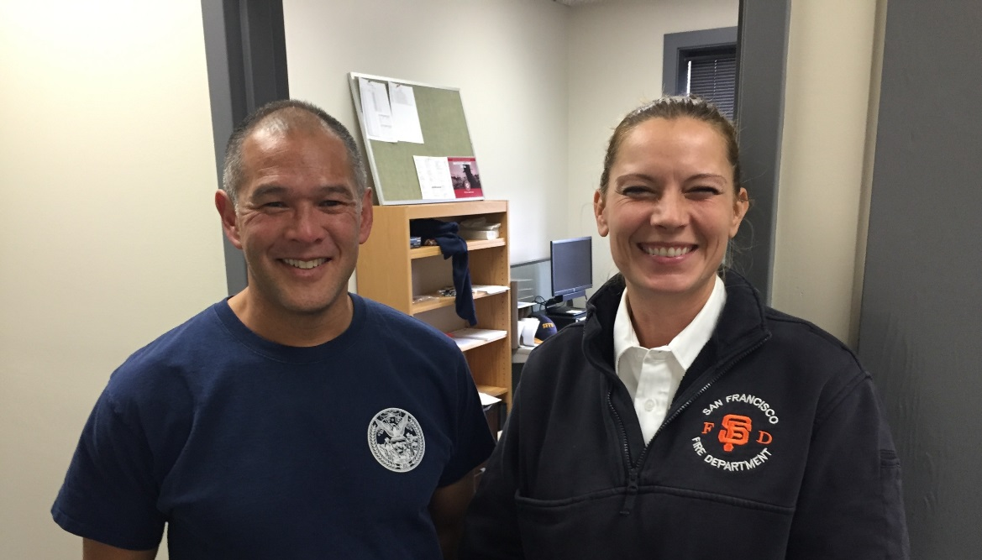
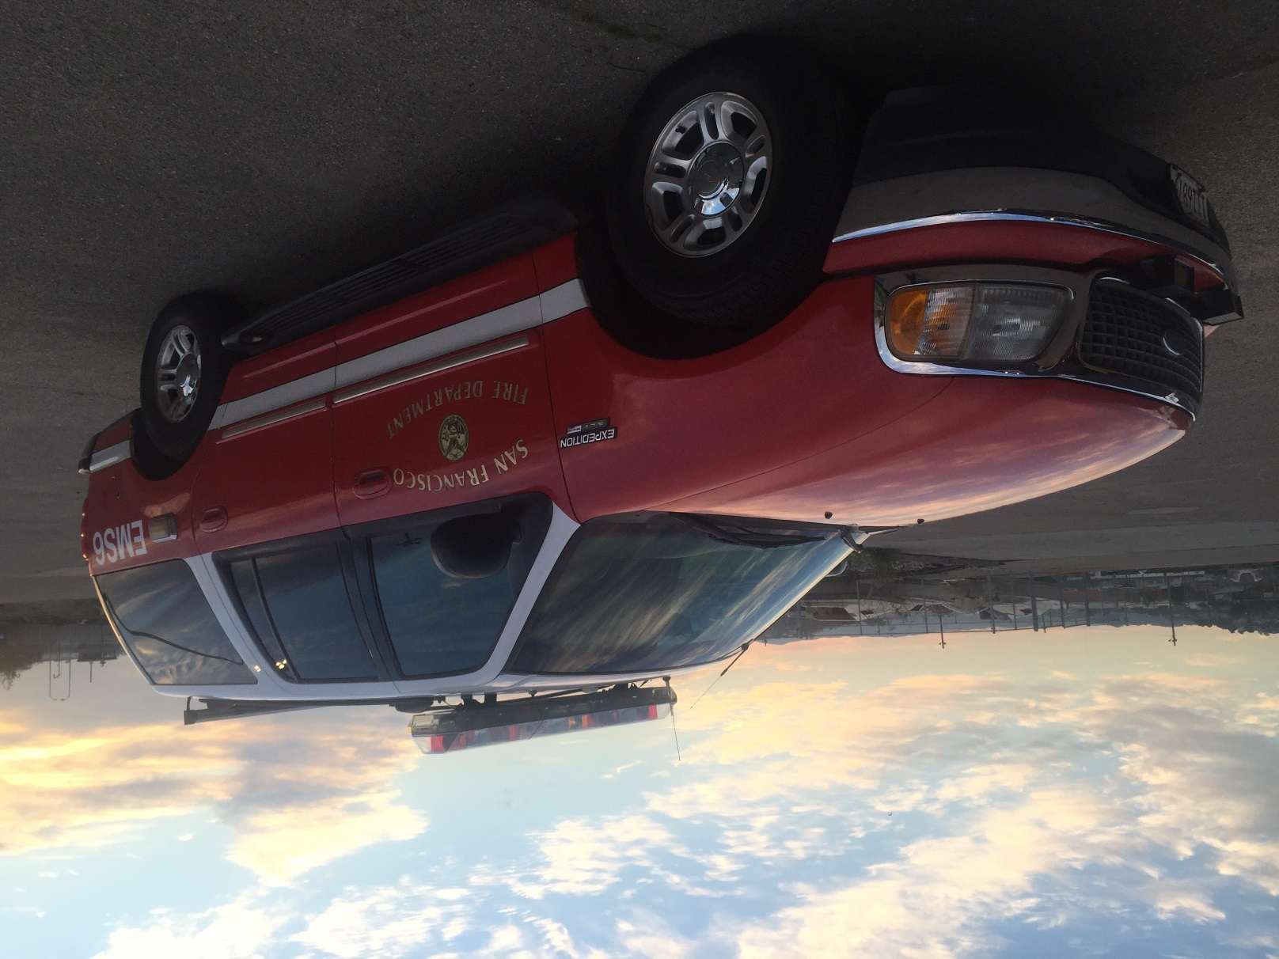
Program Description
H-33 EMS Captain: Paramedic Supervisor Role
SF DPH HOT Outreach Specialist: Care Coordination Role
Dispatched to 911 incidents
Special called by other EMS Resources, clinics, case managers
12 hours/day x 7 days/week (1200-2400)
Work in conjunction with existing services to stabilize high-users and refer to non-emergency programs

Slide 4
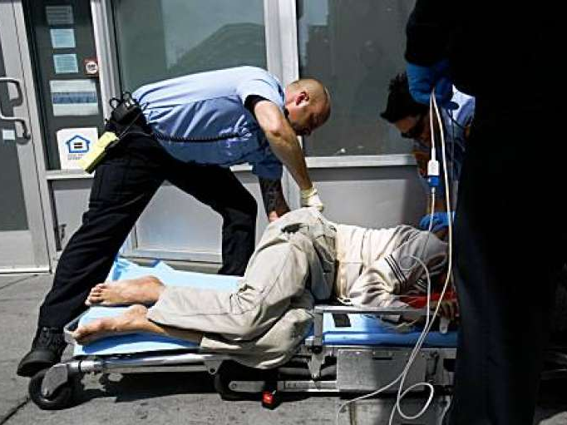
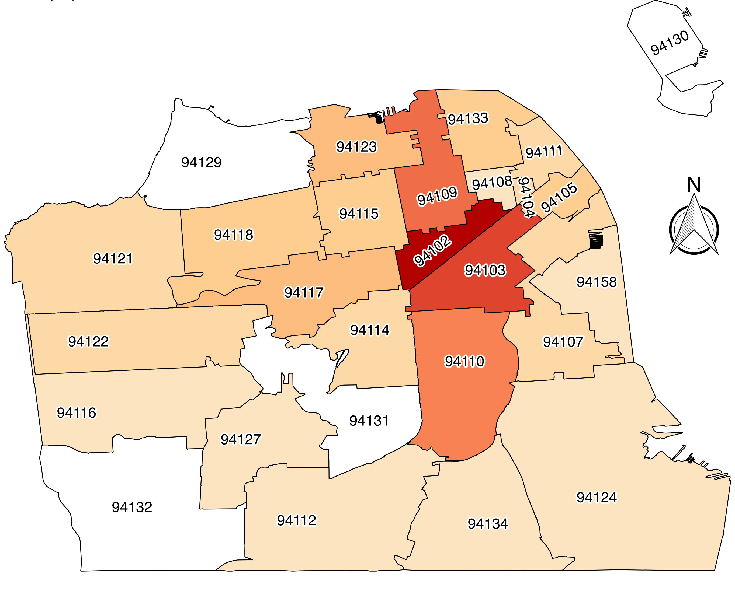
EMS Frequent Users
Identified clients with high 911 utilization
  >4 calls/month or >2 calls/day or
  “Super Users” >10 calls/year
  Identified as system high users (HUMS)= top 1-5% of all services
Work with existing resources to stabilize and connect

Slide 5
EMS-6: Encounters & Clients
Complex interactions and lengthy encounters
Encounter volume is steady
Total Number of EMS-6 Encounters in 2016 (1/26/16-1/26/17) | 2244
Daily Average # of Encounters | 7 encounters/watch
Total Clients to Date | 467

Slide 6
Case Study # 1
2016 911 Contacts | 2016 EMS-6 Contacts | 2017 911 Contacts to Date
28 | 57 | 0
Alcohol use disorder
Mental health diagnosis
History of trauma
Now reunited with family

Slide 7
Case Study # 2
2016 911 Contacts | 2016 EMS-6 Contacts | 2017 911 Contacts to Date
86 | 63 | 0
Sobering services, case management, and detox
No treatment program available after detox, relapsed
EMS-6 found a program suitable for him and sobering & HOT setup the necessary appointments for benefits. Sobering submitted housing application
Coordinated to have individual readmitted to medical detox and treatment program
Supportive housing

Slide 8
Case Study # 3
2016 911 Contacts | 2016 EMS-6 Contacts | 2017 911 Contacts to Date
159 | 130 | 0
Four 911 contacts in a 8-hour period
Admitted and transferred to another hospital secondary to insurance
Consulted with individual, providers, and insurance, changed him to a plan and provider better suited to handle his medical complexities
On re-admission, medically detoxed and verbalized a desire to go home
Coordinated with family and DPH, accompanied by a SW and EMS-6, flown home and reunited with family

Slide 9
2016 | Individual | Prior 911 Contacts | Intervention / Outcome | Current 911 Contacts
 | Case 1 | 15 | Conserved | 0
 | Case 2 | 16 | Housed | 1
 | Case 3 | 19 | Increased level of care | 0
 | Case 4 | 20 | Completed detox and treatment | 0
 | Case 5 | 25 | Completed detox and treatment | 0
 | Case 6 | 28 | Reunited with family | 0
 | Case 7 | 30 | Completed detox and now housed | 0
 | Case 8 | 35 | Skilled nursing facility | 0
 | Case 9 | 35 | Conserved | 0
 | Case 10 | 38 | Case managed | 3
 | Case 11 | 39 | Completed detox and treatment | 3
 | Case 12 | 48 | Housed | 5
 | Case 13 | 49 | Ongoing attempts at detox | 4
 | Case 14 | 86 | Housed | 1
 | Case 15 | 159 | Reunited with family | 0
Notes:
Notes: add date for current 911 contacts and for prior 911 contacts

Slide 10
Case Study # 4
2016 911 Contacts | 2016 EMS-6 Contacts | 2017 911 Contacts to Date
84 | 45 | 24
Severe mental illness and substance use disorder
Evicted from housing
Frequently placed on holds
Often denied service due to behavioral issues

Slide 11
EMS-6: Focus on Super Users
EMS-6 Encounters spent with Super Users | 90%
Super Users who have had contact with EMS-6 *This 42% of Super Users were responsible for 57% of all Super User activity | 42%*
Super Users who reported homelessness in 2016 | 71%

Slide 12
Super Users: System Utilization Trends
Super User: 10 or more EMS contacts within a year
 | 2014* | 2015* | 2016
Unique Users | 42250 | 46898 | 50025
Super Users | 264 | 312 | 452
% that are Super Users | 0.62% | 0.67% | 0.90%
 | 2014* | 2015* | 2016
Total Transports | 50,531 | 57,597 | 61,168
Transports of Super Users | 7,064 | 8,217 | 8,144
Super Users as a % of Transports | 13.98% | 14.27% | 13.31%
Number of super users increasing, but 911 ambulance utilization per client has been decreasing

Slide 13
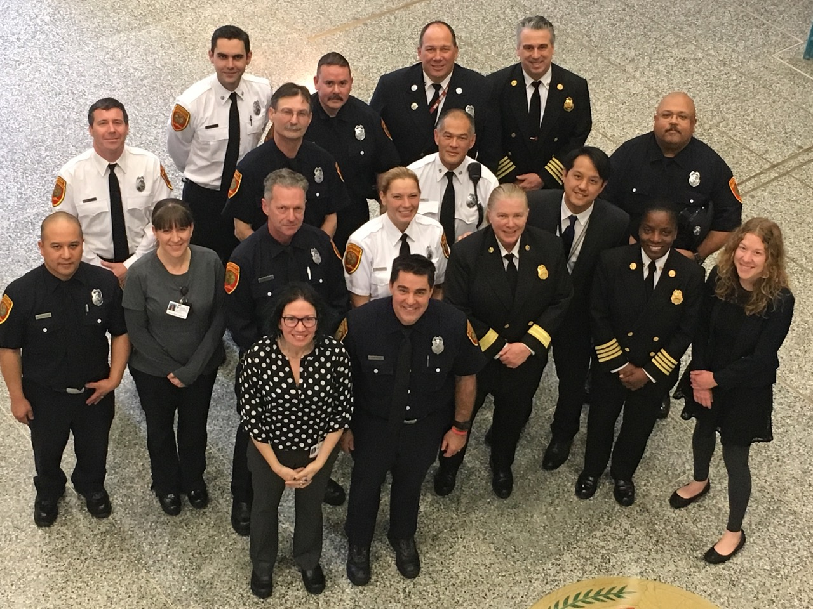
California State Community Paramedicine Pilot Project
Became California EMSA/OSHPD pilot project #13
SF Sobering Center as Alternate Destination
10 Community Paramedics completed month long program
Statewide effort to advance prehospital care

Slide 14
Next Steps
Continued clinical operations
Improved data management with private providers and hospitals
State Community Paramedicine Pilot Project
Continued coordination with behavioral health and resources for homelessness
Improve coordination with law enforcement and legal system
Improve EMS-6 staffing for care coordination

Slide 15
Contact EMS-6
Hours: 1200-2400 every day
Email: fireems6@sfgov.org
Phone: (415)816-6739

