Slide 1

San Francisco Fire Department
Chief Joanne Hayes-White

Slide 2
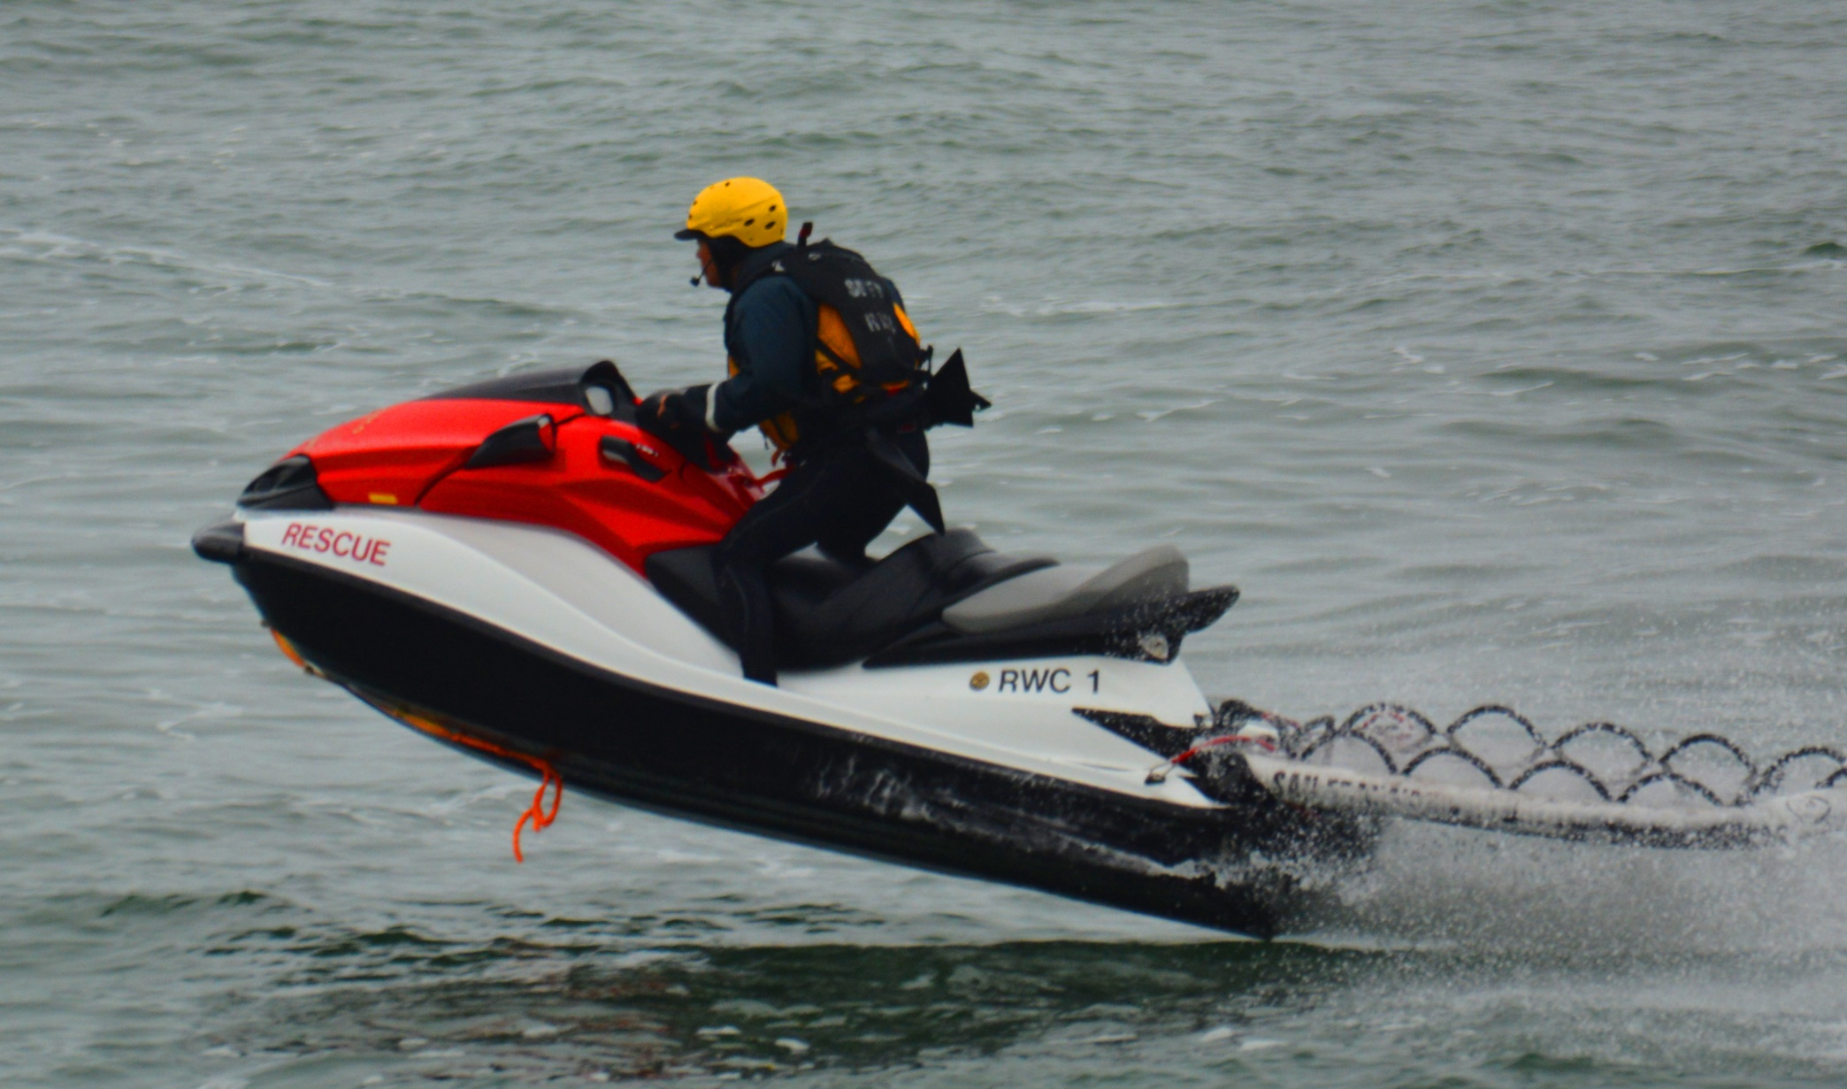
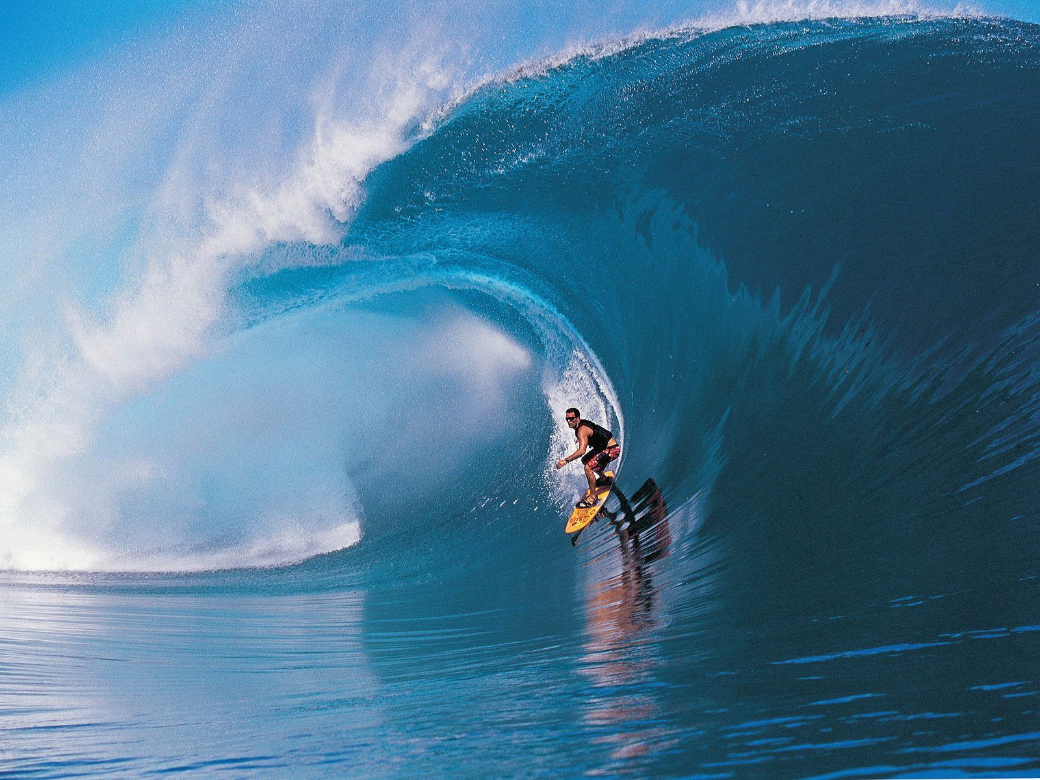
SFFD Surf and Bay Rescue
Programs

Slide 3
Mission Statement
The mission of the SFFD Surf Rescue Program is to be responsible for mitigating any aquatic and coastal emergency that involves water or where water lies in its inherent path within the boundaries of the City and County of San Francisco. The Surf Rescue Program shall be responsible for providing emergency aquatic rescue operations in conjunction with outside agencies, specialized rescue units, in or around the Ocean, Bay, and other standing bodies of water.

Slide 4
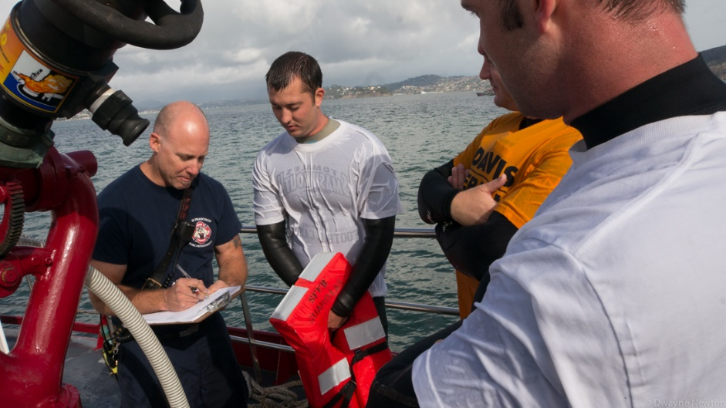
Surf Rescue Program Goals
It is the mission of the Surf Rescue Program to provide lifesaving training, re-certification, and to procure equipment for the San Francisco Fire Department and its personnel as it relates to an aquatic rescue incident.
To ensure that all Surf/Bay rescue members are properly trained and equipped to mitigate all aquatic emergencies within the maritime boundaries of the City and County of San Francisco.

Slide 5
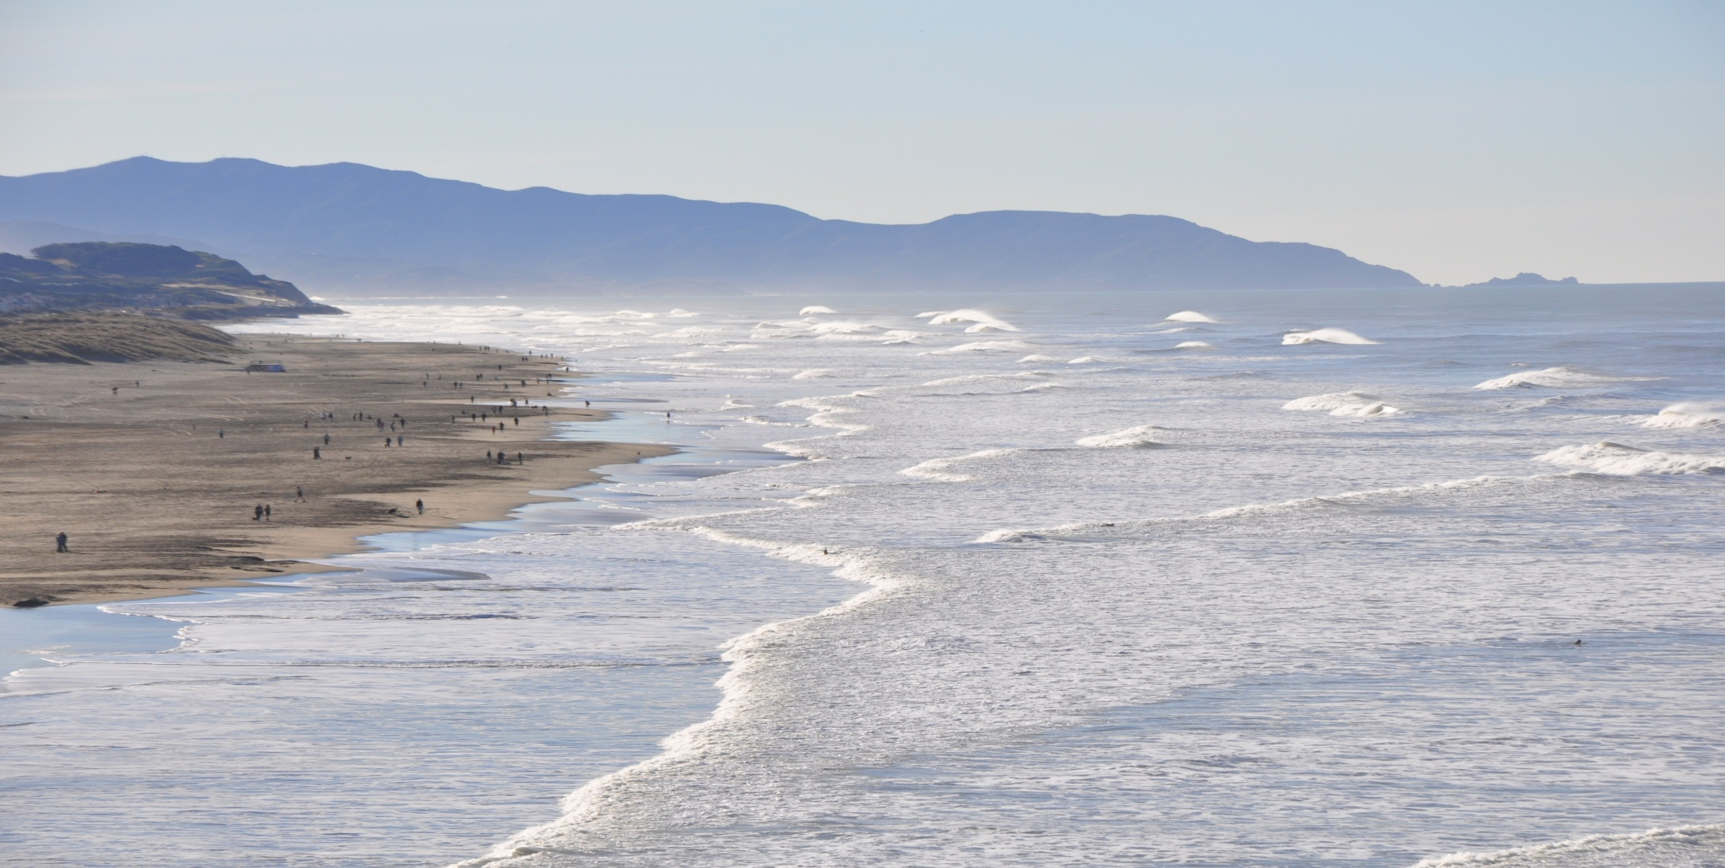
Over 2 million people use Ocean Beach yearly. In1998, Ocean Beach was voted the most dangerous beach in the nation.

Slide 6
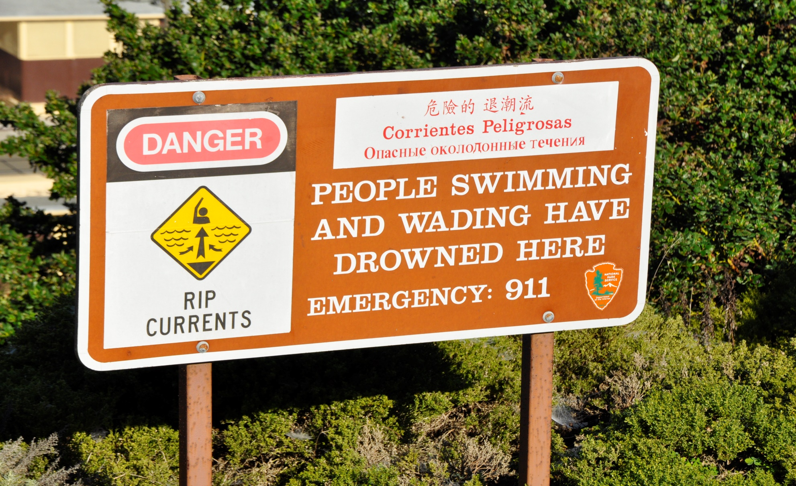
Despite posted warning signs, Ocean Beach still attracts hundreds of swimmers daily

Slide 7
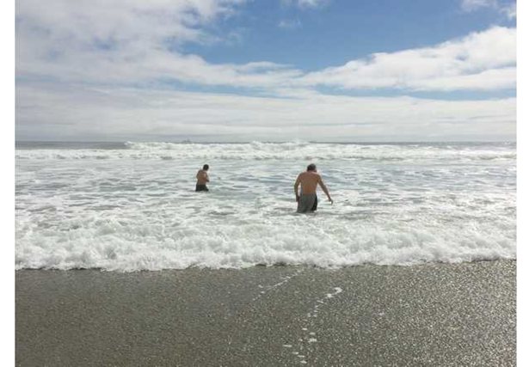
This picture taken of the seemingly calm waters of Ocean Beach minutes before a strong Rip Current claimed the lives of
Jose Garcia Sr. and Jose Garcia Jr. September 2014
OTHER RESCUE RELATED NEWS ARTICLES
San Francisco Fire Department Performs Dramatic Surf Rescue
Article Jul 1, 2005
Massive Waves, Riptides Pull Two Men Out To Sea Off San Francisco, Team Of Firefighters Perform Daring Surf Rescue
By Henry K. Lee
Fire Department rescues swimmer near Cliff House at Ocean Beach
Updated 11:21 pm, Friday, September 26, 2014
Son dies day after father, after being pulled from Ocean Beach
SFFD Called To Ocean Beach To Rescue Distressed Swimmers Four Times Wednesday
By Tom Prete

Slide 8
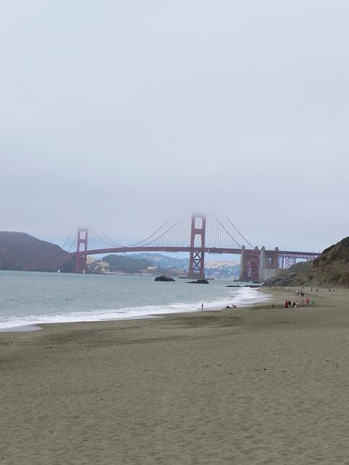
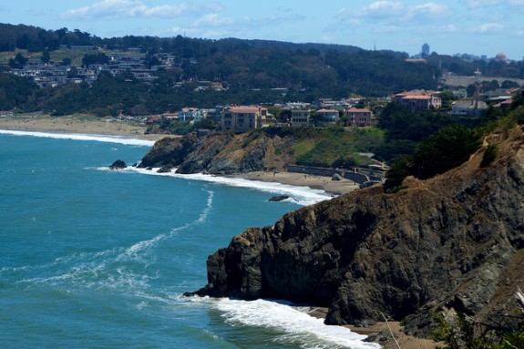
San Francisco has 22 miles of coastline
Including China & Baker Beaches
The average water temperature is 51 degrees.

Slide 9
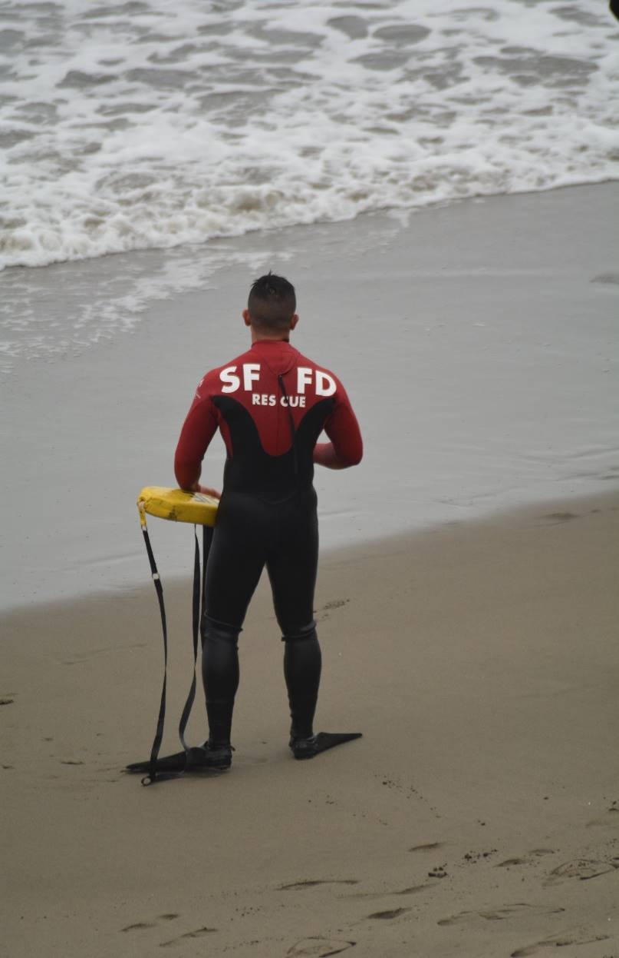
What it takes to become an SFFD
Surf Rescue Swimmer

Slide 10
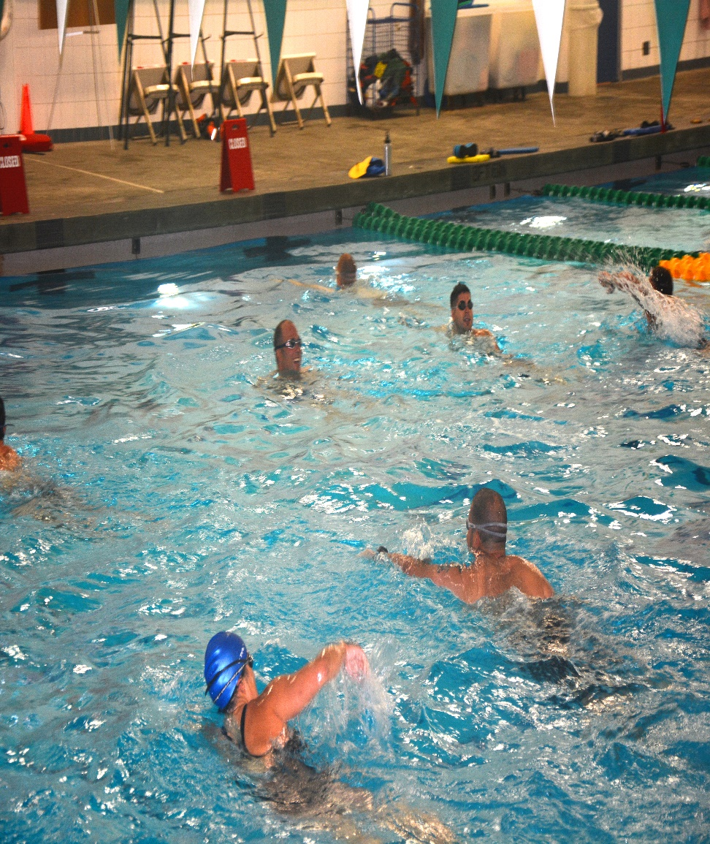
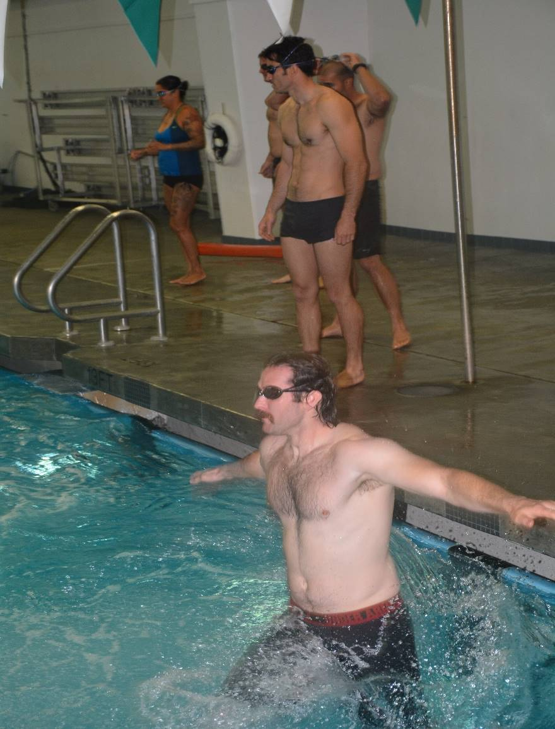
New members wishing to become surf rescue swimmers must pass the SURF RESCUE COURSE held annually in early May.
(The week long course starts in a pool and ends at Ocean Beach)

Slide 11
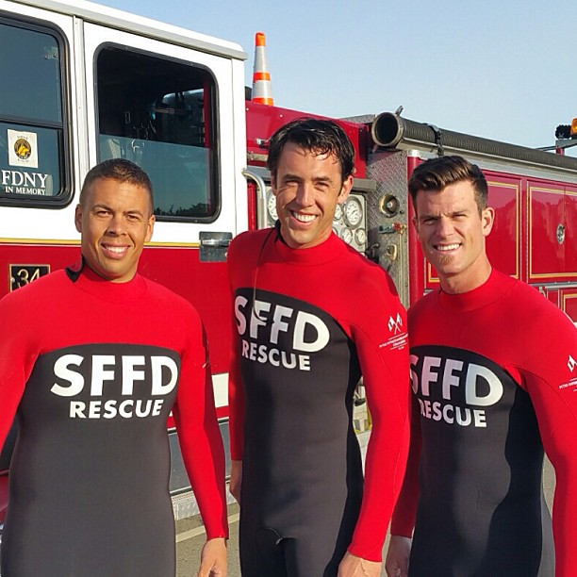
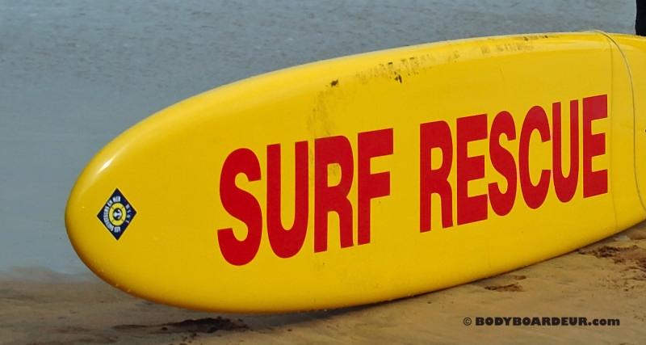
The SURF RESCUE COURSE consist of-
Qualifying 400 yard swim in 10 minutes (pool)
Complete an open water swim at Aquatic Park
Perform Rescue Techniques at China Beach
Learning how to read tides, rip currents, bay currents, and waves
Learning surf lifesaving techniques
Members must perform rescues at Ocean Beach to pass
Survive the course!!!

Slide 12
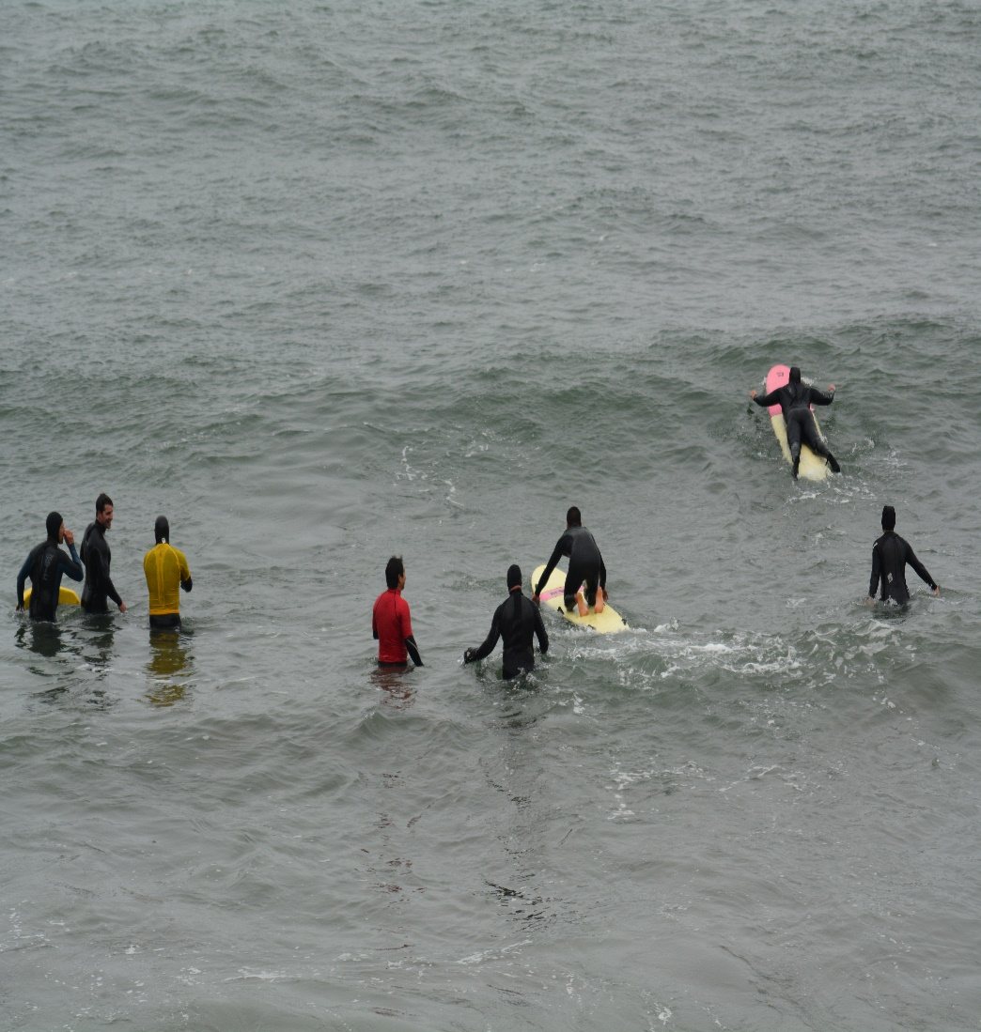
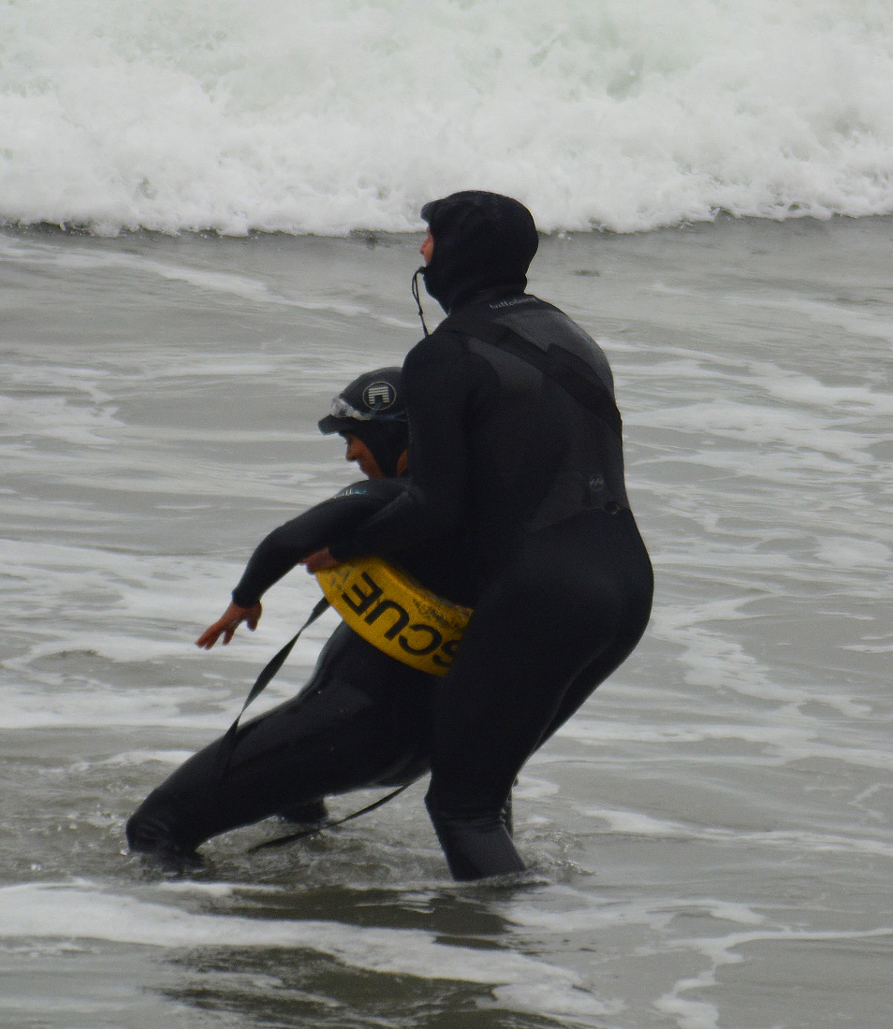
Surf Rescue members recertify every two years to hone lifesaving skills and stay updated with the latest surf rescue techniques and equipment.

Slide 13
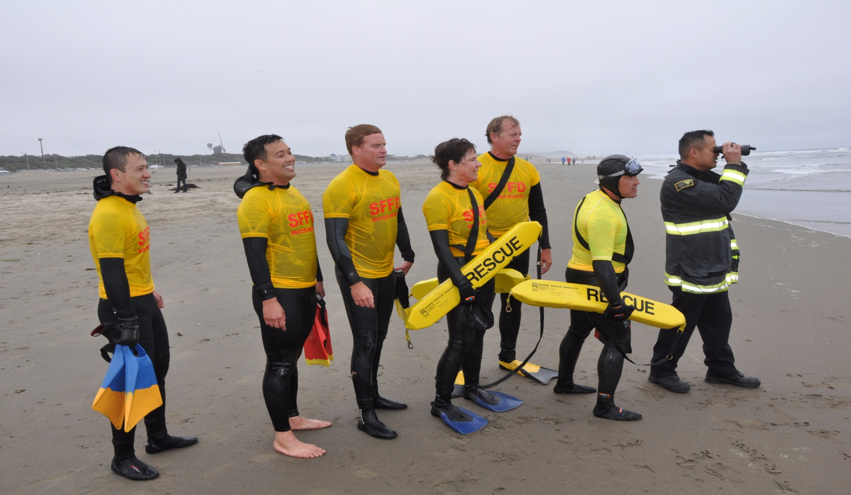
A single victim requires six rescue swimmers staged with the RGS - the Primary Team (2), the Intercept Team (2), the RIC Team (2).

Slide 14
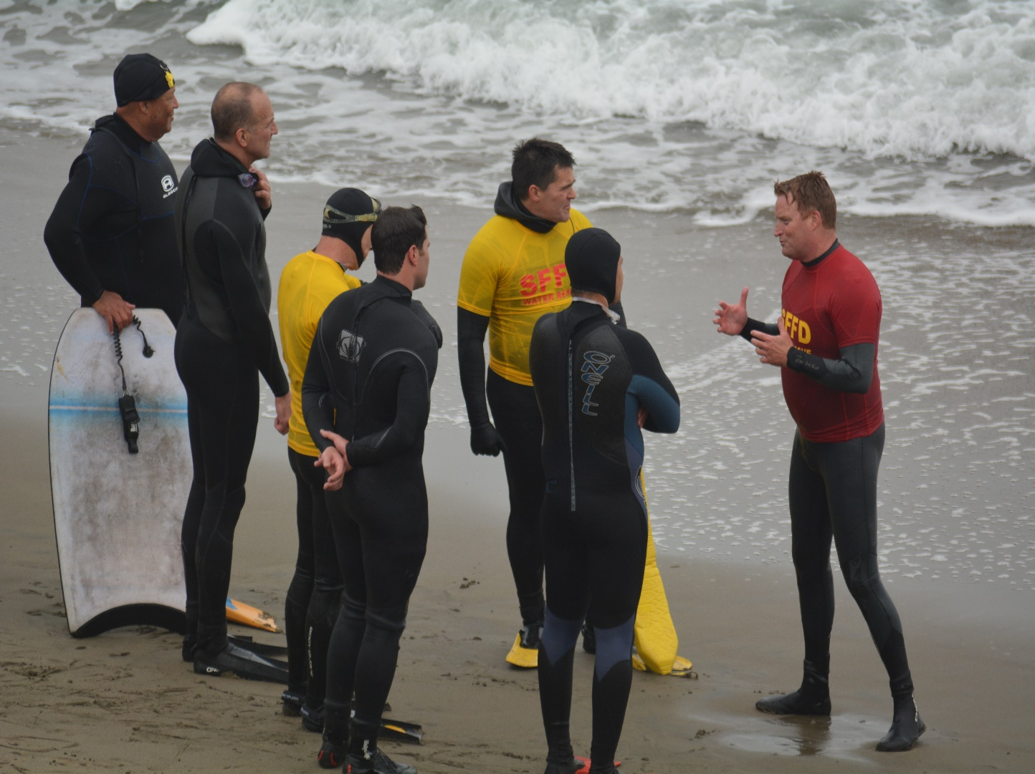
Captain Robert Styles recipient of the Sullivan Award, given for extreme bravery for saving a drowning swimmer during extreme conditions at Ocean Beach, gives instruction to seasoned surf rescue members.
Surf Rescue Training

Slide 15
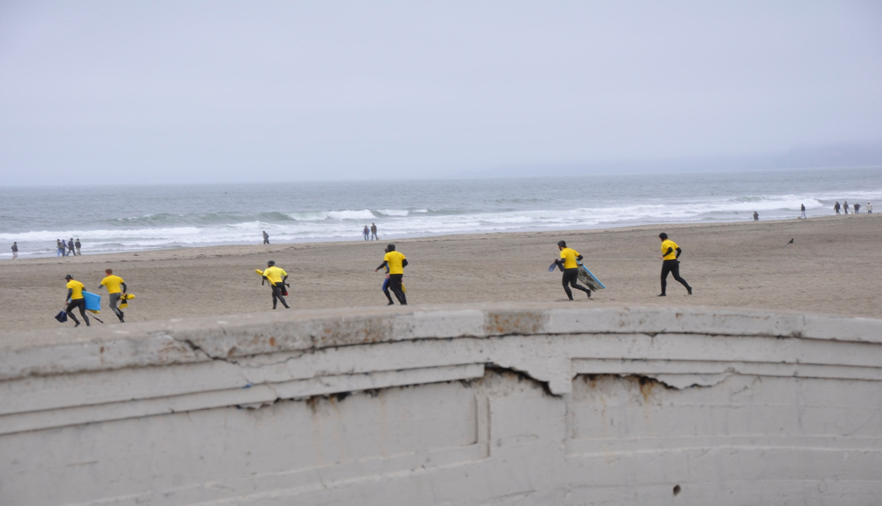
Rapid deployment of rescue swimmers and resources are key to a successful rescue.

Slide 16
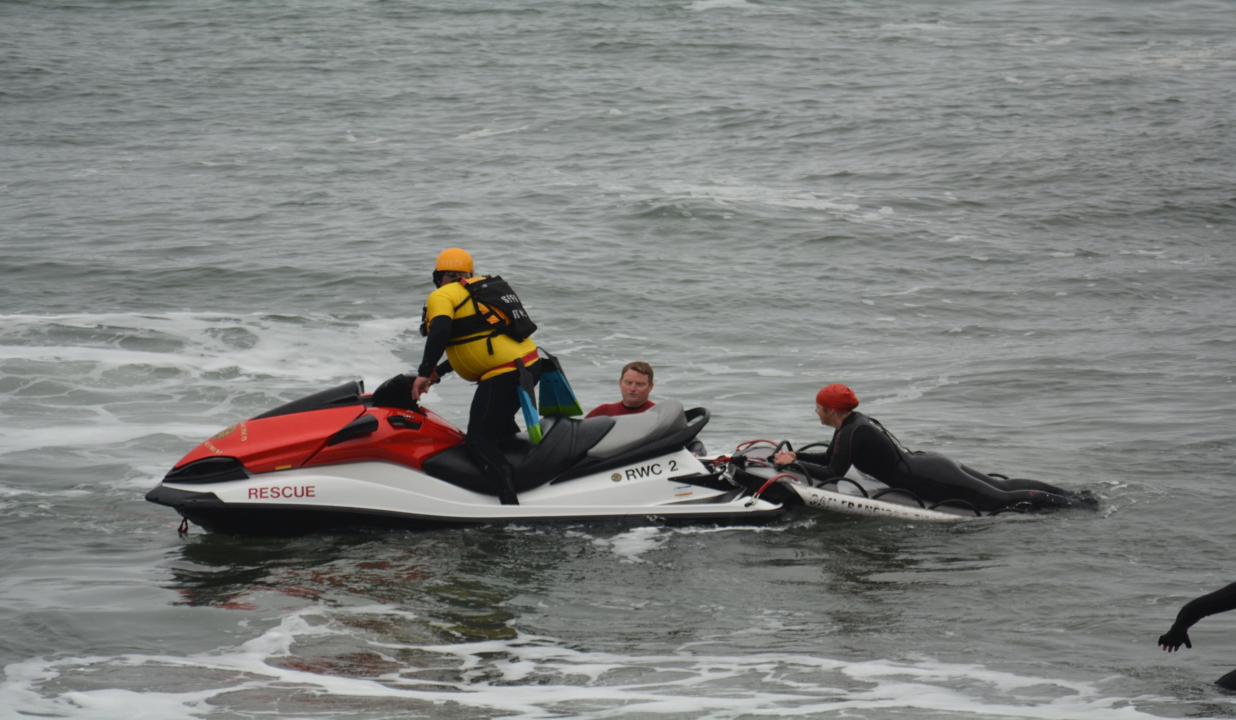
Members spend countless hours training on becoming expert boat and rescue watercraft operators.

Slide 17
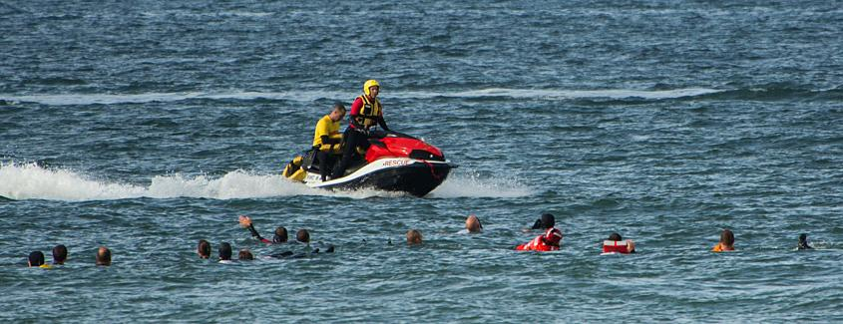
Currently the SFFD Surf Rescue Program has 236 Rescue Swimmers.

Slide 18
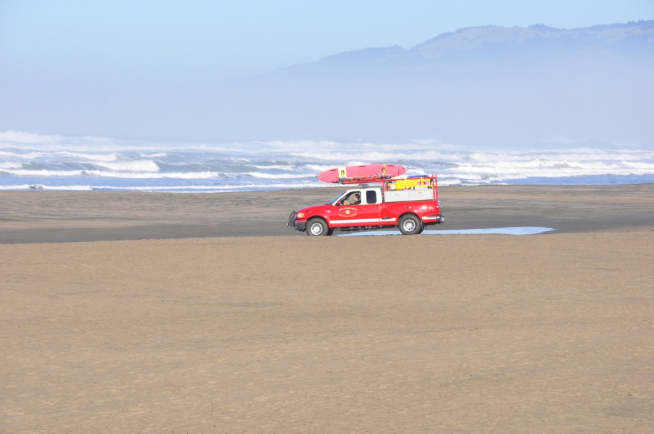
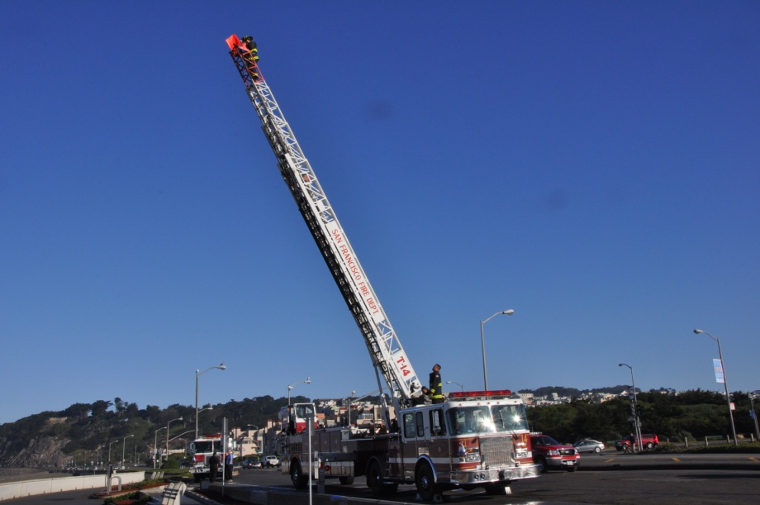
Proper apparatus positioning will expedite locating and extracting the victim.
CR1 / CR2 positions @ the shoreline
Aerial spotter will assist locating the victim

Slide 19
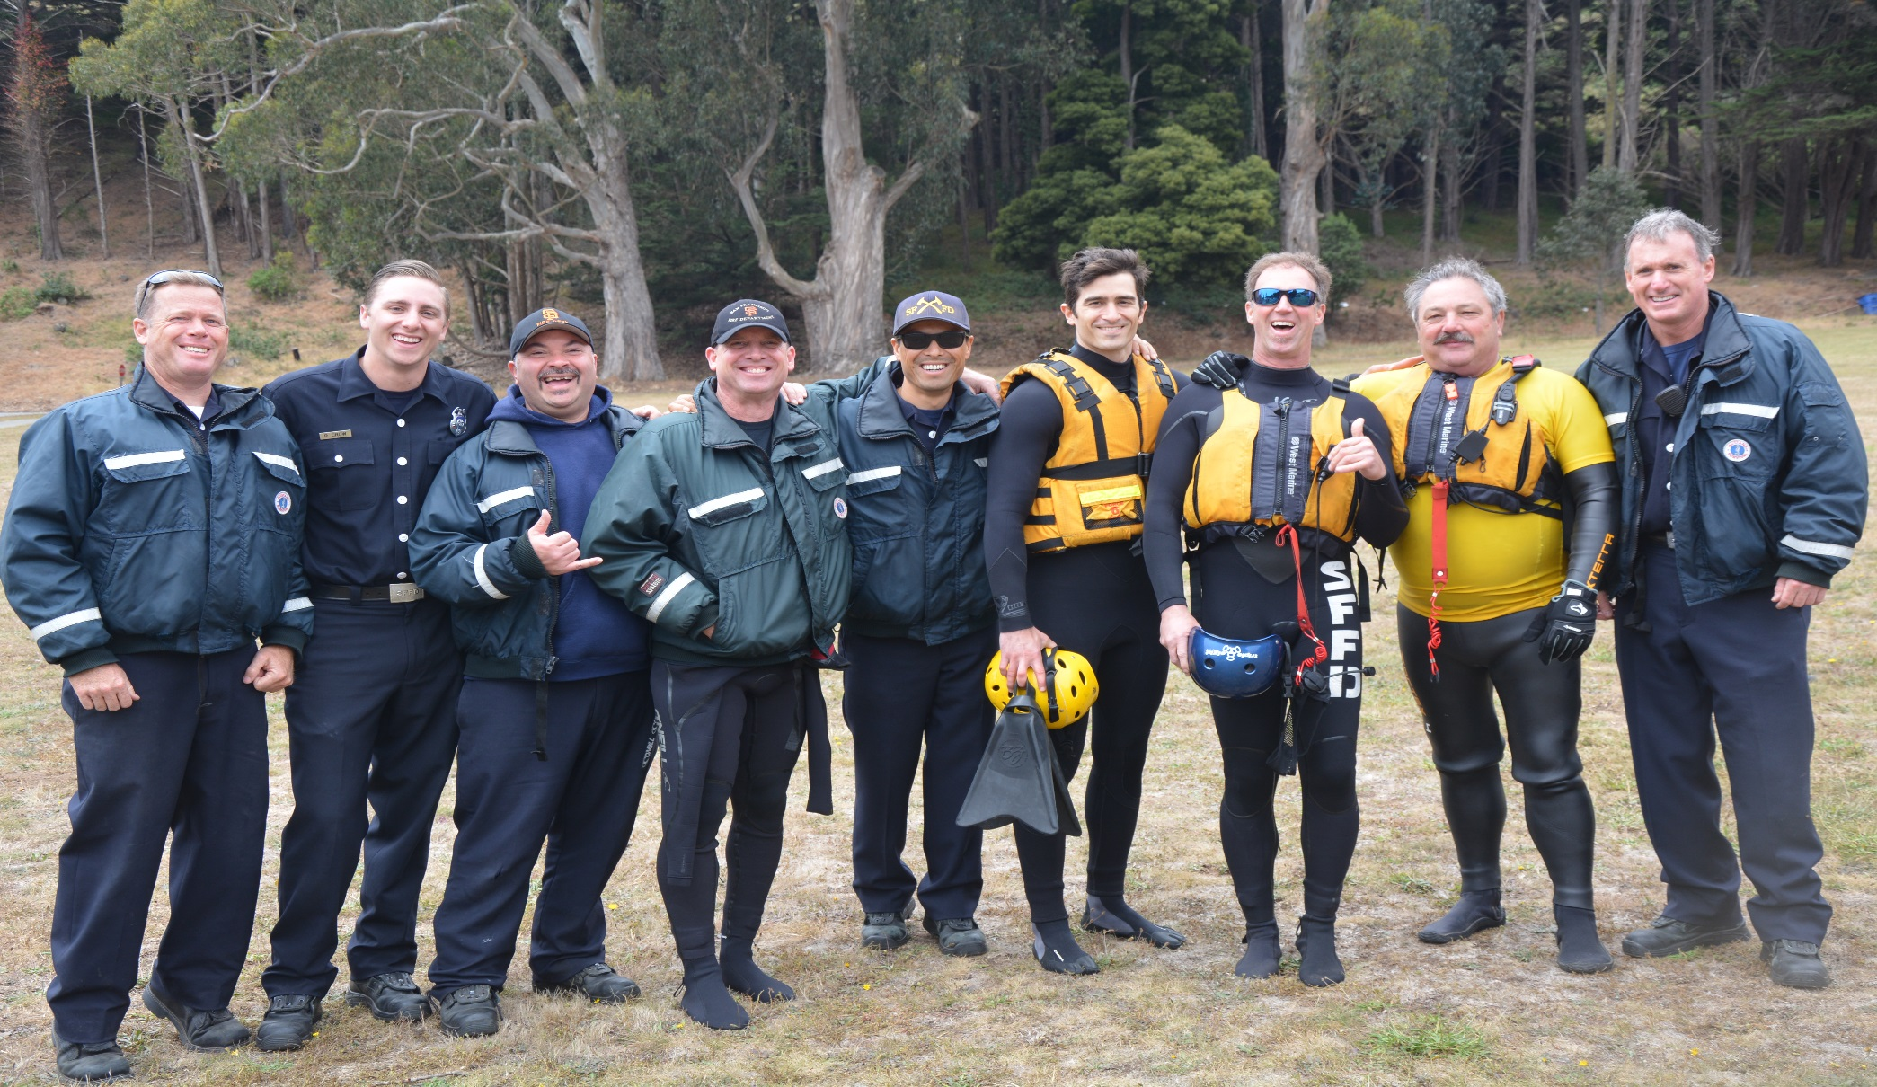
Surf and Bay Rescue Response
Statistics 2002 -2014

Slide 20
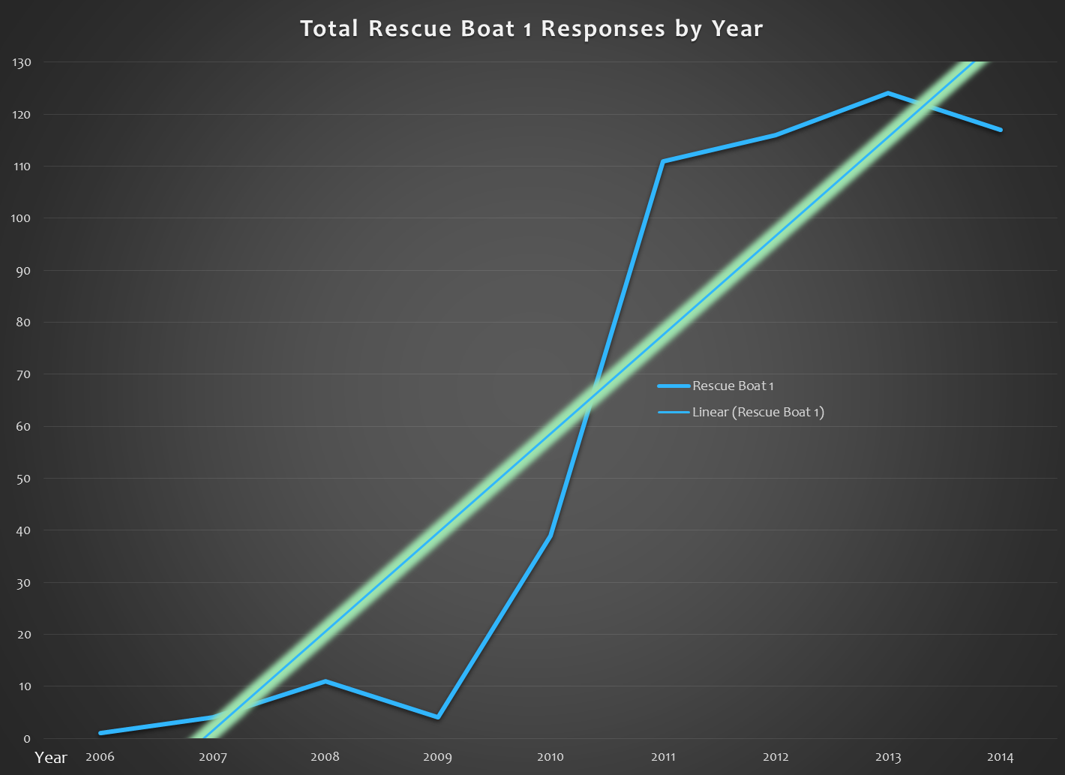

Slide 21
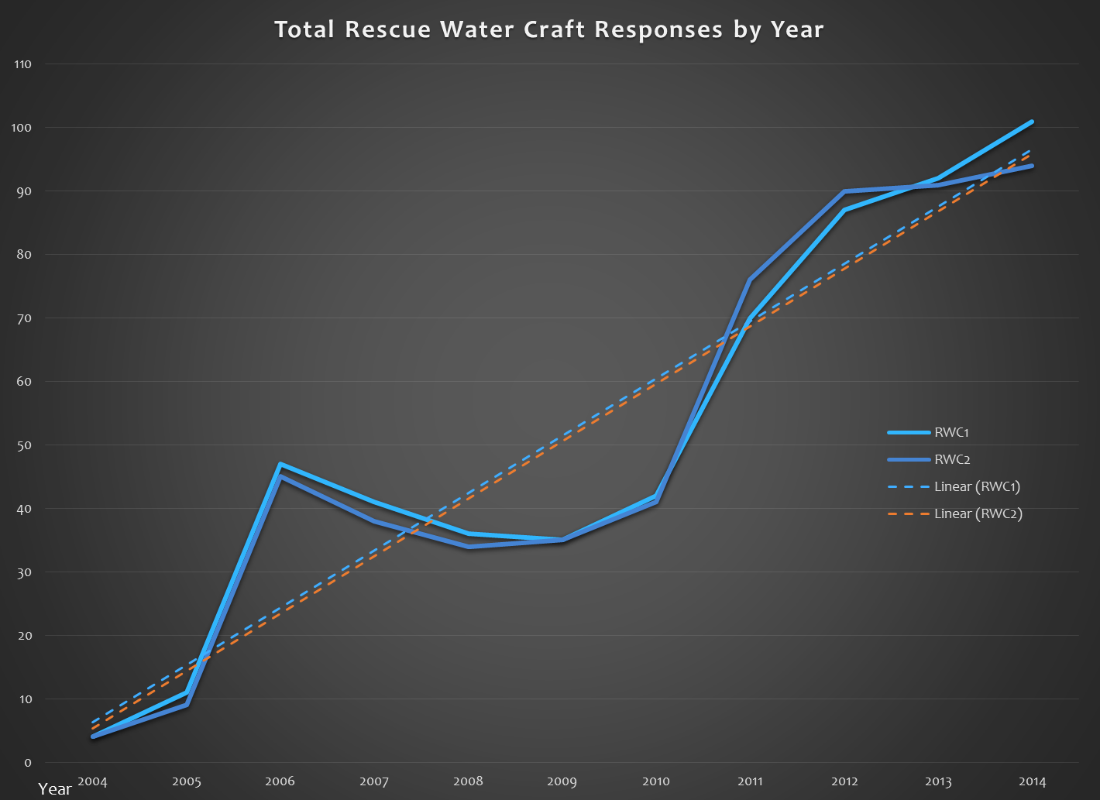

Slide 22
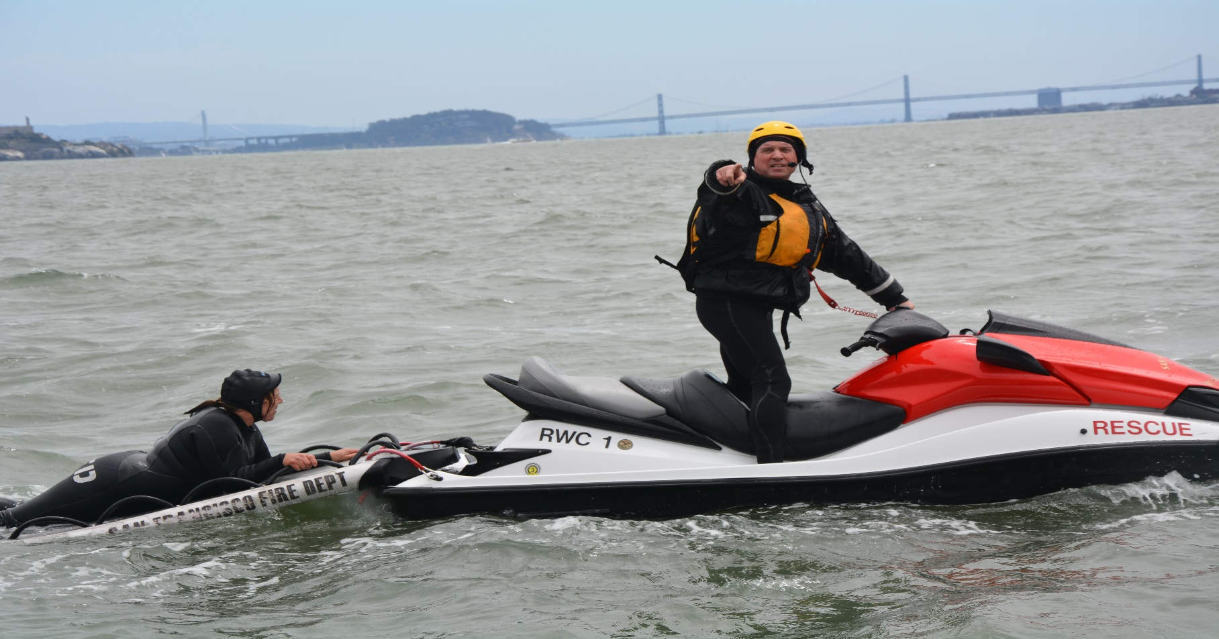
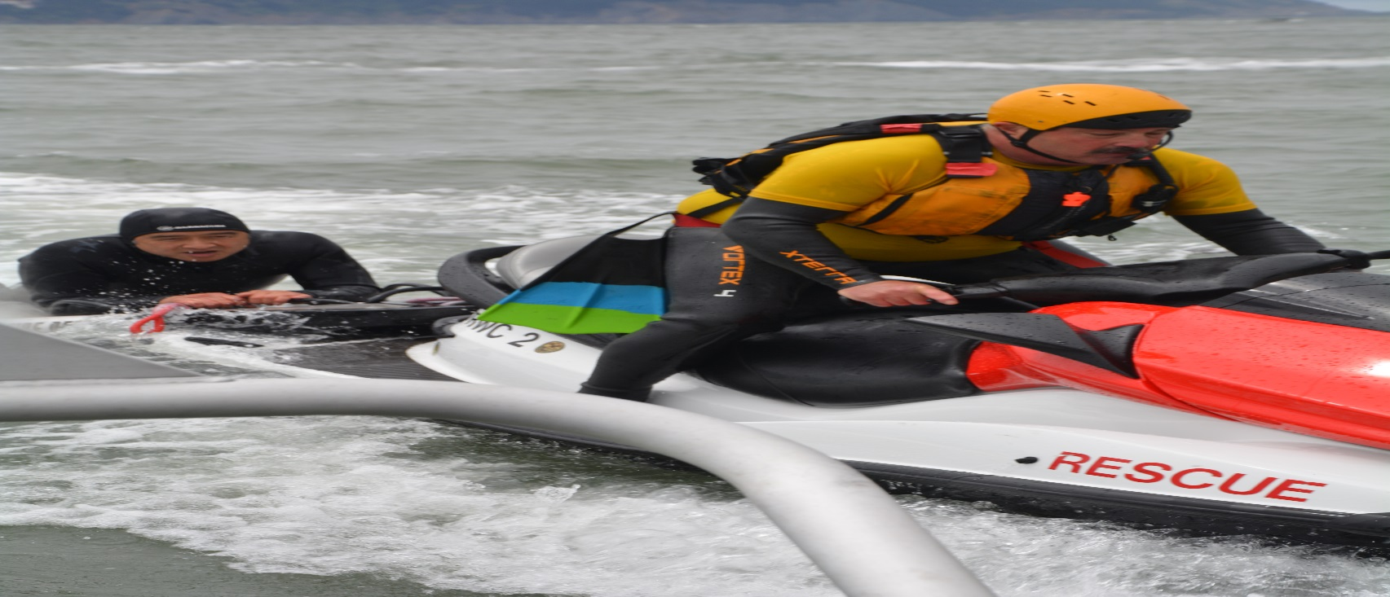
SFFD and Inter- Agency Training

Slide 23
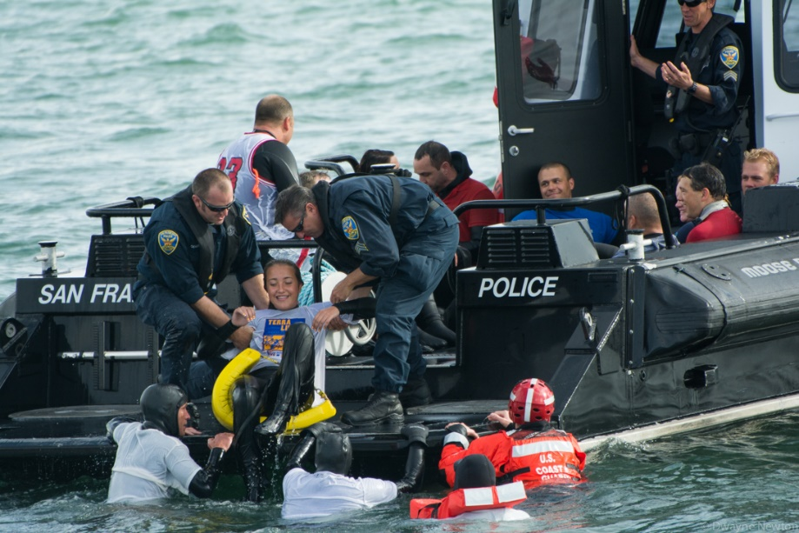
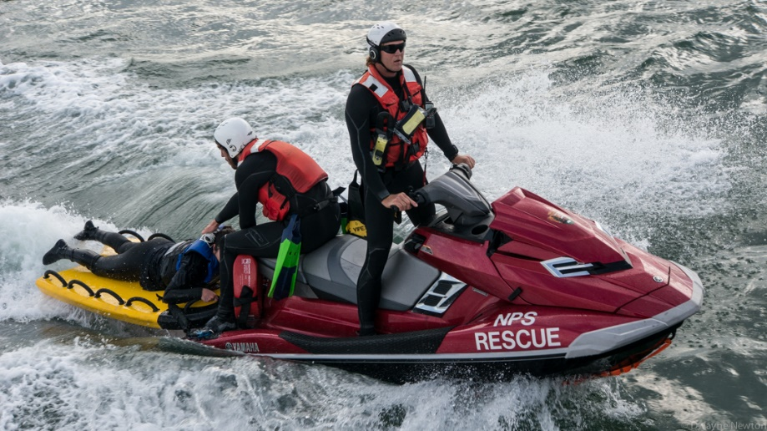
Inter Agency Rescue Drill
2014 Bay Rescue # 1
SFFD Police Moose Boat
National Park Rescue

Slide 24
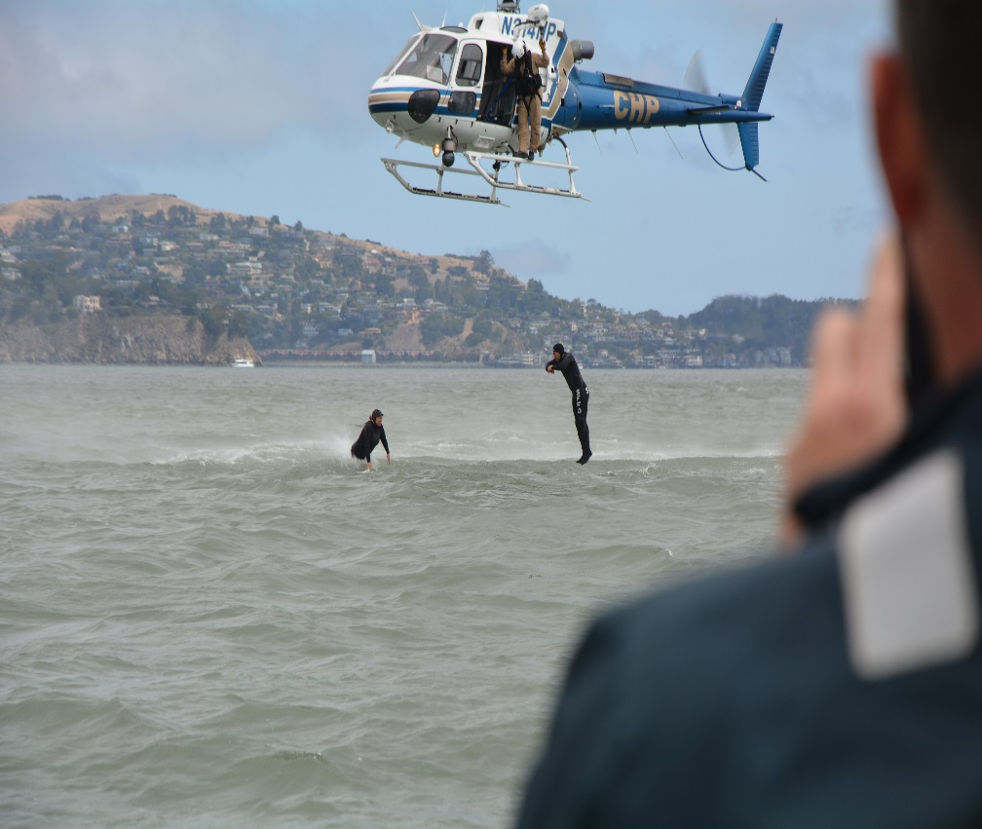
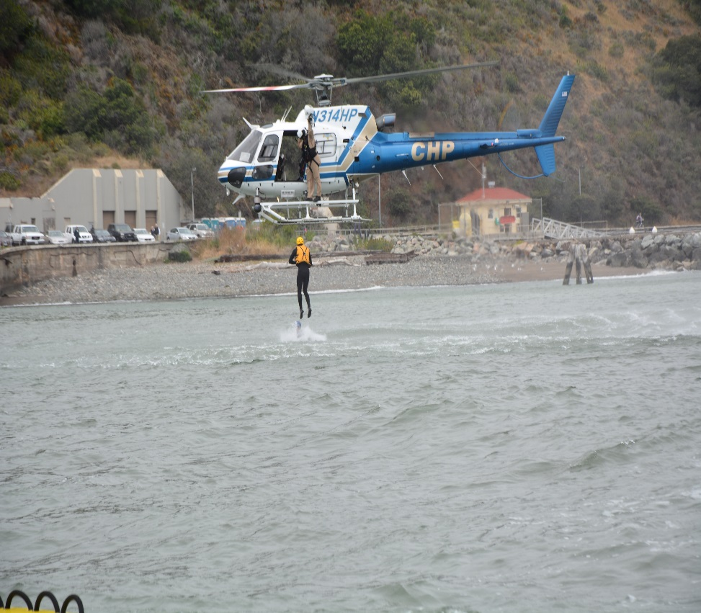
Members from Rescue 1 dive team and rescue swimmers from Fire Station 16 train with
CHP to add rapid response Helo casting to their many skills .

Slide 25
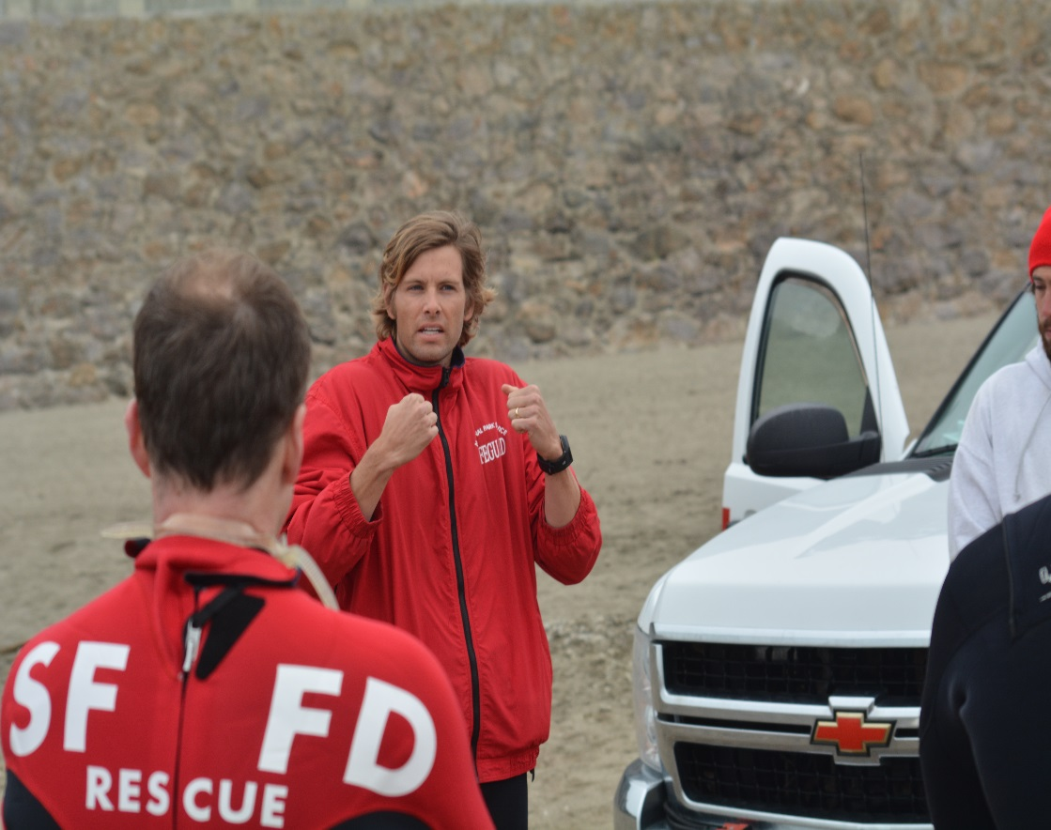
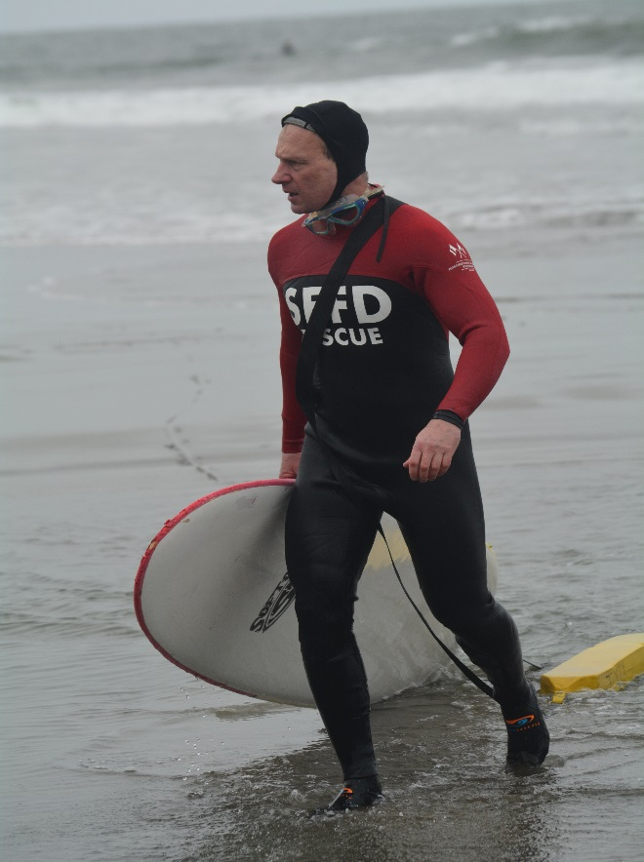
National Park Beach Patrol are a valuable resource and assist with bi-weekly surf rescue instruction and inter-agency drills.

Slide 26
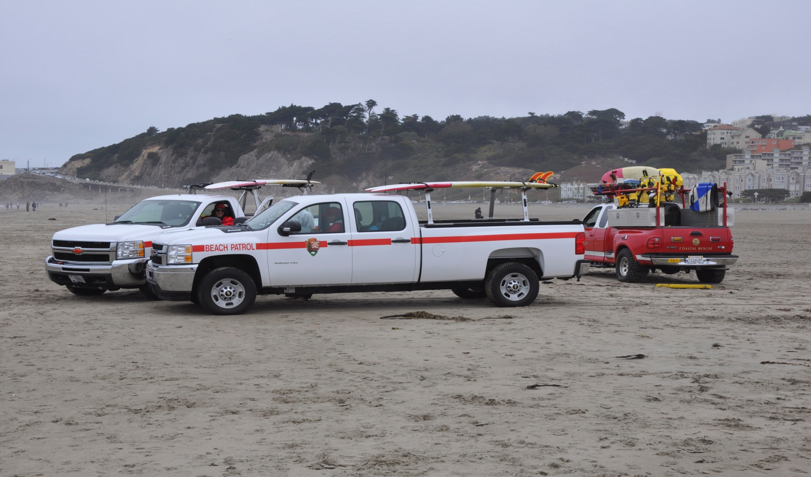
National Park Beach Patrol carry SFFD radios and monitor attack channels 7 & 8 and are a valuable resource with updates.

Slide 27
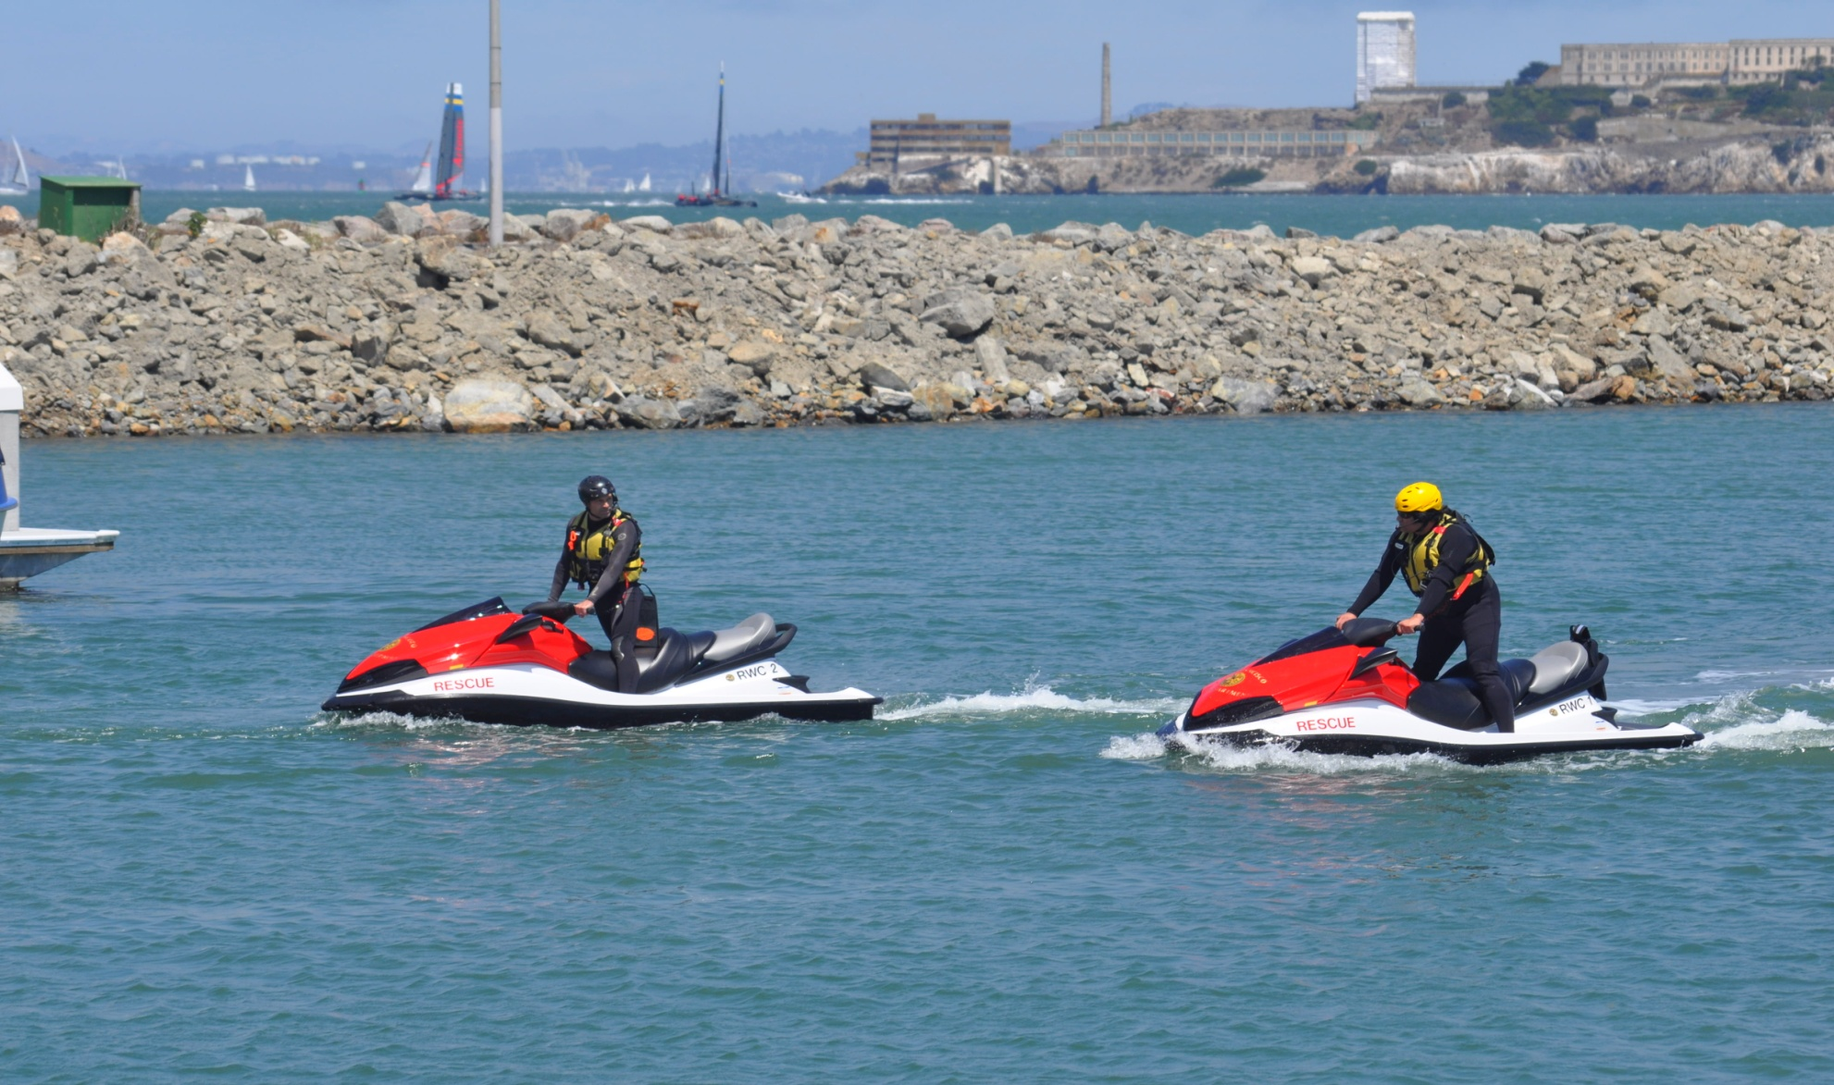
Dispatched with RB1 out of the St. Francis Yacht marina -
SFFD Rescue Water Craft 1 & 2 add rapid response and maneuverability and assist with all Ocean & Bay Operations and events.

Slide 28
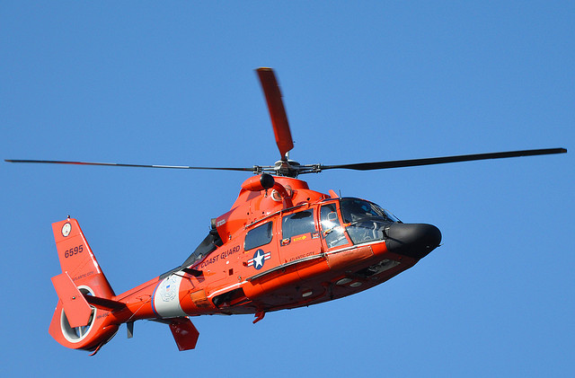
United States Coast Guard out of SFO has a response time to Ocean Beach of 30 minutes and has 1 rescue swimmer.

Slide 29
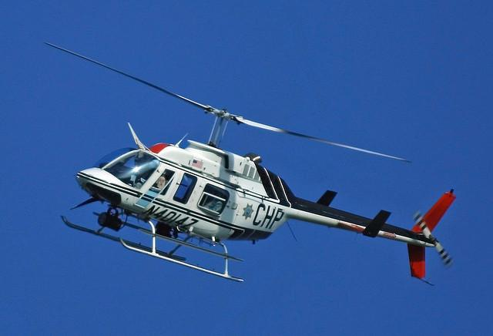
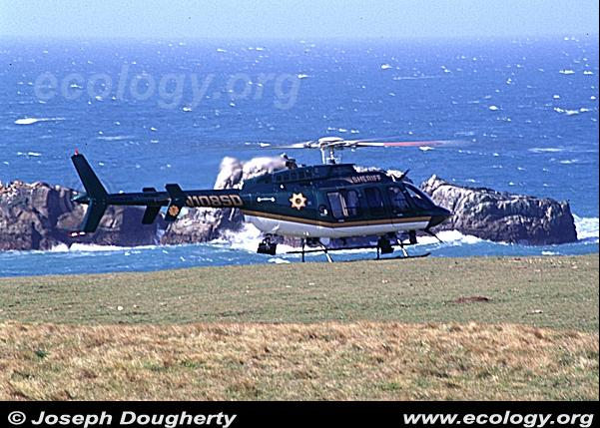
Additional Air Mobil Support - California Highway Patrol & Sonoma County Sheriffs based out of Napa Ca.
.

