Slide 1


Firefighters in
Safety Education
September 27th, 2017
Fire Commission Meeting
Notes:
Welcome and introductions

Slide 2
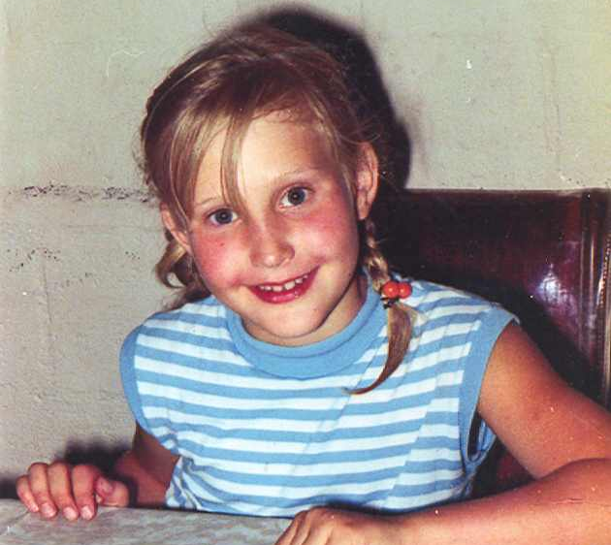
Organizational History
At age eight, Alisa Ann Ruch was fatally injured in a backyard barbecue accident in Southern California.
Bravely using their tragedy as a catalyst for change, Alisa Ann’s parents, local firefighters and medical professionals joined together and created the Alisa Ann Ruch Burn Foundation (AARBF),
a 501(C)3 nonprofit organization, in 1971.
Notes:
AARBF History

Slide 3
Mission and Vision
MISSION
To significantly reduce the number of burn injuries through prevention education, and to enhance the quality of life of those affected by burn injuries in California.
VISION
A safe California free from burn injuries, and a community of empowered burn survivors.

Slide 4
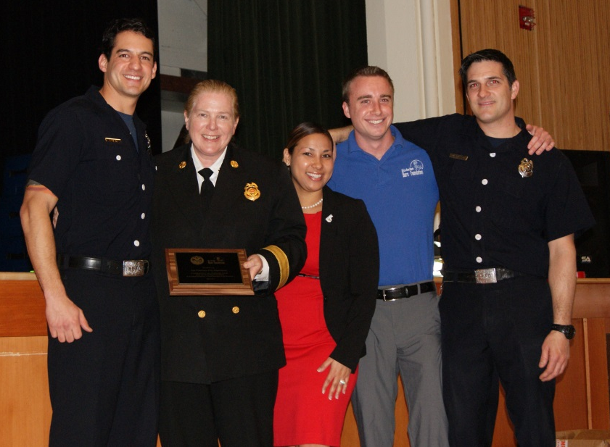
Firefighters in Safety Education
Firefighters in Safety Education (FISE) provides free burn prevention education and materials to thousands of elementary school children every year. Our goal is to bring burn prevention to “each child, each year” in schools and in the students’ native languages.
2017 is the 17th year of AARBF’s partnership with SFFD through the FISE Program!

Slide 5
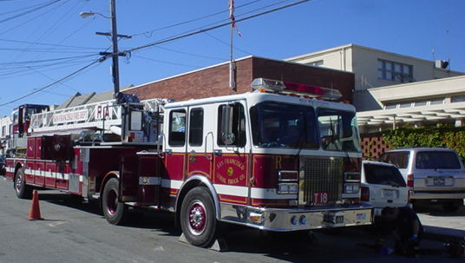
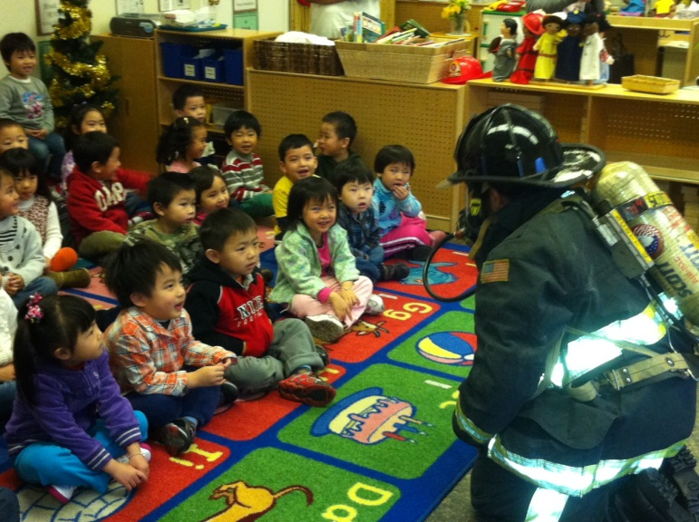
How it works:
Notes:
Contact to schools
Setup presentation (times, location, number of students, coloring books)
Evaluations, parent letters, ect
Day of:
10 minutes before presentation: You arrive to school office and introduce yourself
8:30 to 12PM: Give presentation, maybe 2, always 10 minutes between
Engine detail, might follow
5

Slide 6
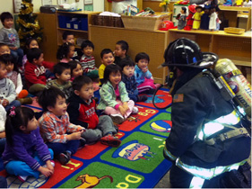

Firefighters in Safety Education
  Smoke Alarms
  Get Low & Go
  Stop Drop & Roll
  Cool a Burn
  Toys vs Tools
  How to Dial 9-1-1
  Hug a Firefighter

Slide 7
Pre- and Post-Testing

Slide 8
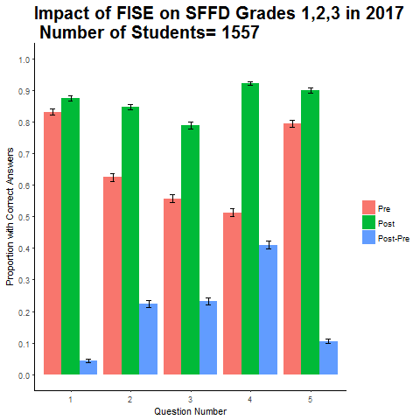
San Francisco Evaluation
Impact of FISE on San Francisco Schools
Grades 1, 2, 3
Notes:
Why FISE? Because it works! Evaluation
N=1,283, 13 schools in 2010
Kindergarten (n=231), learning 15.6%
First, Second and Third (n=623), learning 15%
Fourth and Fifth (n=339), learning 23%
Binary quantitative data (Graphs)
qualitative data (quotes)
8

Slide 9
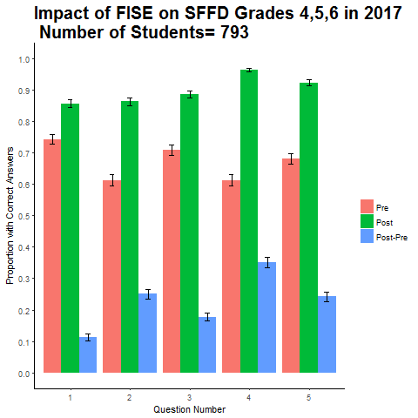
Each child, Each year
Impact of FISE on San Francisco Schools
Grades 4, 5, 6
Notes:
This is why its important to present the same information each time,
Data Collected, qualitative and quantitative
Post Tests Comparing Schools
-Graphs
9

Slide 10
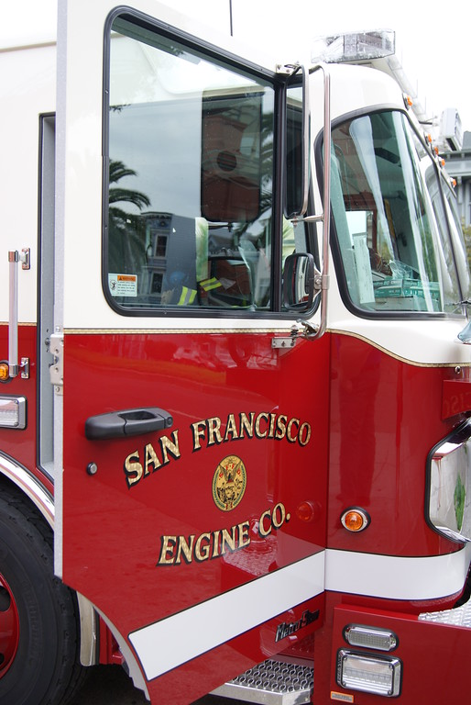
Serving San Francisco
2001-2017
Data beginning in 2008
84,165 Students
682 presentations
Materials in 7 languages
Serving every neighborhood
Notes:
Accomplishments: Numbers
Mission: To save lives and property through prevention and education.
Goals: to make each child an ambassador of safety to their families
Materials are available in Spanish, Cantonese additional materials in Russian, Tagalog and Vietnamese
Success: Educated Over 100,000 students in San Francisco since 2001 with an average of 9,000 students in 60 different presentations each year
10

Slide 11
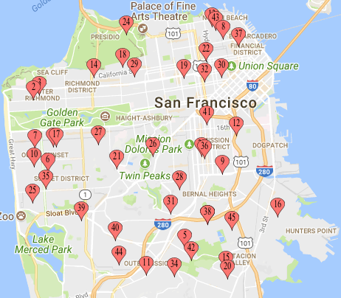
San Francisco
2016-2017
16-17 School Year:
11,730 Students
52 Public and Private
83 presentations
3 languages
Notes:
Accomplishments: Numbers
Mission: To save lives and property through prevention and education.
Goals: to make each child an ambassador of safety to their families
Materials are available in Spanish, Cantonese additional materials in Russian, Tagalog and Vietnamese
Success: Educated Over 100,000 students in San Francisco since 2001 with an average of 9,000 students in 60 different presentations each year
11

Slide 12

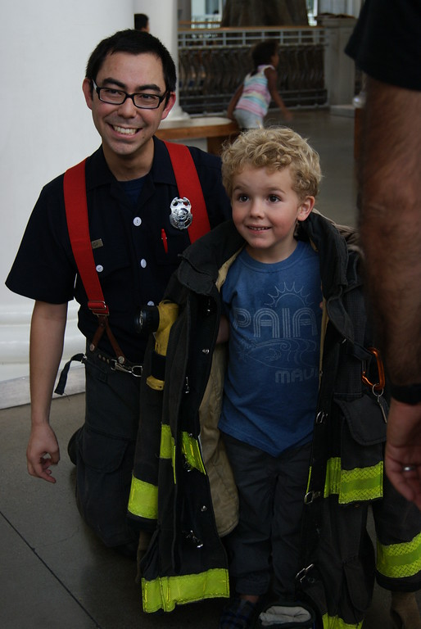
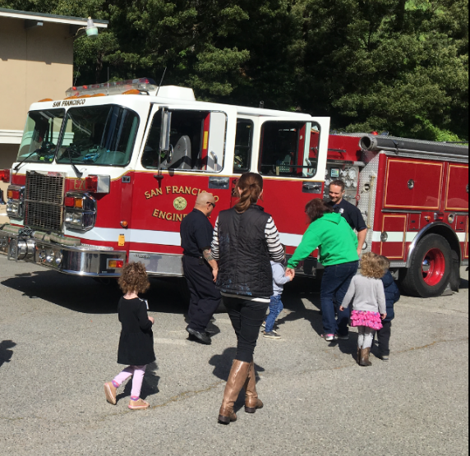
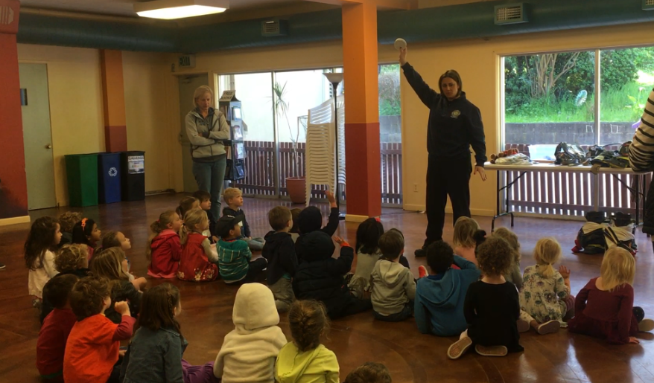
Made Possible by Volunteers

Slide 13
Thank you!
Notes:
13

