Slide 1

San Francisco Fire Department
Bureau Of Fire Prevention & Investigation
Community Outreach Section
May 2018

Slide 2
MISSION STATEMENT
The mission of the SFFD Bureau of Fire Prevention Community Outreach Section is to educate our community regarding safe fire practices both in their homes and at work in order to reduce the risk of fires and preserving life and property.

Slide 3
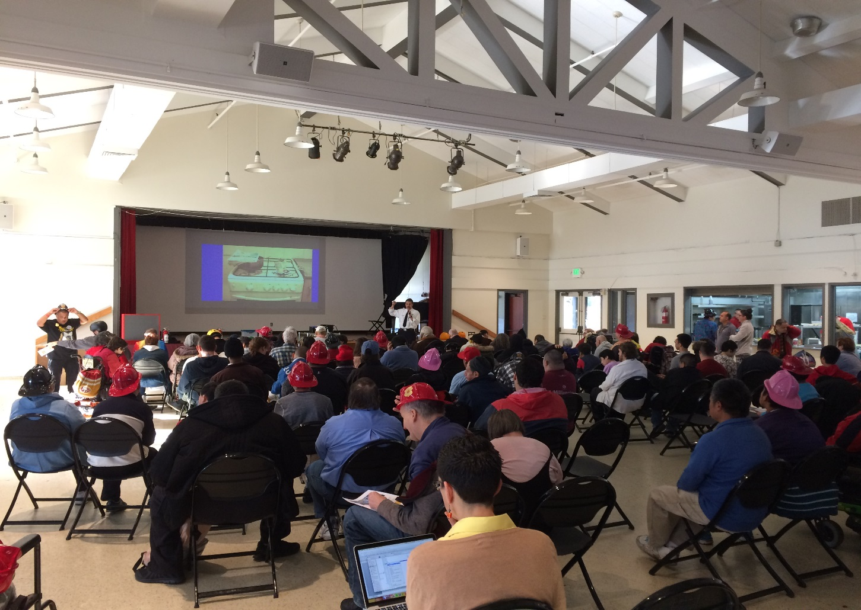
Fire Safety Education
Nov 2017 - April 2018
sixty-five presentations
more than 3,780 community members

Slide 4
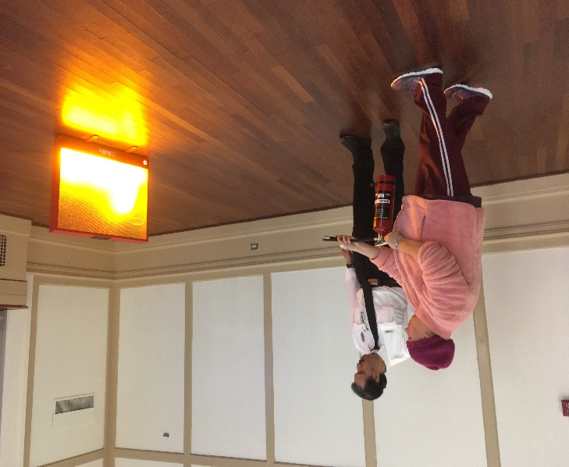
Outreach Methods
> Program introduction letter
> Home fire safety PPT presentation
> Simulated fire extinguisher demo with audience participation
> Multi-lingual SFFD, NFPA, FEMA brochures, pamphlets
> SFFD website: www.sf-fire.org

Slide 5
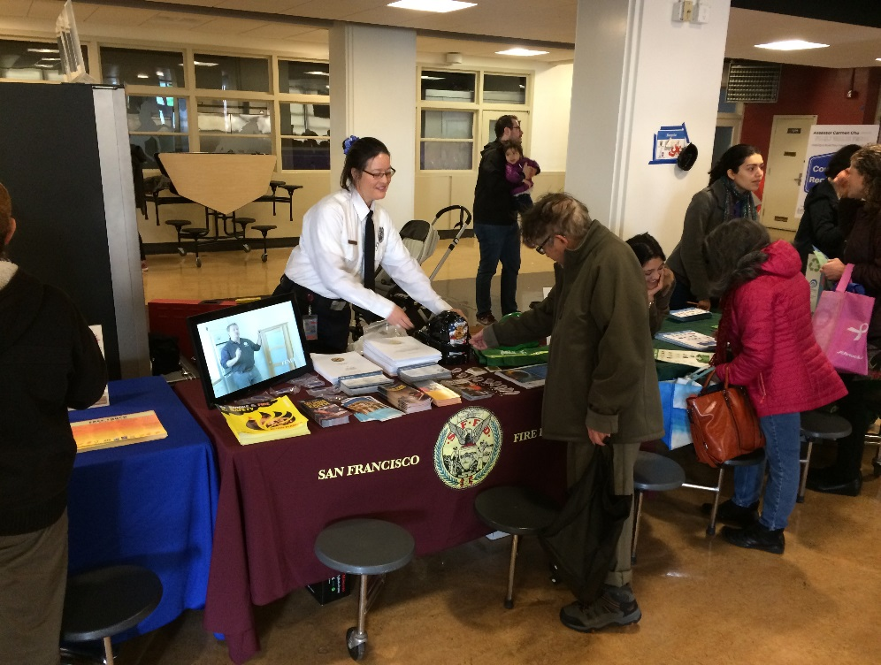
Outreach Methods
Community Outreach
  Street Fair Info Booths
  Charity Events
  District Fairs (Battalion Fairs)
Media Campaigns
  Recruitment/Outreach Committee
  SFFD PIO
  Smoke alarms
  Carbon alarms
  “SWAG”

Slide 6
City Partners
Office of Civic Engagement and Immigrant Affairs
- assists with Multi-lingual translation (LEP)
* written
* spoken (simultaneous and consecutive)
Community Youth Centers of San Francisco
- assists with Multi-lingual translation (LEP)
Rebuilding Together San Francisco
- provide outreach assistance

Slide 7

Presentation
    “Fire Safety in the Home” power point
    Interactive fire extinguisher demonstration and audience participation with a simulator
    Presentation provided during:
    * Normal business hours
    * Evenings
    * Weekends

Slide 8
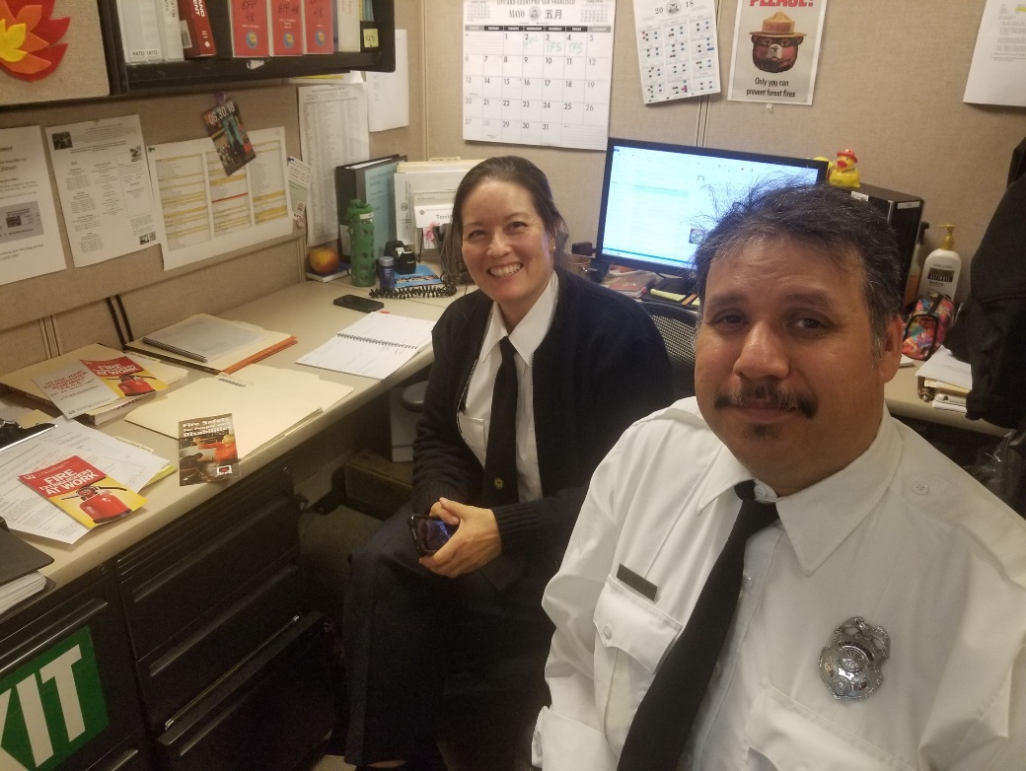
Our BFP Community Outreach Team
  Inspector
  Tomie Kato
  Inspector
  Fernando Juarez
  Thank you for your support!

