Slide 1
SFFD NERT
Neighborhood Emergency Response Team

Slide 2
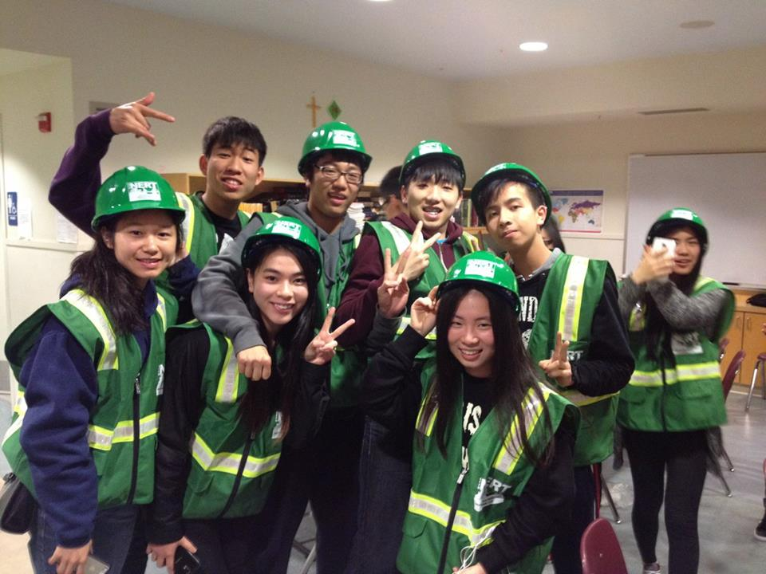
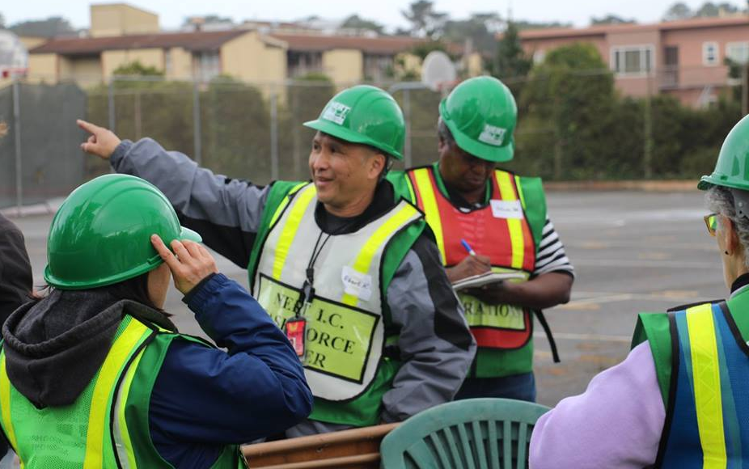
What is NERT
Program Background
4 Pillars
Basic Training Goals
Retention

Slide 3
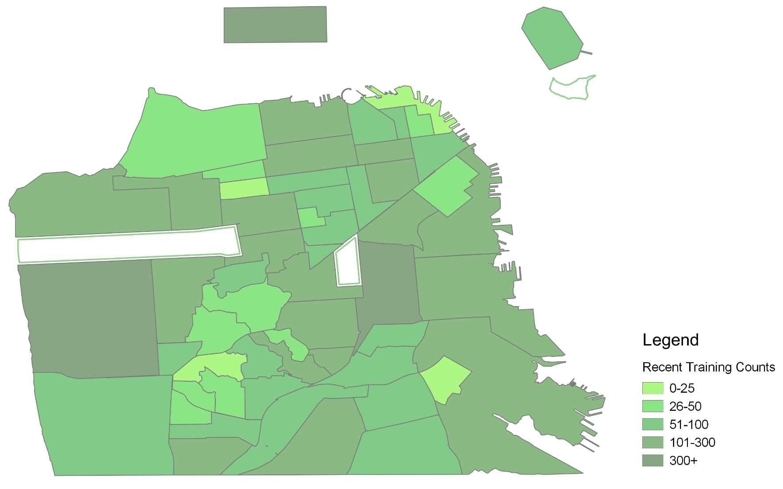
NERT Coverage
Trained to date: 26,800
Regroup communications 9,421

Slide 4
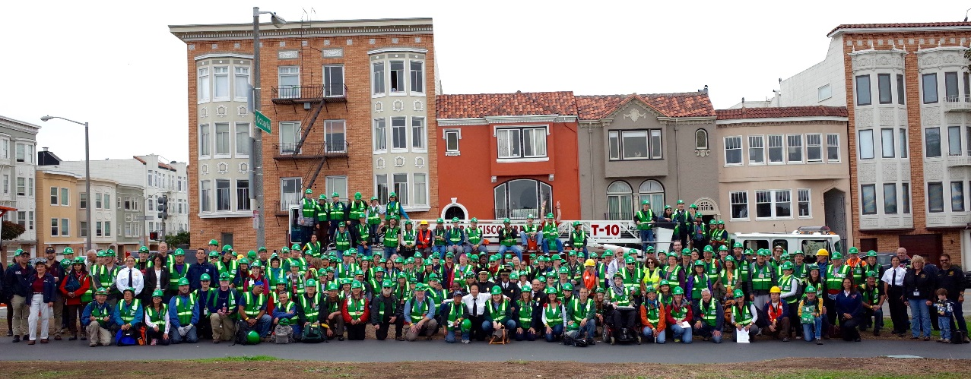
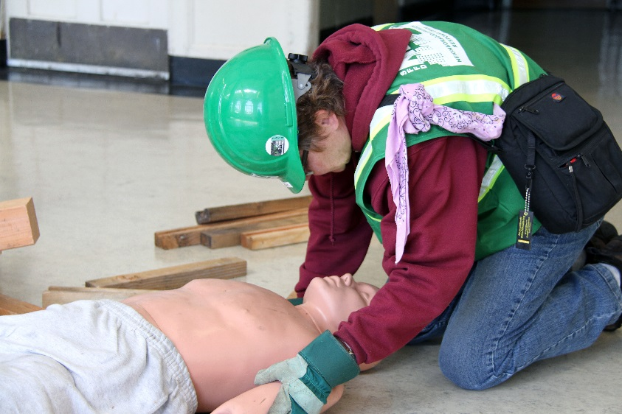
NERT Activities
SF Ready
Basic Training
Advanced Training
  Classes
  Drills
  Initiatives
Neighborhood Team building

Slide 5
Volunteer Participation
Total NERT graduate hours 14,465
Hours equate to reimbursement

Slide 6
NERT Activity Summary
Accomplishments
Next Steps
Added Listos training – a 4 week Spanish language preparedness curriculum developed in Santa Barbara County. Delivered May, 2015
Disaster Mental Health pilot delivered and 25 NERTs completed Train the trainer in this partnership with Department of Public Health and SF CARD.
Coordination with Patrick Otellini, SF Resilience Officer for 100 Resilient Cities
3 training sessions completed by SFPUC staff for NERTs in water treatment and distribution after disaster.
Plan TeenNERT training session
Complete partnership for a 501c3 with San Francisco Health Foundation
April and October drill coordination with SFFD
Increase instructor pool within SFFD
Asks/Issues
Coordination with City and County to increase awareness and marketing of and participation in NERT.
Increase staff support in NERT

Slide 7
