Slide 1
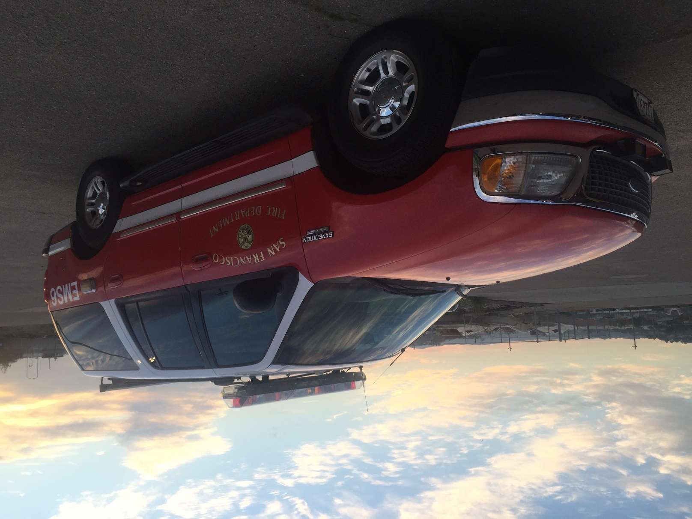
  EMS-6 Update
San Francisco Fire Commission
March 9th, 2016

Slide 2
Program Description
H-33 EMS Captain: Paramedic Supervisor Role
SF DPH HOT Outreach Specialist: Care Coordination Role
Dispatched to 911 incidents
Special called by other EMS Resources, clinics, case managers
12 hours/day x 7 days/week (1200-2400)
Work in conjunction with existing services to stabilize high-users and refer to non-emergency programs

Slide 3
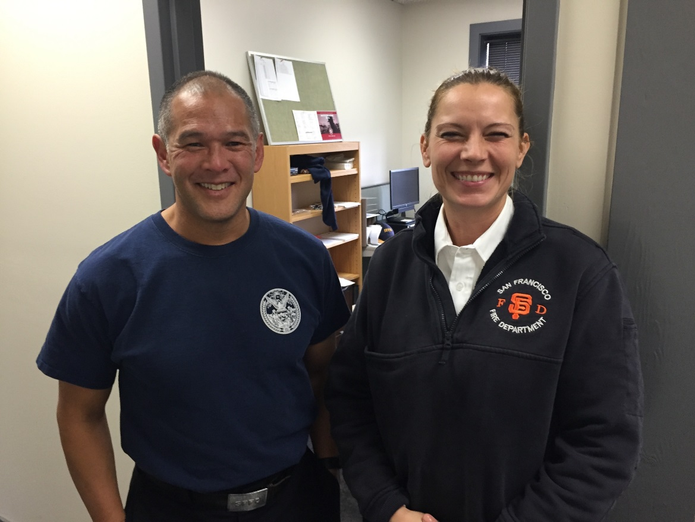
EMS-6 Team
H-33 EMS Captains
  April Bassett
  Simon Pang
DPH Homeless Outreach Team
Operations began on January 30, 2016

Slide 4
EMS High Users
Identified clients with high 911 utilization
  >4 calls/month or >2 calls/day or
  Identified as system high users (HUMS)
Work with existing resources to stabilize and connect
Case Examples
Notes:
Patient with a psychiatric hx arrived in SF via bus. She utilized EMS 6 times and the crew identified her as an EMS6 candidate. She was engaged by EMS6, shelter was obtained and she was able to return home via Homeward Bound.
Patient arrived in SF in early February and generated 6 911 calls. EMS6 was alerted by ambulance crews and engaged patient. After several attempts with follow up by EMS6, shelter was obtained, eventually resulting in a 90 day bed and a visit by a psychiatric RN. HOT also facilitating transfer of benefits to SF.

Slide 5
EMS “Super Users”
>15 calls/month
Top 5 individuals = 35% EMS-6 encounters
Active case management
High Users of Multiple Systems (HUMS)
Ongoing clinical management plans
Case Examples
Notes:
Patient with a hx of chronic etoh abuse. 40 calls for service since December 2015. EMS6 able to engage and follow through when he called 911 6 times in 24 hours. EMS6 able to advocate for a referral to medical detox. Patient currently in treatment and planning on continuing in a supportive program.
Patient with chronic psychiatric problems. More than 30 calls for service for vague complaints and requests for social services. EMS6 able to determine that patient’s medical home was the VA hospital and after discussing with patient and hospital providers, he was admitted for placement. Patient is currently in stable long term care facility.

Slide 6
Encounter Volume
221 encounters in 30 days
Average = 7 encounters/shift (7.1 + SD 2.7)
BUSY

Slide 7
Encounter Type

Slide 8
Location

Slide 9
Homeless

Slide 10
Next Steps
Training additional team members
Streamlining documentation to facilitate data collection
Data sharing for collaboration between providers
Continue to identify barriers to care

Slide 11
Contact EMS-6
Hours: 1200-2400 everyday
Email: fireems6@sfgov.org
Phone: (415)816-6739

