Slide 1
San Francisco Fire Department
DRONE PROGRAM
Unmanned Aerial System (uas)

Slide 2
Updates:
BENEFITS
CHALLENGES
PROGRESS
NEXT STEPS

Slide 3
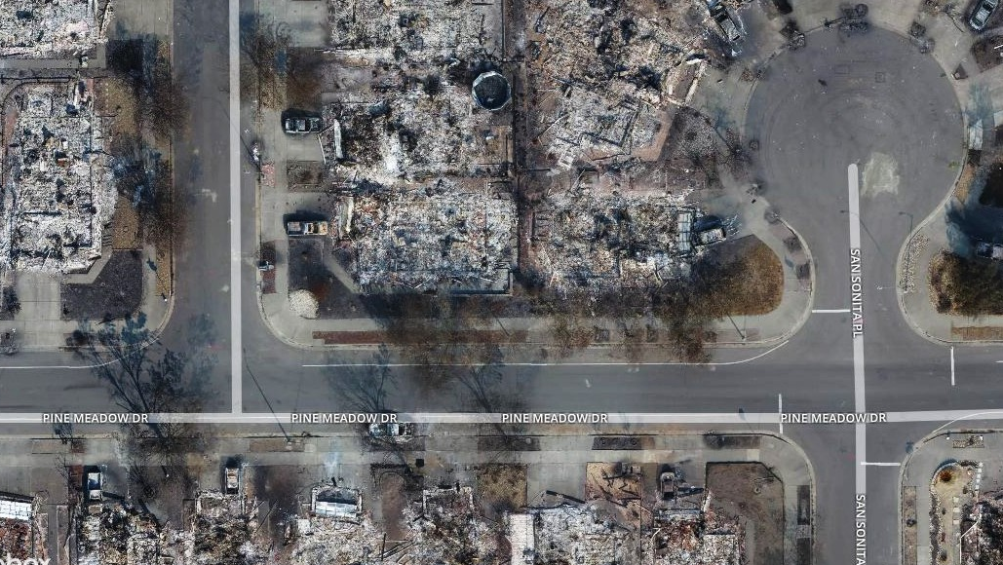
Benefits of a uaS program:
Rapid Damage Assessment
Situational awareness
Search and rescue/training
Thermal imaging

Slide 4
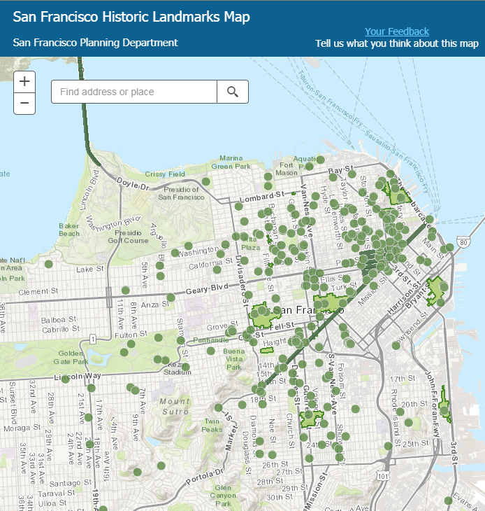
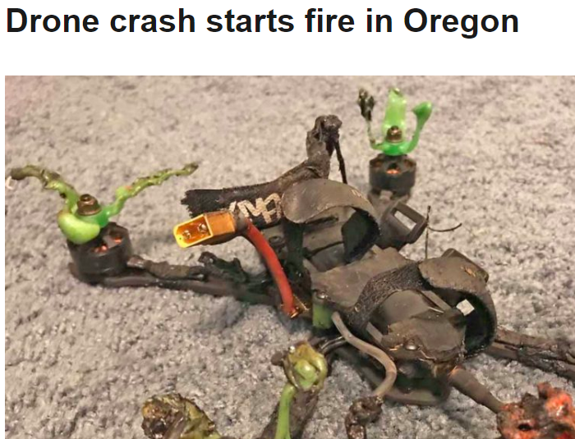
Challenges:
Restrictions (Part 107 rules and S.F. specific):
Flight at night
Above people (S.F. is the second most dense city in the U.S.)
Out of line of sight
Near airport including Heliports (5 in S.F.)
Within 500ft of historic buildings without prior notice to property owners
Data security concerns: privacy rights, HIPAA protections

Slide 5
Restriction waivers:
107 Restrictions may be waived by F.A.A. with proper authorization and education of drone pilots with a Remote Pilot Certificate
In addition, the SFFD can apply for a Certificate of Waiver or Authorization (COA) through the F.A.A.
Having both 107 waivers and a COA “signals to the public and other local entities that all steps are being taken by your public agency to create a thorough, well-organized drone operation”

Slide 6
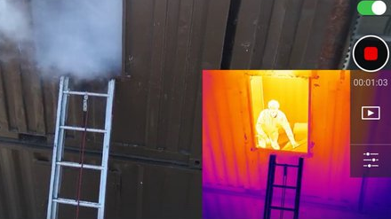
The san Francisco fire department is taking a methodical, measured approach to our uas program to learn from other jurisdictions
Progress:
Attended DJI Drone symposium in Menlo 3/28/18
Reviewed Menlo Policy and lessons learned
Conferred with FDNY regarding benefits and challenges in a dense, urban environment
Conferred with Federal Aviation Administration for San Francisco specific challenges
Reviewed COIT Policy and other agency draft policies
Met with COIT to discuss current Certificate of Waiver or Authorization (COA) and 107 waivers
Submitted exemption language to City Attorney for review- Pending
Identified appropriate UAS flight school. 24 hour online course.

Slide 7
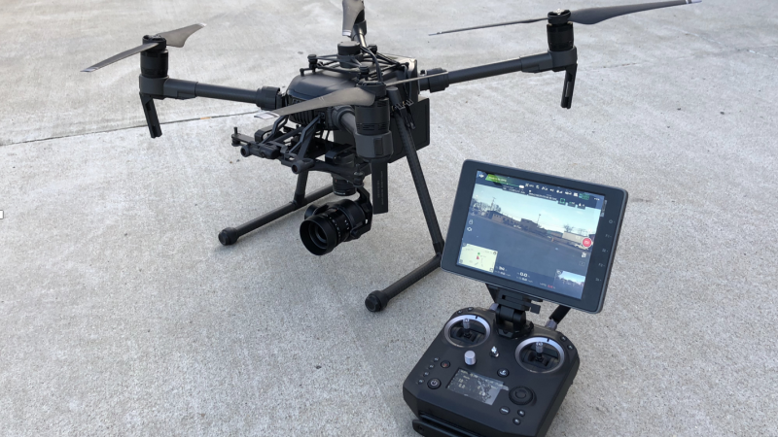
Next steps:
Submit application for flight approval/ aviation request to Cal Office of Emergency Services
Receive awarded grant funding from UASI December 2018
Purchase Request to OCA. Out to bid. 30-90 day process.
Select members to attend UAS flight school.
Receive final draft from City Attorney-once approved submit for 107 waivers and initiate COA process through the FAA. COA is 90 day approval process. Need Letter of Declaration from City Attorney to FAA. Need drone for final authorization.
Train members and initiate SFFD UAS program for field operations

Slide 8
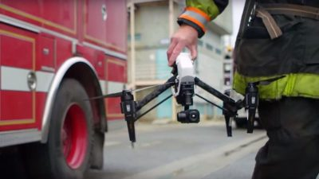
Thank you.

