Slide 1
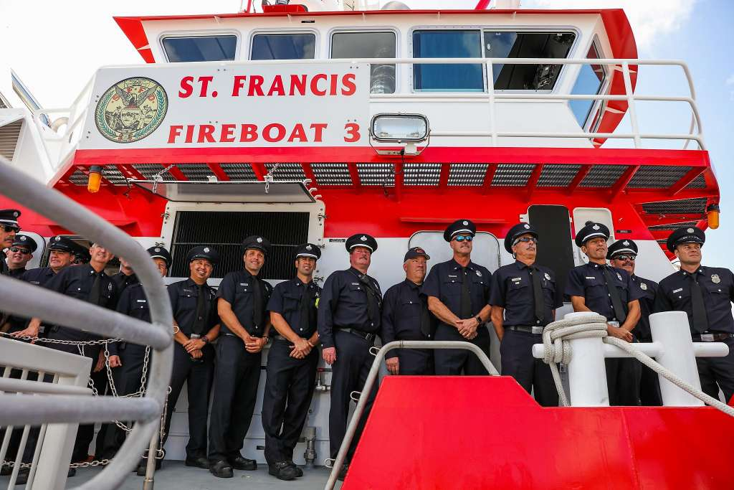




Fire Commission
May 22, 2019

Slide 2
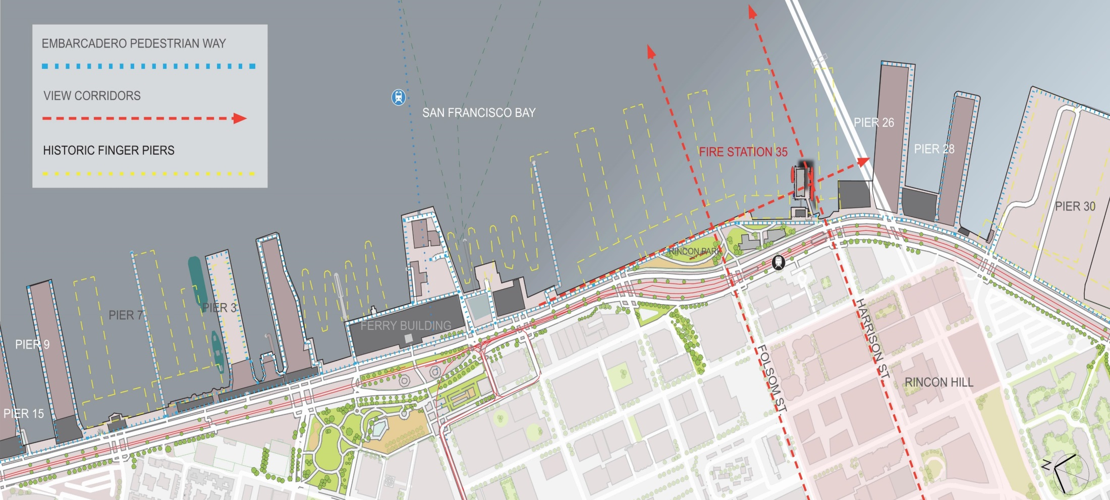
WATERFRONT SITE PLAN

Slide 3
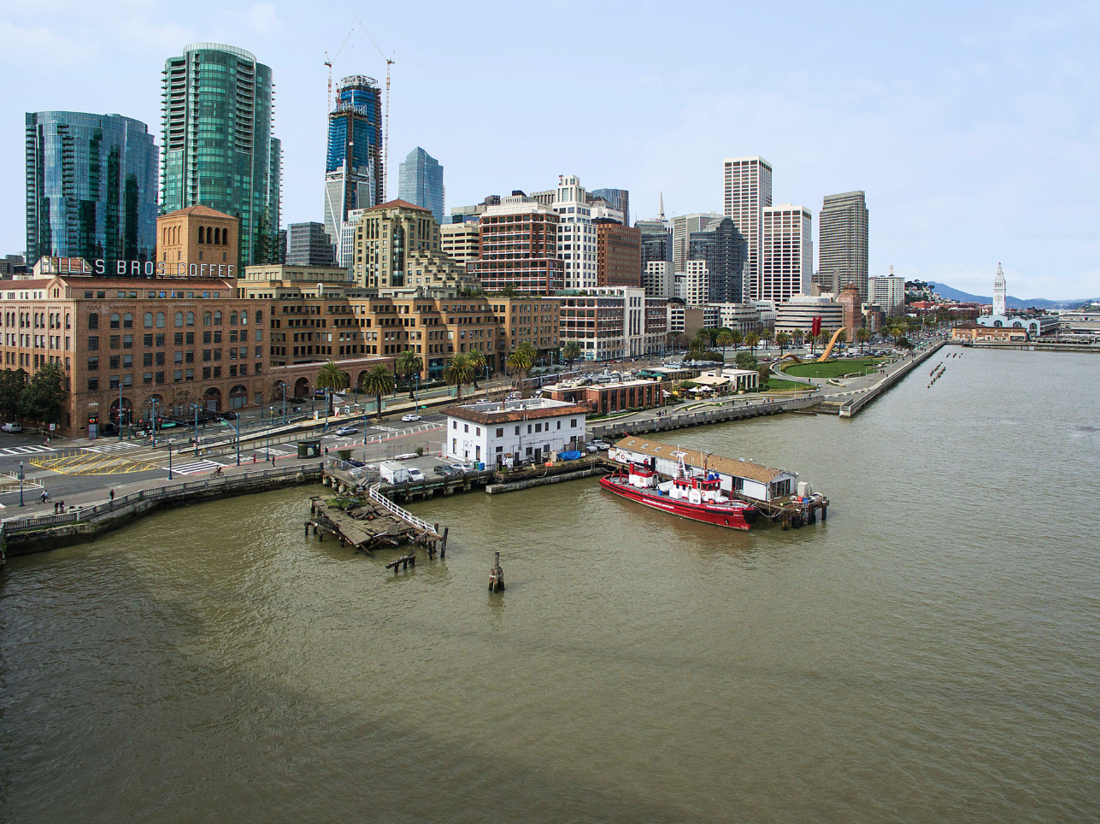
EXISTING SITE

Slide 4
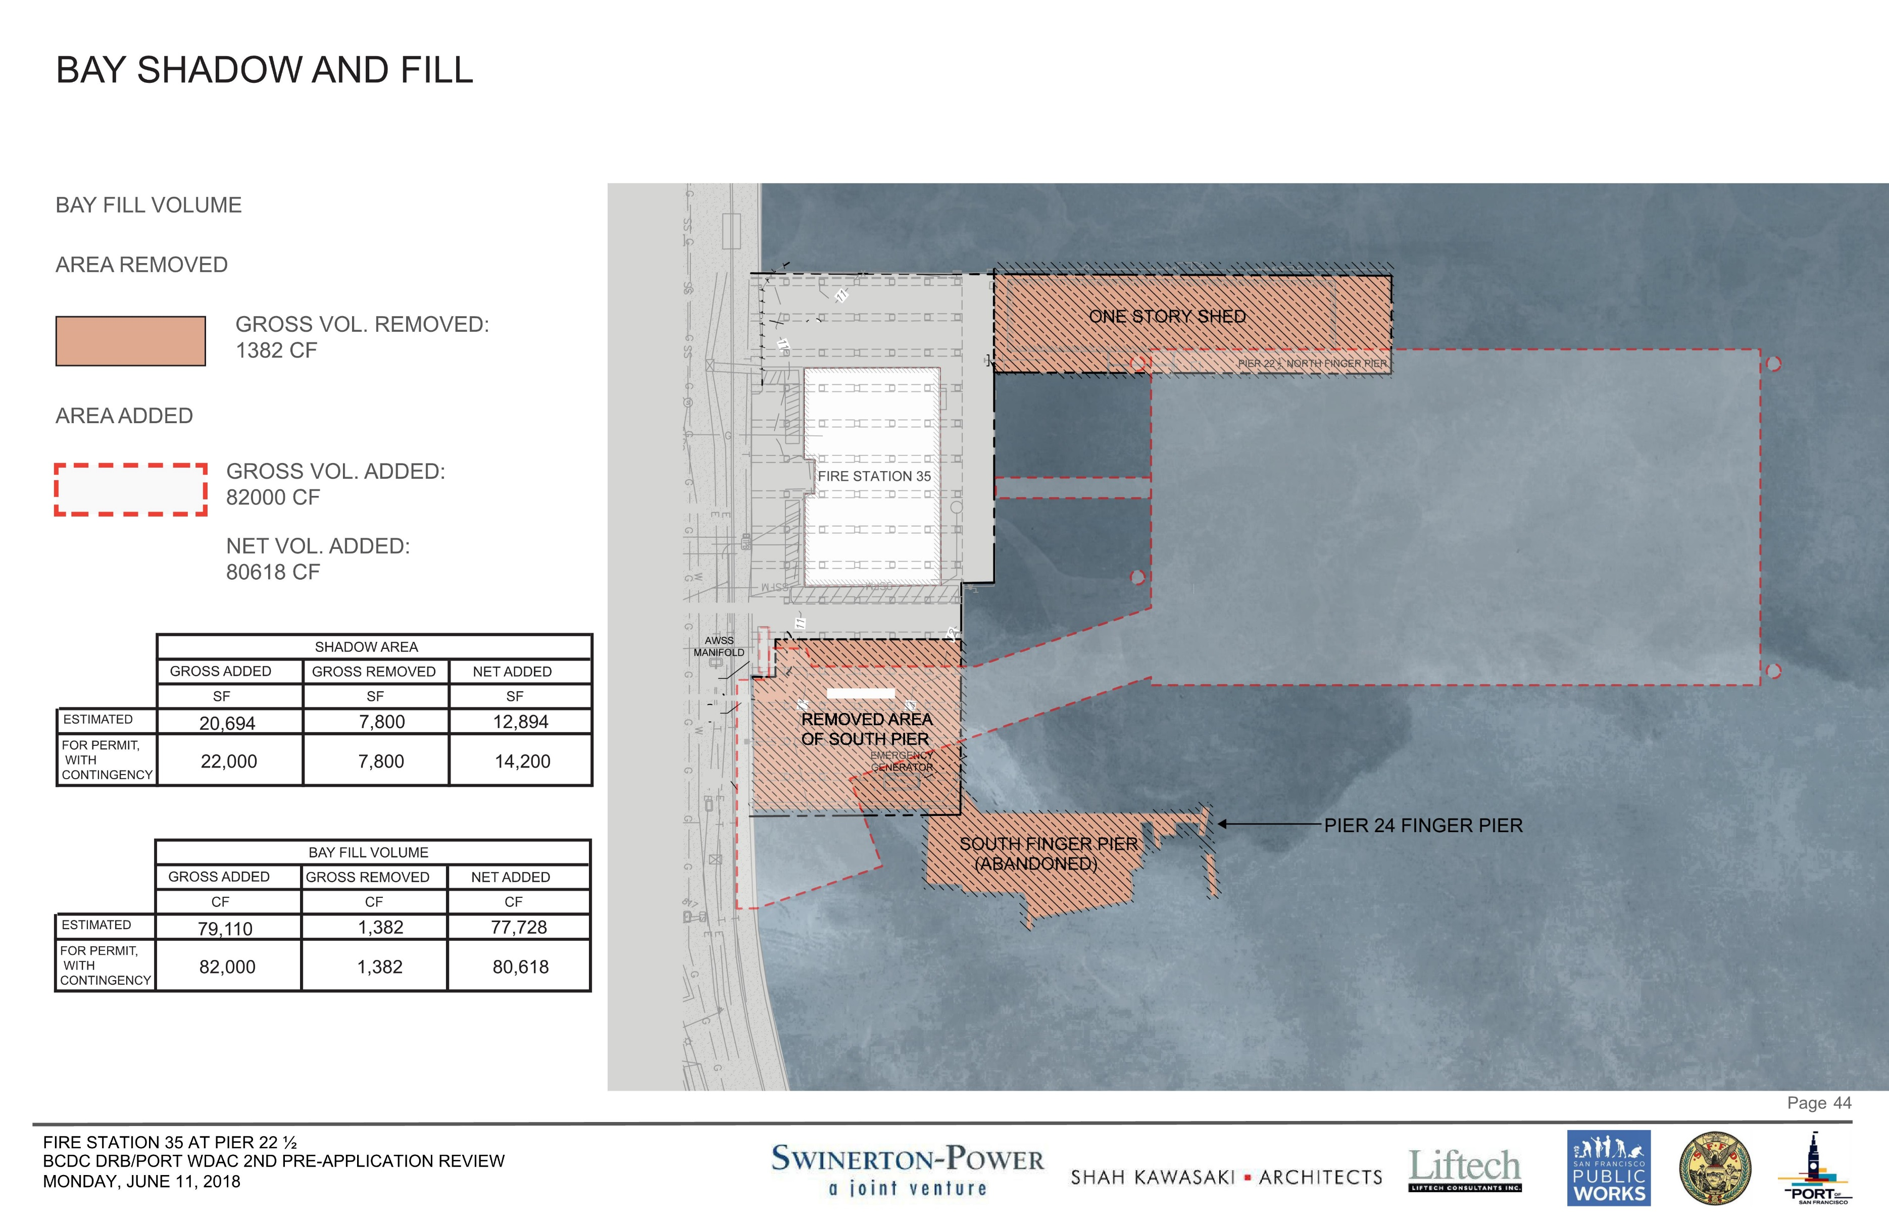
DEMOLITION OF EXISTING FINGER PIERS & MARGINAL WHARF
Historic Fire Station
New Floating Fire Station
Notes:
On-Site Mitigation. The permittees shall remove a total of 6,100 square feet and 36 cubic yards of Bay fill at the project site, consisting of: (1) the approximately 3,300-square-foot north finger pier deck and shed; (2) an approximately 2,800-square-foot portion of the parking lot on the south apron of the Pier 22 ½ marginal wharf; and (3) 74 piles.

Slide 5
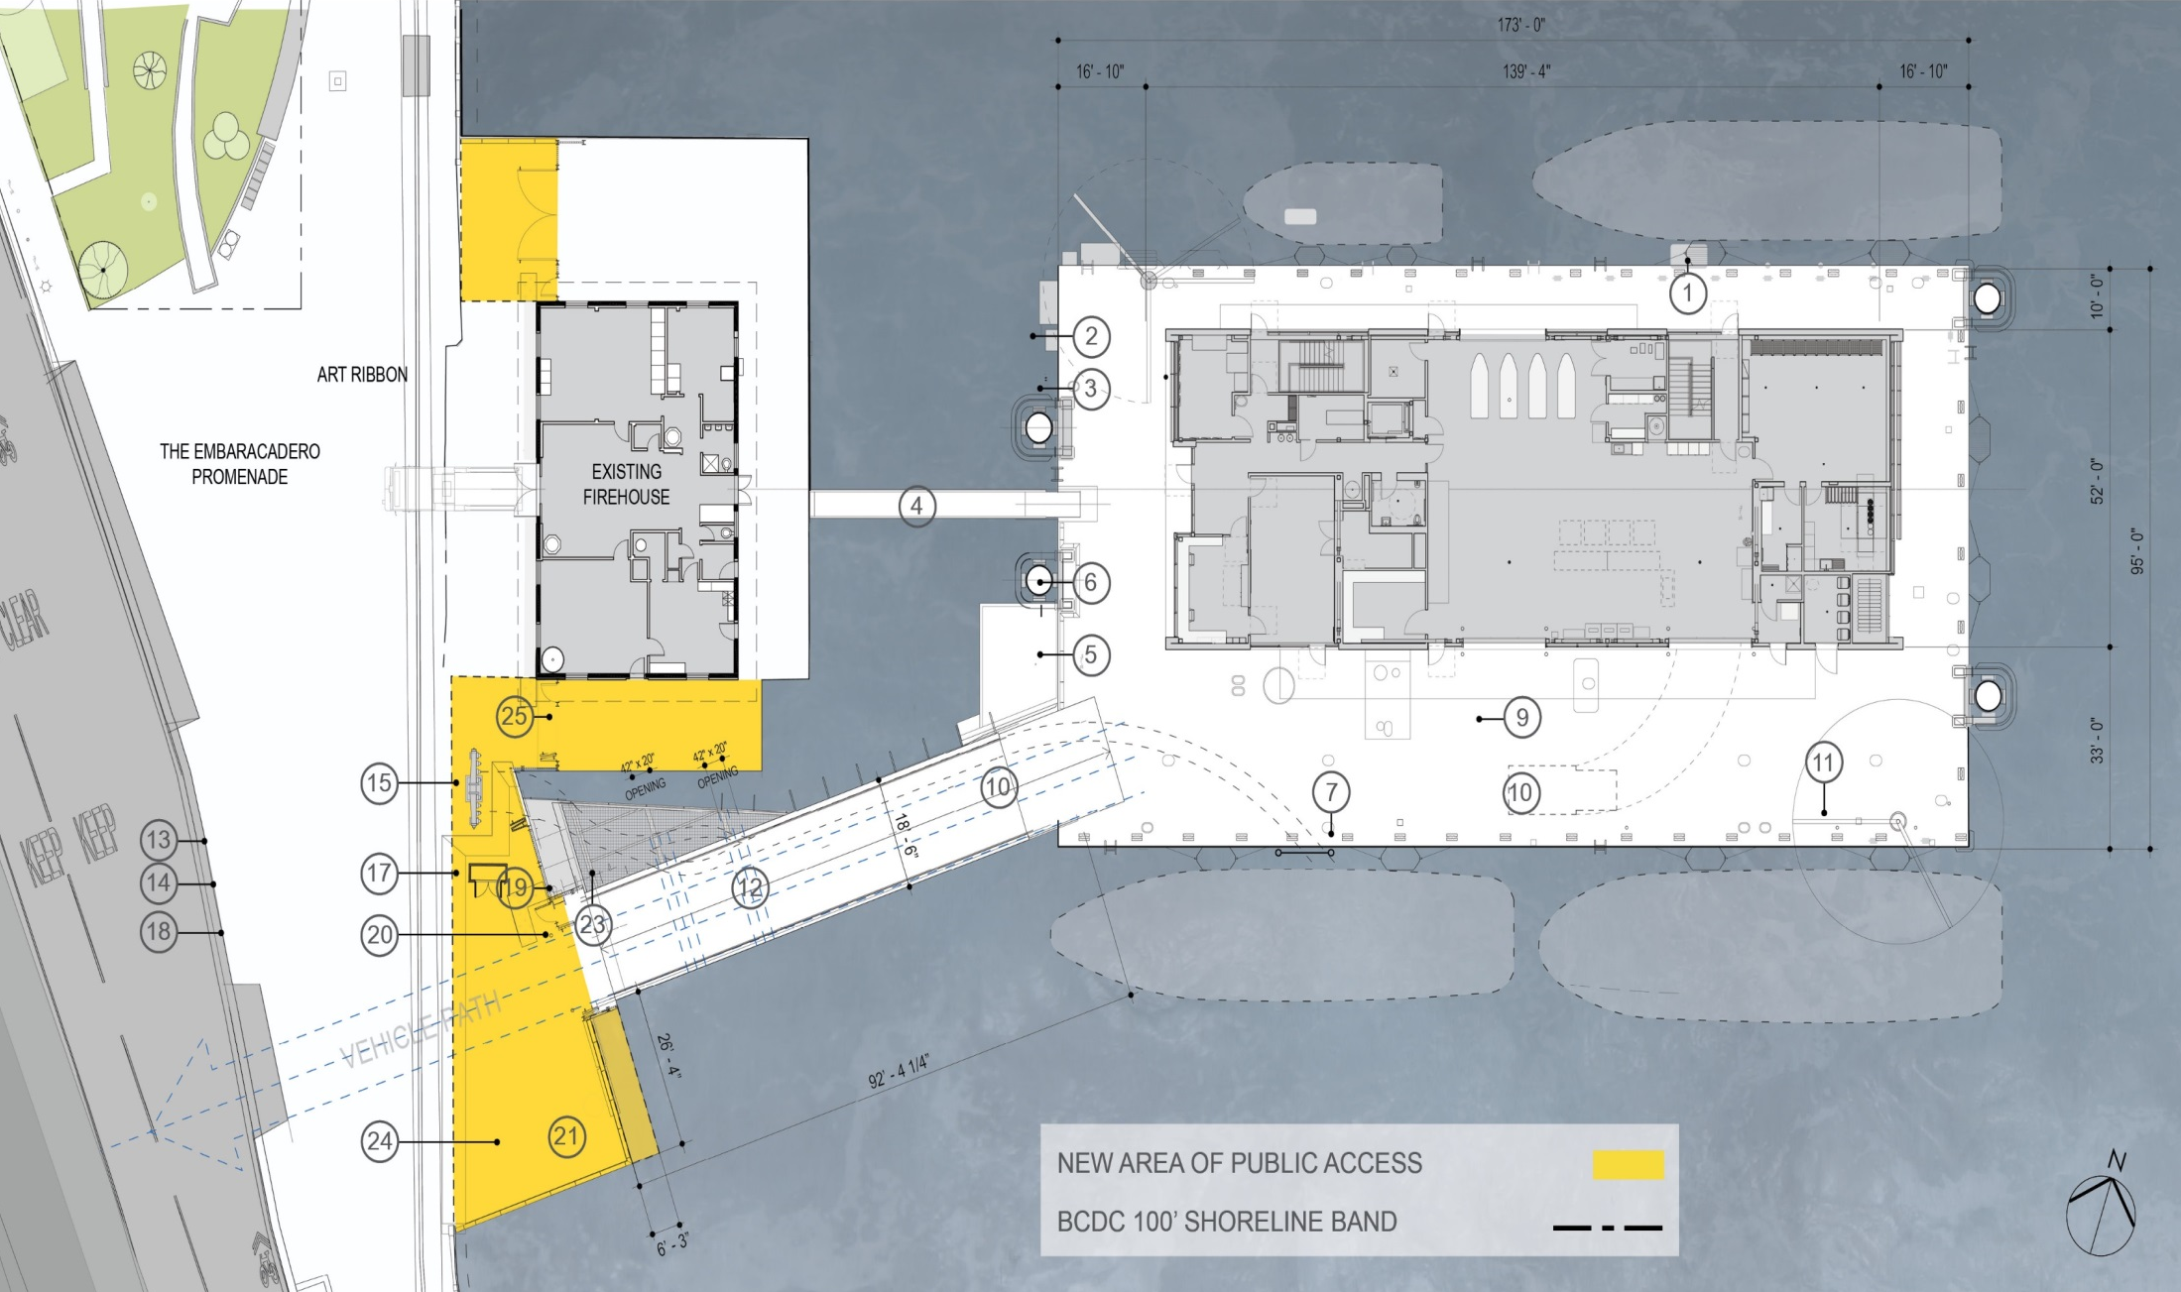
PROJECT DESCRIPTION

Slide 6
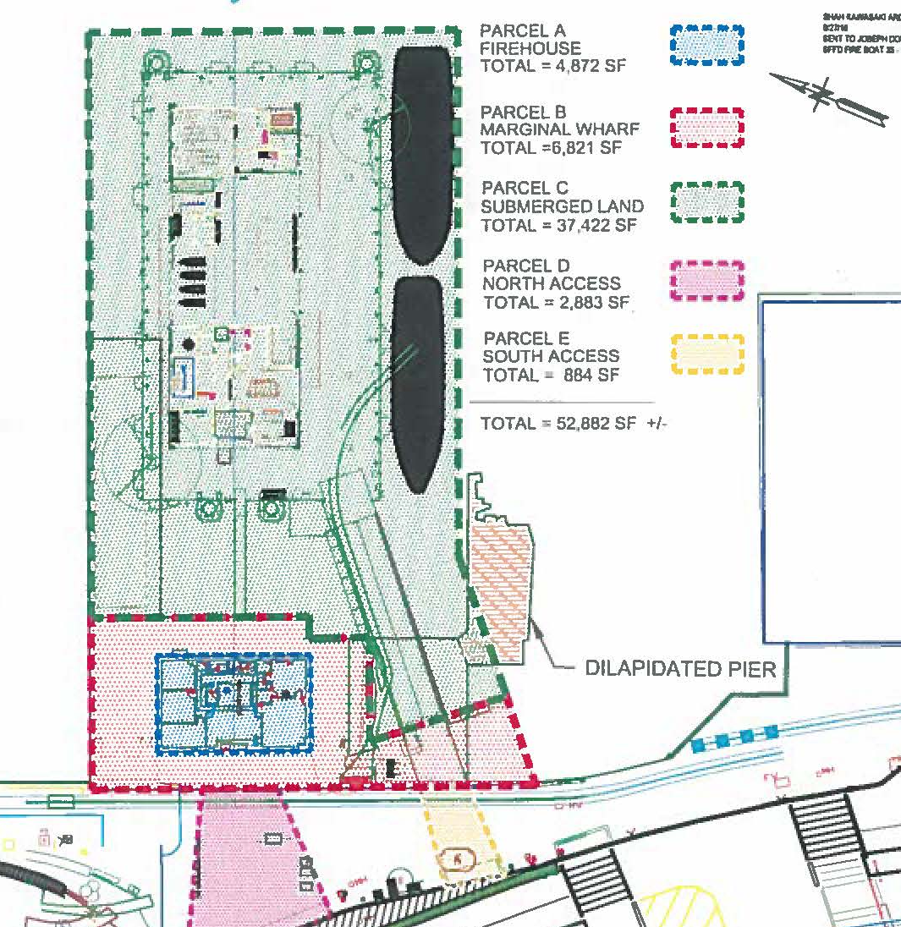
Lease
Area

Slide 7
MOU Terms
50-Year Term
  Project Construction (Approx. 2 Years)
  SFFD Operations
Payment of Rent – approx. $14,000/month commencing after Project completion
Rent Credits
  $1.6m remaining for Pier 26 improvements
  $800,000 estimated for Parcel B improvements
  Potentially additional credits to be granted for future improvements

Slide 8
MOU Terms (cont.)
Maintenance and Repairs will be responsibility of SFFD
  Capital Needs Assessment Every 5 Years
  Port and SFFD to work cooperatively on funding
SFFD may relinquish portions of the Premises under certain conditions
SFFD Must Comply with:
  CEQA (MMRP)
  Operations Plan
  All Regulatory Permits and Conditions Therein
  Applicable City Laws and Ordinances

Slide 9
